Slide 1
EXPEDITED REVIEW
November 1, 2023

Slide 2
Objectives
Remind study teams what does require review by the IRB
Describe the levels of IRB review
Define the categories of Expedited Review
Outline the IRB review process for Expedited research

Slide 3
REFRESHER: Does the Study Require IRB Review?
If the study meets both of the following definitions, then it requires IRB review:
Is it Research?
A systematic investigation, including development, testing, and evaluation, designed to develop or contribute to generalizable knowledge (HHS Common Rule)
Any experiment that involves a test article and one or more human subjects, and that either must meet the requirements for prior submission to the Food and Drug Administration (FDA)
Does it involve Human Subjects?
A living individual about whom an investigator conducting research:
Obtains information or biospecimens through intervention or interaction with the individual, AND uses, studies, or analyzes the information or biospecimens; OR
Obtains, uses, studies, analyzes, or generates identifiable private information or identifiable biospecimens (HHS Common Rule)
An individual who is or becomes a participant in research, either as a recipient of the test article or as a control. A subject may be either a healthy individual or a patient (FDA)
Notes:
As previously discussed, the definitions vary between Common Rule and FDA regulations
Systematic Investigation: activity that involves a prospective plan that incorporates data collection, either quantitative or qualitative, and data analysis to answer a question or hypothesis
Generalizable Knowledge: Knowledge from which conclusions will be drawn that can be applied to populations outside of the specific study population and contributes to a body of knowledge.
INTERVENTION: includes physical procedures by which information or biospecimens are gathered and manipulations of the participant or participant’s environment that are performed for research purposes.
INTERACTION: communication or interpersonal contact between investigator and participant.
IDENTIFIABLE PRIVATE INFORMATION: is private information must be individually identifiable for which the identity of the participant is or may readily be ascertained by the investigator or associated with the information.

Slide 4
Levels of IRB Review
There are three levels of IRB review for human participant research. Each category is different in the level of scrutiny and review procedures required.
Exempt
Exempt from the requirements of Common Rule but not exempt from ethical considerations
Fits one or more of the 8 Exempt Review Categories
Expedited
Research involving minimal risk*
Fits one or more of the 9 Expedited Review Categories
Full Board
Greater than minimal risk to subjects
Not covered under other review categories
Limited IRB Review may apply
Does not mean “fast”
Reviewed by fully convened Board
*Minimal Risk: The probability and magnitude of harm or discomfort anticipated in the research are not greater than those ordinarily encountered in daily life or during the performance of routine physical or psychological examinations or tests
Notes:
Research activities that present no more than minimal risk to human subjects may be reviewed by the IRB through the Expedited Review Procedure authorized by 45 CFR 46.110 and 21 CFR 56.110.
Minimal Risk for the General Public as defined by 45 CFR 46.102(i) The probability and magnitude of harm or discomfort anticipated in the research are not greater than those ordinarily encountered in daily life or during the performance of routine physical or psychological examinations or tests.
The expedited procedure may not be used a) where identification of the subjects and/or their responses would reasonably place them at risk of criminal or civil liability or be damaging to the subjects' financial standing, employability, insurability, reputation, or be stigmatizing, unless reasonable and appropriate protections will be implemented so that risks related to invasion of privacy and breach of confidentiality are no greater than minimal; or b) for classified research involving human subjects.
To be eligible for expedited review, the research activities must be limited to those described in one or more of nine (9) federally-defined Expedited Review Categories.

Slide 5
Expedited Categories: Initial Review
Category 1: Clinical studies of drugs and devices that do not require an Investigational New Drug (IND) or Investigational Device Exemption (IDE) application. Requires Consent/HIPAA | Category 2: Research that collects blood samples by finger stick, heel stick, ear stick or venipuncture from healthy, non-pregnant adults and sometimes children (limited amount of blood). Requires Consent/HIPAA | Category 3: Prospective non-invasive collection of biological specimens for research purposes only. Requires Consent/HIPAA | Category 4: Collection of data through non-invasive standard of care procedures. Requires Consent/HIPAA
Category 5: Review of data, documents, records, specimens that have been or will be collected solely for non-research purposes. Waiver of Consent/HIPAA | Category 6: Collection of data from voice, video, digital or image recordings made for research purposes. Requires Consent/HIPAA | Category 7: Research performed on individual or group characteristics or behaviors or involves employing surveys, interviews, oral histories, focus groups, etc. May require Consent/HIPAA
Notes:
Categories one (1) through seven (7) pertain to both initial and continuing IRB review.

Slide 6
Expedited Categories: Continuing Review
Category 8: Continuing review of research previously approved by the convened IRB as follows: Where (i) the research is permanently closed to the enrollment of new participants; (ii) all participants have completed all research-related interventions; and (iii) the research remains active only for long-term follow-up of participants; OR Where no participants have been enrolled and no additional risks have been identified OR Where the remaining research activities are limited to data analysis. | Category 9: Continuing review of research, not conducted under an investigational new drug application or investigational device exemption where categories two (2) through eight (8) do not apply, but the IRB has determined and documented at a convened meeting that the research involves no greater than minimal risk and no additional risks have been identified.
Notes:
Categories eight (8) and nine (9) pertain only to continuing IRB review.

Slide 7
Informed Consent for Expedited Studies
Voluntary informed consent should be obtained from participants for any exempt research where the investigator will be collecting data through interaction with participants.
For Expedited research, the standard requirements for informed consent (or its waiver, alteration, or exception) apply.
Templates for Consents can be found on the IRB website.
BELMONT REPORT
Beneficence
Justice
Respect for Persons
Notes:
As a refresher, the Belmont Report summarizes the three basic ethical principles for protection of Human Subjects. The ethical principle of respect for persons means individual should be treated as autonomous agents, and this is put into action by requiring some level of informed consent when interaction with subjects is involved in the study design.

Slide 8
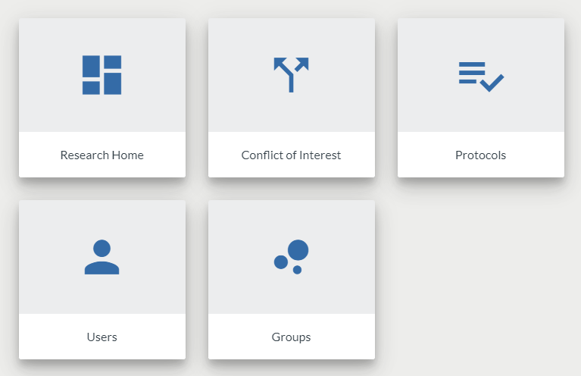
How to Submit for an Expedited Application
Start a New Protocol in Kuali Protocols and select Expedited under “Protocol Type.”
Additional instructions for submitting a study for exempt determination are available in the Kuali Quick Guides found on the IRB website.

Slide 9
IRB Review Process
Initiation of IRB Application via Kuali
Submission of the Application to the IRB
Review of the Application by IRB Analyst
If Changes Needed, Application Returned to Study Team until Finalized
Study May Begin
Designated IRB Reviewer Issues Approval
Notes:
The requirements for review of research using expedited procedures are identical to review by the convened board with the exception that instead of review by the Full Board, the Chair or an experienced member of the IRB designated by the Chair reviews the research and may request modifications and approve the research.
PI or study team member creates an application in Kuali
PI submits the application to the IRB
The designated reviewer completes a full review for exempt, expedited or reliance applications; or an administrative review for full board studies.
If changes are needed, the administrative reviewer will return the application to the study team member until issues are resolved.
If no issues were identified or once all issues are resolved, the IRB will approve the study. The study team will receive an email from the Kuali System with the IRB determination

Slide 11
Save the Date!
December Lunch & Learn
Date: December 6, 2023
Time: 12:00 PM
Topic: Full Board Review

