Slide 1
April 21, 2022
HRM Liaisons Meeting
April 2022 Meeting

Slide 2
HRM General Updates
Juli Sholar, HRM Assistant Director Talent Management

Slide 3

Post Job Offer Drug Testing
Drug Testing
(504) 568-8888 • cap@lsuhsc.edu
HDC @ 411 S. Prieur, Suite 233
Notes:
Talk about CAP services

Slide 4

Substance Abuse and Drug Free Workplace Policy - CM-38
Alcohol abuse and the illegal use or abuse of other drugs is associated with numerous health, safety, and social problems. The performance of faculty, staff, residents, students and other LSUHSC-NO affiliated individuals may be adversely affected by engaging in substance abuse.
This policy, including the prohibitions and provisions, shall be used to promote and safeguard the workplace/school environment from the consequences of alcohol and drug use.

Slide 5
Substance Abuse and Drug Free Workplace Policy - CM-38
Providing a safe, productive, and healthy environment that is consistent with providing the highest quality services to patients and the most effective learning environment for students.
Creating and maintaining a drug-free workplace pursuant to the Federal Drug-Free Workplace Act of 1988, the Drug Free Schools and Communities Act Amendment of 1989, and the Louisiana Drug Testing Act of 1990.
Providing a safe and healthy environment for our patients, employees, students, visitors, vendors, suppliers, contractors, and members of our community.

Slide 6
Pre-Employment
Drug Testing / Post Job Offer
Third Party Administrator – Applya https://www.i3screen.net/login/
LSUHSC Drug Testing Office
  Shauntel Jones
  Scott Embley
Business Office Managers or designee “order” post job offer testing
Post job offer testing can occur 90 days prior to the tentative start date
Candidates can not start until drug test is complete and you have received clearance for hire from the Drug Testing Office
  Clear for hire email must be dated before the start date
Phone (504) 568-8888
Email: Drugtesting@lsuhsc.edu

Slide 7
Post Job Offer Drug Panel
7 Panel + Oxy
  Amphetamines
  Barbiturates
  Benzodiazepines
  Cannabinoids
  Cocaine Metabolite
  Opiates
  Phencyclidine (PCP)

Slide 8
Before Drug Screen can be submitted
Two Documents
  Agreement to Submit to an Alcohol and/or Drug Test and Authorization for the Release of Test Result
  LSUHSC New Orleans Campus Post Job Offer Drug Testing Instructions for Job Candidates and House Officers
    https://www.lsuhsc.edu/orgs/campushealth/drugtesting.aspx
The “agreement to submit to an alcohol and/or drug test and authorization for the release of test result” must be signed by the House Officer and returned
The ““agreement to submit to an alcohol and/or drug test and authorization for the release of test result” must be placed in the House Officer file

Slide 10
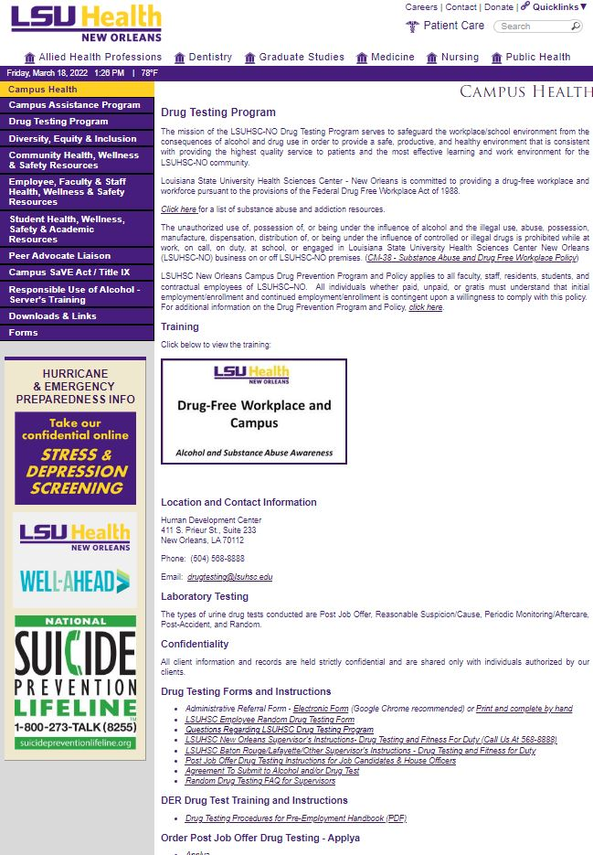
Forms
Handbook
Applya Site

Slide 11
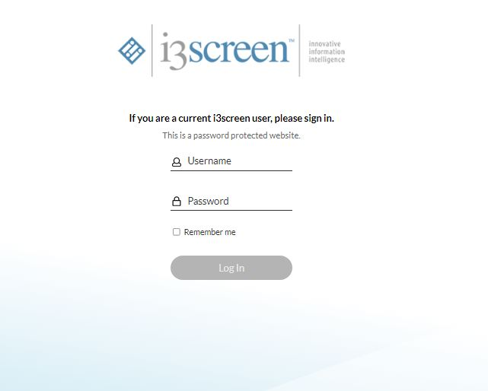
If you need access, email Drugtesting@lsuhsc.edu
You will receive an email from i3screen and you’ll have
24 hours to access your account once you receive the
email
Username is your lsuhsc.edu email
Temp password will be provided
You create your own password

Slide 12
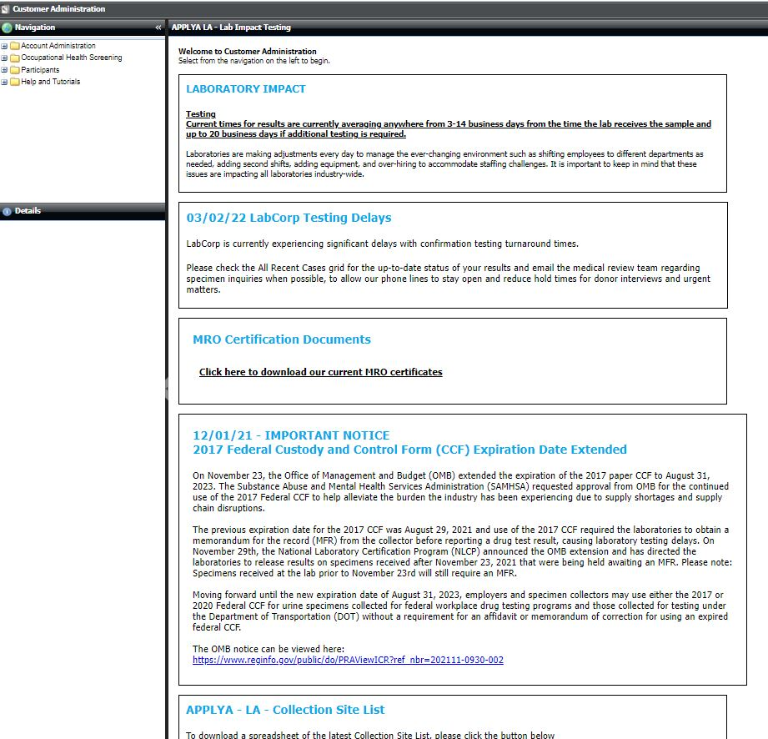
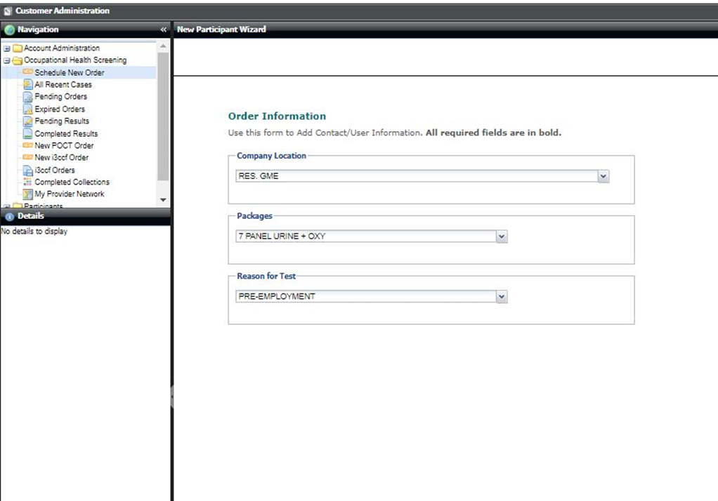

Slide 13
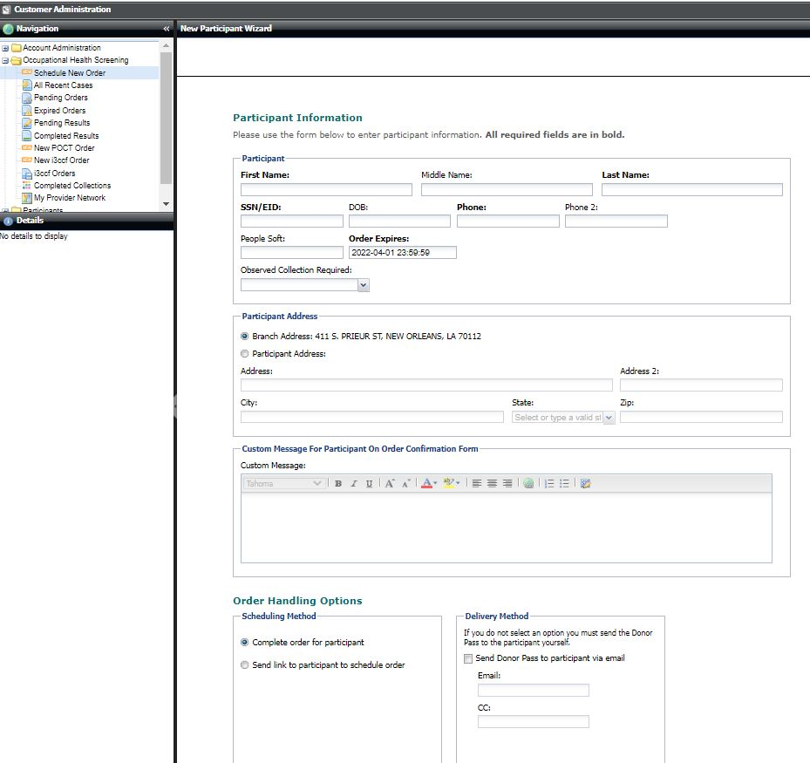
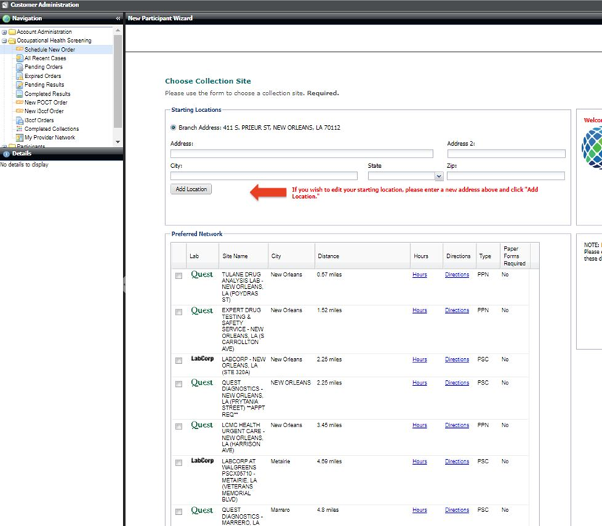


Peoplesoft Chart String
Observed Collection - No
Remember to include
who will receive the
Clear for hire in the
Custom message
Section
Clearance to NAME and EMAIL

Slide 14
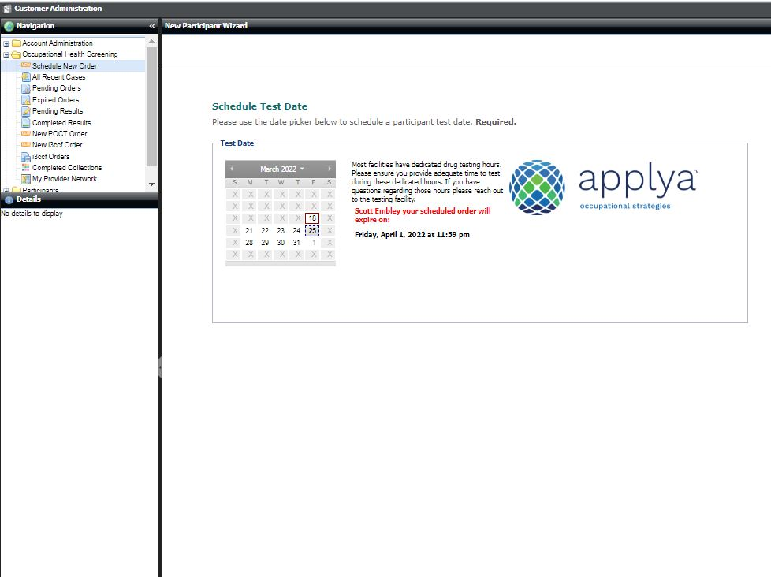
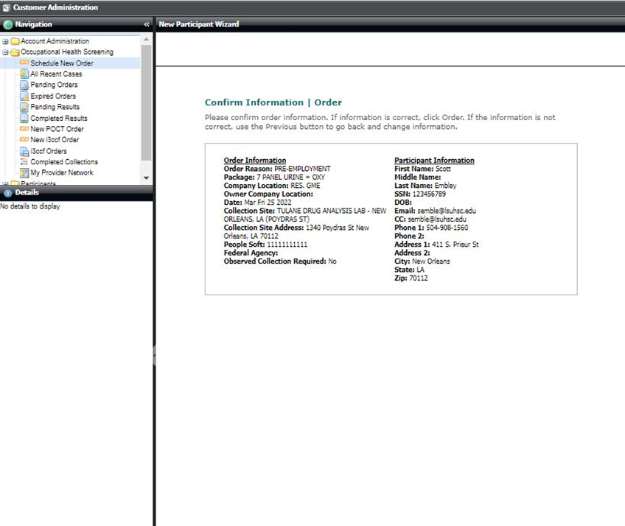
5 working days to take the drug test
once order is submitted.

Slide 15
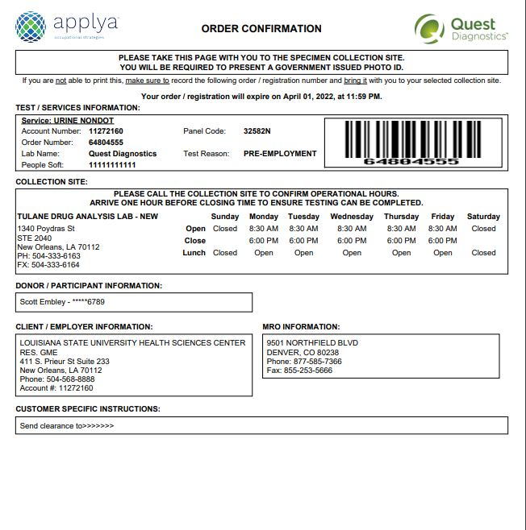
Emails will come from i3screen
Must take the Order Confirmation plus 1 form of
Identification with them to the approved collection
site

Slide 16
Challenging the Results of a Drug Test
LSUHSC-NO allows any individual who wishes to challenge the drug test results to do so. You must do so within 72 hours of notification of a positive test result.
If you believe a drug test is in error or wish to challenge the drug test results, it is your responsibility to notify the MRO and the appropriate Administrative Body or their designee. You must have the same sample retested at your own expense at a laboratory that is SAMHSA certified. The second test must be of equal or greater sensitivity for the drug in question as was the initial test.

Slide 17
HRM Compensation
Sara Schexnayder, HRM Compensation Manager

Slide 18
Compensation
HRM Compensation@lsuhsc.edu
Equity/Salary Review Update
Tentative Effective Date 7-1-22
Compensation will send a file to each School’s financial lead detailing proposed recommendations for equity adjustments based on market and internal salary/experience assessment.
Departments can assume a 2% pool of unclassified and faculty base salaries for budgeting purposes
Staff and Faculty will be reviewed separately

Slide 19
Compensation
HRM Compensation@lsuhsc.edu
Merit Increases
Effective Date 7-1-22
After all performance evaluations are due to HR on May 20, 2022, HR will provide Schools/Divisions their combined listing of performance ratings along with a suggested merit matrix by May 24th .
Any unclassified staff or faculty at 75% effort or higher and employed as of 9/1/21 will be eligible for a merit increase consideration.
The pool for each school will be determined by the amount of salary for all employees within an area as of 8/31/21.
Schools/Divisions will have the discretion to determine the merit amount but must stay within their overall 3% pool.
Applying an across the board 3% to all employees is not acceptable. Increase percentages need to correspond to employee evaluations.
The range of all increases must be between 0% to 6% and a maximum of $7,500 per employee.
All merit increases will need to be finalized and sent to HR on or before
June 2, 2022.

Slide 20
HRM Benefits
Kacy Smith, HRM Benefits & Retirement Manager

Slide 21

Employees Transferring Out
Important that HRM is notified of an employee that is leaving
LSUHSC and transferring to another state agency
∙ Impacts insurance, leave, and retirement
∙ Supervisor or employee should contact HRM prior to separation
∙ Advise resigning employees to contact HRM if they are transferring
Email NOHRM@lsuhsc.edu

Slide 22
Employee Benefits
∙ Health and supplemental insurance, leave benefits, state retirement and supplemental retirement accounts
∙ Employee discounts:
- AT&T, Cox, Microsoft, Dell, Audubon Zoo, NO Athletic Club, etc.
∙ LSUHSC Dental Family Practice – discount on services
∙ Campus Federal Credit Union – special rates on accounts and loans
∙ Campus Assistance Program – resources for employee health and wellness
∙ On-campus Wellness Center
∙ On-campus childcare
∙ START – college savings program for your child or grandchild
∙ Educational leave
∙ Tuition Exemption within the LSU System
More information:
HRM Benefits

Slide 23
HRM Talent Acquisition
Shauna Caputo, Senior Talent Acquisition Consultant

Slide 24
HRM Talent Acquisition recruittalent@lsuhsc.edu
SLIDE TITLE
TEXT

Slide 25
HRM Talent Development
Matt Copeland, HRM Talent Development Manager

Slide 26
HRM Talent Development
TalentDevelopment@lsuhsc.edu
PES – Civil Service Audit
Outstanding PES Plans for 2021-2022 Year.
Immediate Action Required.
HRM Talent Development will be contacting Supervisors.

Slide 27
HRM Talent Development
TalentDevelopment@lsuhsc.edu
Working With Minors – Summer Programs
Training Requirement per PM-16:
  Protection of Minors Participating in University Programs
  https://www.lsuhsc.edu/administration/pm/pm-16.pdf
“Each Authorized Adult must have completed all training and certifications required by law and the University including but not limited to training for Mandatory Reporters. Training for Mandatory Reporters may be completed via the standards and requirements set by the Louisiana Department of Children and Family Services (See Appendix 1).
Authorized Adults shall be re-trained at least once every three years after their initial training. The Campus Administrator shall determine how and where documentation of training is to be maintained. Unless maintained centrally by the Campus Administrator, the Program Administrator shall retain documentation that each Authorized Adult has completed the required training and shall produce written evidence of such training on demand. Adults participating in an LSU Supervised Program and who will have supervisory responsibility for minors shall undergo training that meets the same minimum standards as that required for Authorized Adults. The campus administrator may determine what additional training other participating adults must have.”

Slide 28

HRM Talent Development
TalentDevelopment@lsuhsc.edu
Working With Minors
Training Resources:
Create Account Link
Access Training Link

Slide 29
HRM Talent Development
TalentDevelopment@lsuhsc.edu
Unclassified Perf Eval Updates
Deadline May 20, 2022
Resource Page Updates.
  Session Recordings edit and website additions.
  2022 Staff Evaluation Process Overview (VIDEO LINK)
  2022 Self-Evaluation Process – Best Practices & Process Overview (LINK)
Faculty & Staff are separate evaluation processes.
Self-Evaluations should be sent to Evaluating Supervisor, not HRM Portal.
Do not submit employee self-evaluation as your evaluation.
Comments Required for any rating other than a “3” Meets Expectations

Slide 30
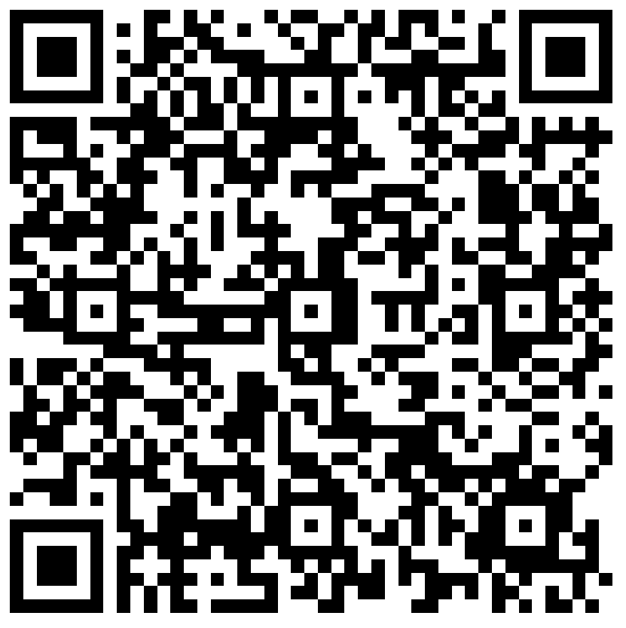
HRM Liaison Questionnaire
2022 Unclassified Performance Evaluation Process Update

Slide 31
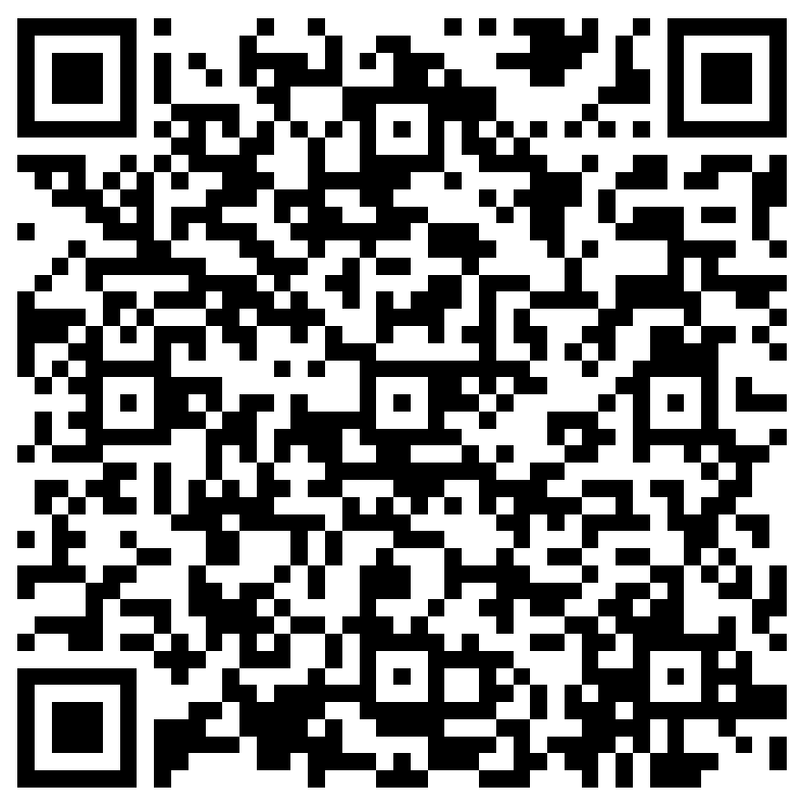
The next Zoom Liaisons Meeting will be held on
Thursday, May 19, 2022 (1000a-1100a)
Please let us know if there is a topic that you would like to hear about!
MS Forms: LINK HERE

Slide 32
Human Resource Management Contacts
Employee Relations
Employee Relations Consultant | Leila McConnell | #3-4947
Compensation & Benefits
Compensation Manager | Sara Schexnayder | #3-4226
Benefits & Retirement Manager | Kacy Smith | #3-8740
Benefits Consultant | Laurie Kirzner | #3-8741
Benefits Generalist (Leave Administrator) | Mark Gele | #3-7812
Benefits Specialist | Chakia Hebron | #3-2455
Compensation & Compliance Analyst | Maddie Hopkins | #3-7378
Benefits Analyst | Kel Brownfield | #3-7780
Human Resource Information Systems (HRIS)
Assistant Director, HRIS | Michelle Sharp | #3-2029
HRIS Manager | Jane Behlen | #3-1616
File Room Coordinator | Janet Magee | #3-8158
HRIS Administrative Coordinator | Dee Bonvillian | #3-4834
Talent Management
Assistant Director, Talent Management | Juli Sholar | #3-2954
Sr. Talent Acquisition Consultant | Shauna Caputo | #3-2047
HR Analyst | Timethia Brown | #3-4835
HR Analyst | Christina Guillory | #3-2044
Talent Development Manager | Matt Copeland | #3-1609
HRM/Talent Development Department Coordinator | Alexander Tran | #3-2214

Slide 33
Questions?

