Slide 1
August 18th, 2022
HRM Liaisons Meeting
August 2022 Meeting

Slide 2
HRM General Updates
Juli Sholar, HRM Assistant Director Talent Management
Notes:
PM-20 and Staffing Updates. Welcome, Denise!!

Slide 3
HRM General Updates
Chancellor’s Memorandum 73: Telecommuting Policy
New Hire Packet Routing & Hire Dates

Slide 4
HR Information Systems
Michelle Sharp, HRM Assistant Director of HRIS

Slide 5
Human Resource Information Systems
HRIS@lsuhsc.edu
Gratis Employees
  3,044 active
  Longest employed = 69 years
  Over the age of 100 = 6
  Oldest gratis employee = 102
  Reminder!
  We are requesting you audit the active gratis employees within your department. The Office of Human Resource Management will be distributing departmental lists in the coming weeks for review.

Slide 6
Human Resource Information Systems
HRIS@lsuhsc.edu
Record Retention
    As many departments are preparing for a move, the question around record retention has been asked a few times.
    We are working with a few departments to identify the scope of files and data within those files and will be able to provide a process and best practice that we recommend.
    ** Human Resource Management’s personnel file on an employee is the source of truth. **

Slide 7
Human Resource Information Systems
HRIS@lsuhsc.edu
Education Questionnaire for Classified Employees
Louisiana Revised Statute 42:290 and Civil Service Rule 15.8 establish the requirements for agencies to report employee data to State Civil Service. In an effort to improve the ability of SCS to respond to requests for the educational makeup of the classified workforce, agencies are newly required to maintain the following education-related information for all classified employees:
• Highest level of education achieved
• Type of degree/certification/diploma awarded
• The major field of study is also required (if a college degree is indicated)

Slide 8
Human Resource Information Systems
HRIS@lsuhsc.edu
Education Questionnaire for Classified Employees
How are we capturing this data?
We will now require a form that allows the employee to select an options that best describes their highest education level. This newly developed form will be part of the new hire packet for Classified/Civil Service employees, and available on the HRM website.
Current employees:
Supervisors of Classified employees will receive an email with the required form. Forms should be distributed to their employees along with the email explaining the process and the new requirement.
Completed forms should be returned to the Office of Human Resource Management or emailed to nohrm@lsuhsc.edu.

Slide 9
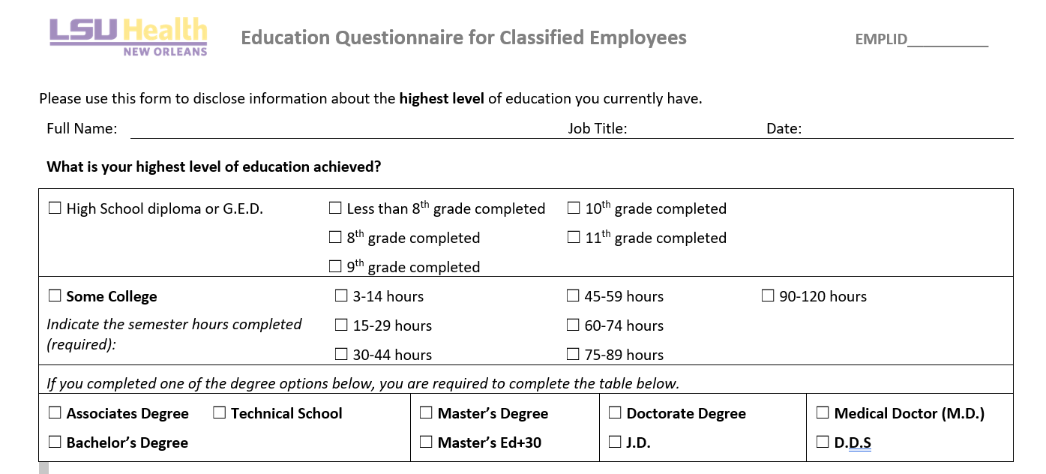
Human Resource Information Systems
HRIS@lsuhsc.edu

Slide 10
HRM Talent Development
Denise Robinson, Talent Development Manager
Notes:
PM-20 and Staffing Updates. Welcome, Denise!!

Slide 11
Performance Evaluation System
The yearly performance cycle from planning to appraisal
HR PES Final Review
2
10
3
4
5
6
7
8
9
1
PES Plan Review
The Human Resources representative reviews the evaluation for accuracy.
Supervisor enters the employee’s work and behavior expectations in accordance with the guidelines of Louisiana State Civil Service.
Employee Acknowledges Evaluation Meeting
Second Level Approval of PES Plan
After the PES evaluation meeting has taken place, the Employee acknowledges.
The second level Supervisor reviews the plan for accuracy.
Supervisor Acknowledges Evaluation Review Meeting
PES
Supervisor Acknowledges Plan Review Meeting
After the PES evaluation meeting has taken place, the Supervisor acknowledges.
After the PES plan meeting has taken place, the Supervisor acknowledges.
Second Level Supervisor Approval
Employee Acknowledges PES Plan
After reviewing the Supervisor’s evaluation, the second level Supervisor approves.
After the planning meeting has taken place, the Employee acknowledges.
Supervisor Evaluation
HR Reviews PES Plan
At the end of the performance cycle, the Supervisor appraises the Employee.
The Human Resources representative reviews the plan for accuracy.
Notes:
Steps 1 - 5 are colored in blue. These are the steps that will be completed in the planning period.
Steps 6 - 10 are colored in red. These are the steps that will be completed in the performance evaluation period.

Slide 12
Performance Evaluation System
HRM Talent Development
TalentDevelopment@lsuhsc.edu
Evaluation | Review Phase
Talent Development is currently reviewing the Evaluations submitted to confirm each submission is compliant with standards set by the State Civil Service.
HRM will complete its review by 8/31/2022.
In the process, supervisors may have their submissions returned to them if they do not meet the SCS standards. Talent Development will provide assistance in properly completing the Evaluation.

Slide 13
HRM Talent Development
TalentDevelopment@lsuhsc.edu
PES Planning
Planning Process is open. Employee Plans due September 9, 2022.
To formulate an equitable plan, Talent Development suggests remembering some key best practices in mind!
  Do not include any medical information in a planning.
  When formulating these expectations, follow the SMART model. Be Specific, and make goals Measurable, Attainable, Realistic, and Time-Based.
  Be detailed in describing tasks or behavior expectations!
Provided below are Suggested Milestones to follow to remain on track for completion prior to the deadline!
Step |  | Suggested Dates
1 | Supervisor PES Plan Review | August 1 – August 8, 2022
2 | Second Level Supervisor Approval | August 9 – August 16, 2022
3 | Supervisor Acknowledges Planning Meeting Occurred | August 17 – August 31, 2022
4 | Employee Acknowledges PES Plan | September 1 – September 9, 2022
5 | HRM Reviews and Approves
2022-2023 PES
Notes:
HRM suggests following these milestones to complete the various steps of the PES process in a timely manner, ensuring everyone has ample time to complete their PES steps and staying

Slide 14
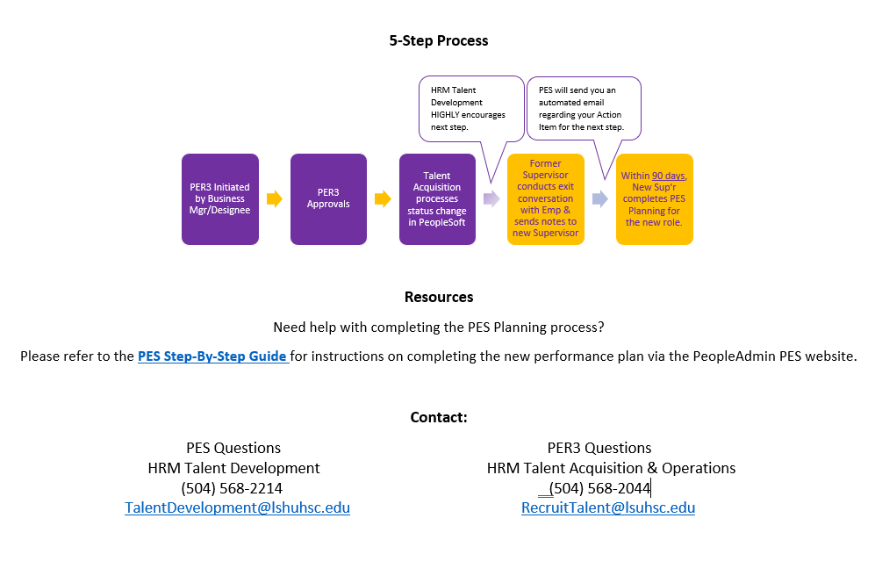
Promotions & Title Changes for State Civil Service
Classified Employees – Supervisor’s Guide
HRM Talent Development
TalentDevelopment@lsuhsc.edu

Slide 15
HRM Talent Development
TalentDevelopment@lsuhsc.edu
Supervisor Training Series
Talent Development is currently developing a comprehensive Supervisor Training Series to assist our supervisors in understanding and properly executing various processes they will need to conduct in their supervisory role that may require training/guidance.
Some examples include:
Posting a new position on PeopleAdmin
How to properly complete a new hire packet
Information about FMLA, ADA, etc.
Best Practices for conducting performance evaluations.
Quick Poll!
As it stands, does your department practice conducting a formal exit interview when your employees are leaving a position?

Slide 16
HRM Talent Acquisition
Shauna Caputo, Talent Acquisition Manager

Slide 17
HRM Compensation
Sara Schexnayder, HRM Compensation Manager

Slide 18
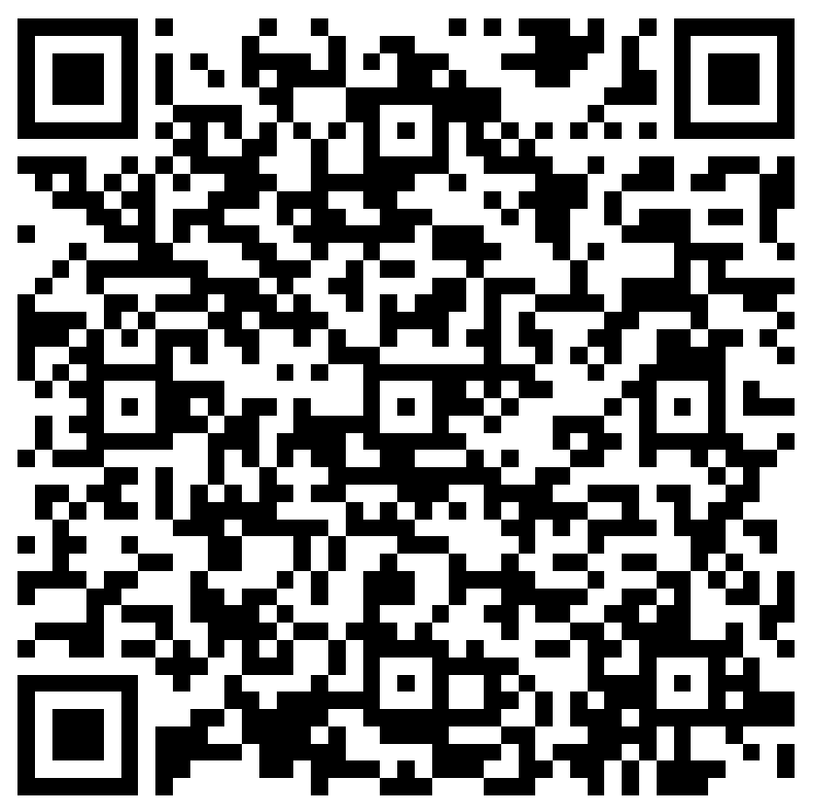
The next Zoom Liaisons Meeting will be held on
Thursday, September 15, 2022 (10:00a-11:00a)
Please let us know if there is a topic that you would like to hear about!
MS Forms: LINK HERE

Slide 19
Human Resource Management Contacts
Employee Relations
Employee Relations Manager | Leila McConnell | #3-4947
Employee Relations Consultant | Carla Popularas | #3-5798
Compensation & Benefits
Compensation Manager | Sara Schexnayder | #3-4226
Benefits & Retirement Manager | Kacy Smith | #3-8740
Benefits Consultant | Laurie Kirzner | #3-8741
Benefits Generalist (Leave Administrator) | Mark Gele | #3-7812
Benefits Specialist | Maddie Hopkins | #3-2455
Compensation & Compliance Analyst | vacant | #3-7378
Benefits Analyst | Kel Brownfield | #3-7780
Human Resource Information Systems (HRIS)
Assistant Director, HRIS | Michelle Sharp | #3-2029
HRIS Manager | Jane Behlen | #3-1616
File Room Coordinator | Janet Magee | #3-8158
HRIS Administrative Coordinator | Dee Bonvillian | #3-4834
Talent Management
Assistant Director, Talent Management | Juli Sholar | #3-2954
Talent Acquisition Manager | Shauna Caputo | #3-2047
HR Analyst | Timethia Brown | #3-4835
HR Generalist | Aminah Moody | #3-4832
HR Generalist | Cristina Guillory | #3-2044
Talent Development Manager | Denise Robinson | #3-1609
HRM/Talent Development Coordinator | Alexander-Quang Tran | #3-2214

Slide 20
Questions?

