Slide 1
HRM Liaisons Meeting
February 2023 Meeting

Slide 2
HRM Updates
Denise D. Robinson, Talent Development Manager

Slide 3

Human Resources Management
nohrm@lsuhsc.edu
HRM Leadership News!
Jill Fragoso
We’re excited to share that LSU Health Sciences Center’s first Chief Human Resources Officer (CHRO) will be joining our team on February 27, 2023.
We’re moving forward together!

Slide 4
Human Resources Management
nohrm@lsuhsc.edu
More Staffing Updates!
HRM has identified candidates for 4 of our vacant positions within some of the following areas:
Employee Relations
Talent Acquisition
Benefits
We’re moving forward together!

Slide 5
HRM Employee Relations
Leila McConnell, Employee Relations Manager

Slide 6
HR Information Systems
Jane Behlen, HRIS Manager

Slide 7
Human Resource Information Systems
HRIS@lsuhsc.edu
Monthly Certification Reminders
Monthly certifications are available to employees on the 5th of the month, to certify time for the prior month.
Employees should certify their time before the supervisor completes the certification.
  Supervisors should be viewing the Leave Detail data within the certification to confirm there are no outstanding time requests needing action
  PeopleSoft> Main Menu> Manager Self Service> Certification (Supervisor)
If the employee is not available to submit their certification, the supervisor will be prompted to select a reason when they submit the certification, and should enter a note with details, as necessary.
  For example, if one of your employees is on leave, it is not necessary for the employee to log in and complete their certification while on leave. The supervisor can certify the time, and select a ‘Certification Reason’ that indicates why the employee has not certified, including comments if appropriate.
  When an employee terminates employment, the supervisor should expect to see their final certification and can select the Certification Reason: Terminated.
  If you see a certification for the following month, this would be a red flag to follow up and determine if there may be additional steps to complete this employees termination status. It is important to be mindful of this to avoid overpayments, and ensure an accurate and timely final pay check.

Slide 8
HRM Benefits
Beth Worthen, Benefits & Retirement Manager

Slide 9
HRM Benefits
nohrmbenefits@lsuhsc.edu
2022 Tax Information
Form 1095-C anticipated to be printed and electronically available on 2/23/2023.
All employees can receive their 1095-C electronically. In order to receive an electronic copy of your 1095-C, you must complete the 1095-C Consent Form through Employee Self-Service.
Main Menu, follow the path: Self Service | Benefits | 1095-C Consent.
If you have previously consented to receive an electronic 1095-C, you do not have to do so again. Once the Consent Form is submitted, it will remain valid until you submit a Withdrawal of Consent Form unless your employment is terminated.

Slide 10
HRM Benefits
nohrmbenefits@lsuhsc.edu
2024 LSU First Wellness Credit
To qualify or to continue the $25/month premium wellness credit ($35/month for those with a covered spouse) for the 2024 plan year, the following requirements must be met:
Continue to be enrolled in LSU First for the 2023 and 2024 plan years.
Employee and covered spouse (if applicable) must have a preventive visit with a Primary Care Physician (PCP) that includes biometric screening (height, weight, BMI, & blood pressure) and preventive lab work that includes a basic metabolic panel between November 1, 2022 - October 31, 2023.
Active participation in care coordination, if identified as a candidate by HighCare, is required to maintain the wellness credit. Plan members will be contacted directly by the care coordination team through HighCare.
Both the employee and spouse must meet the requirements to qualify for the credit. If either the employee or covered spouse fails to meet the requirements to qualify for the wellness credit, no premium credit will be awarded.

Slide 11
403(b) Supplemental Retirement
Louis Bundy with TIAA will be scheduling sessions on March 16, 2023.
Location: Study Room 3108 (across from the MEB cafeteria)
To schedule a meeting contact louis.bundy@tiaa.org
More information regarding supplemental retirement benefits can be found at : https://www.lsuhsc.edu/administration/hrm/supplemental_retirement.aspx

Slide 12
HRM Talent Acquisition
Shauna Caputo, Talent Acquisition Manager

Slide 13
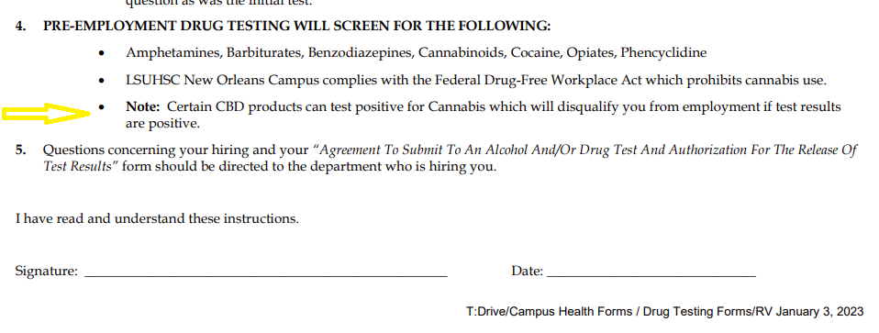
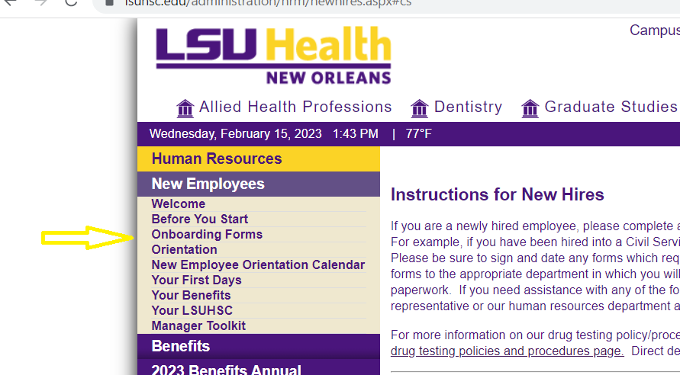
HRM Talent Acquisition
recruittalent@lsuhsc.edu
Pre-Employment Drug Testing Form Update
https://www.lsuhsc.edu/orgs/campushealth/docs/Post_Job_Offer_Instructions.pdf
Form requirement added to House Officer, Unclassified & Classified New Hire Checklists

Slide 14
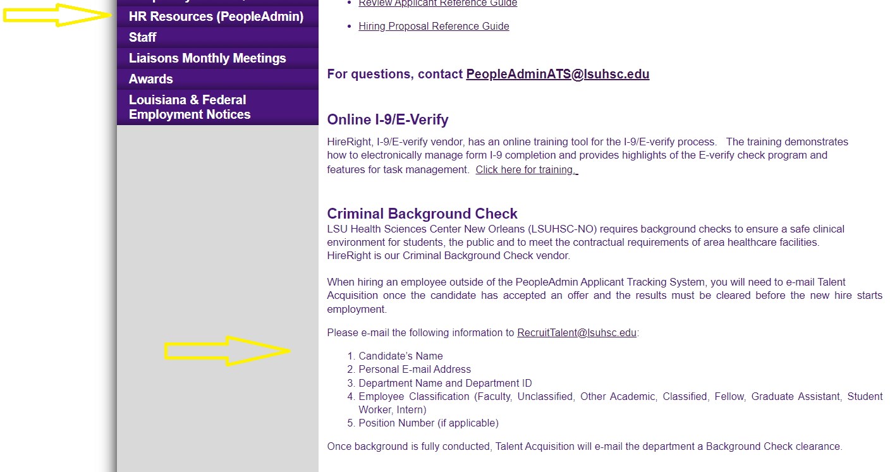
HRM Talent Acquisition
recruittalent@lsuhsc.edu
UPDATE - Hire Right Information Required
TA/OPS no longer needs chargeback chart string information for Hire Right background
checks & I-9
Background Check Process (required for all paid employees)
Email is required for recruitments completed outside of People Admin system (Student Worker, Graduate Assistant, Fellow, Intern, part-time POA Faculty)
Email recruittalent@lsuhsc.edu information below

Slide 15
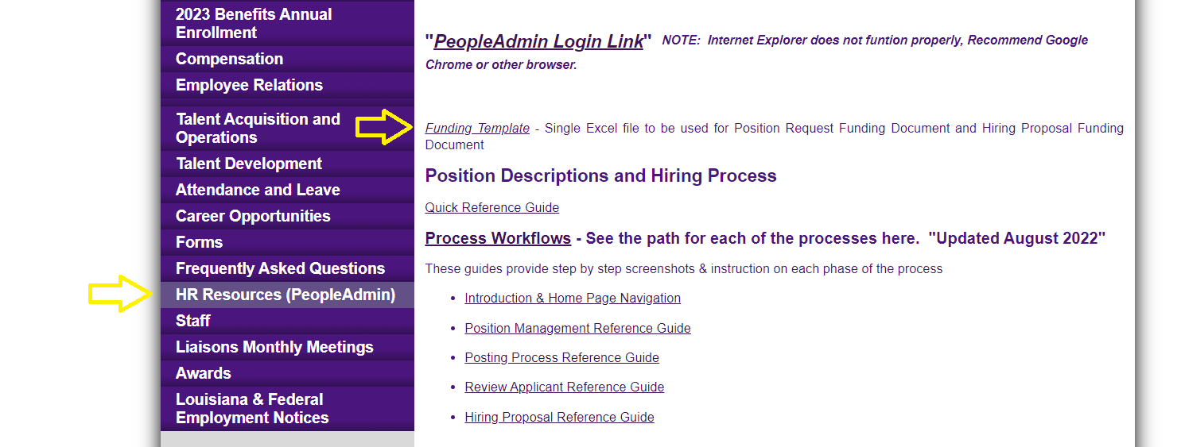
HRM Talent Acquisition
recruittalent@lsuhsc.edu
People Admin Process
Update hiring proposal to “offer accepted” - this triggers automated email to TA/OPS team to start background check
Updated Funding template

Slide 16
HRM Talent Development
Denise D. Robinson, Talent Development Manager

Slide 17
HRM Talent Development talentdevelopment@lsuhsc.edu
Performance Evaluations for Unclassified Staff & Faculty
DECEMBER - JANUARY
Training & Education
FEBRUARY
Submission Portal Opened 2.1.23
MARCH
Manager & Self-Evaluations are submitted through the Portal
Self-Evaluations Begin
Manager Evaluations Begin
Evaluation Meetings Begin
Submission Deadline – March 15th
WHAT TO REMEMBER DURING THE SUBMISSION PROCESS
Avoid Data Entry Errors → Ensure the employee’s name and the overall score that you enter into the submission form matches the evaluation attachment.
Obtain All Required Signatures – The employee and the evaluator should sign. 2nd Level Signature is required ONLY if the overall rating is 1-Unsatisfactory OR 5 – Outstanding.
Justify Your Rating → Comments are required for any rating other than “3 – Successful”.

Slide 18

Performance Evaluations
The 4-Step Process Overview
Staff Evaluation Form Faculty Supplemental Rating Form
DOWNLOAD
Access the form on the HRM Talent Development Webpage and available in your training handouts.
EVALUATE
Complete the form in Adobe Acrobat ONLY.
MEET
Meet with the employee for the Performance Conversation.
SUBMIT
Download and Save to your computer.
Open in Adobe Acrobat ONLY.
Distribute to staff for self-evaluations. Inform employees that self-evaluations are highly encouraged components of the evaluation process.
Comment Section
MUST be completed for ratings greater or less than "3". Strongly encouraged for Job-Specific criteria.
Feedback is provided to the employee in a clear and direct fashion with actionable guidance.
Employee and evaluator(s) may sign the form physically or electronically.
Scan the completed form(s) and save to your computer.
2nd-Level approver e-signs if rated "Outstanding" or "Unsatisfactory"
Best Practice
Be sure to use objective measures when evaluating performance. Objectivity is difficult but essential to an equitable evaluation process.
Discuss employee's self-evaluation and supervisor's evaluation of employee.
Submit the evaluation, and, if applicable, self-evaluation and/or planning letter via the Evaluation Submission Portal (linked below and in the Resources section).

Slide 19
Performance Evaluations
Completing the Faculty Supplemental Rating Form
Which Form Do I Use?
You can download the review form from your school’s LSUHSC Webpage if it is made available on the site. Please contact your school leadership for the most up-to-date review form.
School | Forms
School of Medicine | SOM Annual Faculty Review & HRM Faculty Evaluation Supplemental Rating Form
School of Dentistry | Please refer to your school/department leadership. SOD is in the process of developing a revised Annual Review Form, which is expected to incorporate a rating scale.
School of Nursing | School of Nursing Annual Faculty Review Form
School of Allied Health Professionals | HRM Faculty Evaluation Supplemental Rating Form and Planning Letter
School of Public Health | School of Public Health Annual Faculty Review Form
HRM provides general guidance but does not develop or manage the faculty evaluation process for each school.

Slide 20
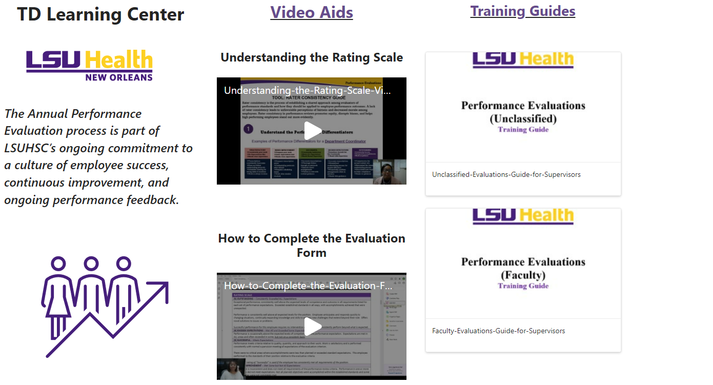
HRM Talent Development talentdevelopment@lsuhsc.edu
LINK: Bookmark the Supervisor Learning Center
Supervisor/Department
Training Series
HRM Talent Development will be piloting training offerings to a select group of areas.
If you are interested in participating and providing feedback, please email TalentDevelopment@lsuhsc.edu.

Slide 21
Questions?

Slide 22
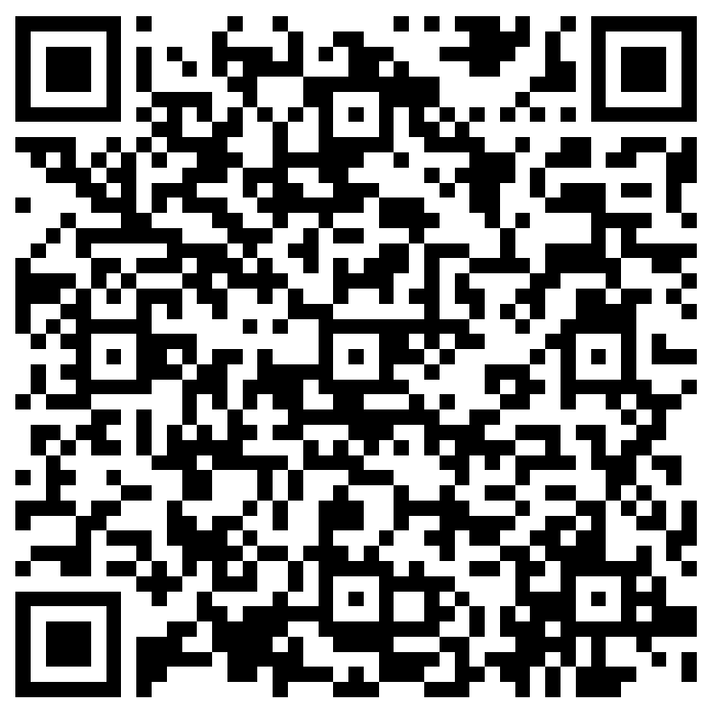
The next Zoom Liaisons Meeting will be held on
Thursday, March 16, 2023 (10:00a-11:00a)
Please let us know if there is a topic that you would like to hear about!
MS Forms: LINK HERE

Slide 23
Human Resource Management Contacts
Employee Relations
Employee Relations Manager | Leila McConnell | #3-4947
Employee Relations Consultant | Carla Popularas | #3-5798
Compensation & Benefits
Compensation Manager | Sara Schexnayder | #3-4226
Benefits Manager | Beth Worthen | #3-8742
Benefits Consultant | Laurie Kirzner | #3-8741
Benefits Generalist (Leave Administrator) | Mark Gele | #3-7812
Benefits Consultant | Maddie Hopkins | #3-2455
Compensation & Compliance Analyst | Kel Brownfield | #3-7378
Human Resource Information Systems (HRIS)
Assistant Director, HRIS | Michelle Sharp | #3-2029
HRIS Manager | Jane Behlen | #3-1616
File Room Coordinator | Janet Magee | #3-8158
Talent Management
Talent Acquisition Manager | Shauna Caputo | #3-2047
HR Analyst | Timethia Brown | #3-4835
HR Generalist | Cristina Guillory | #3-2044
HRM Talent Acquisition Coordinator | Tannia Jacob | #3-4832
Talent Development Manager | Denise Robinson | #3-1609
Learning & Development Trainer | Tranell Barton | #3-8640
HRM Talent Development Coordinator | Alexander-Quang Tran | #3-2214

