Slide 1
Welcome Liaisons!
July 2020 Meeting

Slide 2
AGENDA
COVID Guidance & Employee Relations – Cori Higginson
Classified PES & LASCS Political Activity Rules – Samantha Puszczewicz
PeopleAdmin – Sara Schexnayder
Benefits – Melissa Eckroth
PeopleSoft Term Process – Shauna Caputo
Staff Updates – Mark Gele´

Slide 3
Cori Higginson
COVID Guidance
Return to Campus – Phases Plan
COVID Special Leave – The New Guidance!
LSU Health New Orleans COVID-19 Resources
Supervisor Procedures
COVID Positive Diagnosis and/or Known Exposure
Work From Home Virtual Schooling Accommodation
Termination Review by Legal and ER (certain instances)
See this month’s HRM Guidance for details

Slide 4
Samantha Puszczewicz
Performance Evaluation System
(PES)
July 1 – October 16, 2020* | PES 2020/2021 Plan | Completed electronically in PeopleAdmin
July 1 – October 16, 2020* | PES 2019/2020 Evaluation | Completed on the paper PES form
November 14, 2020 | PES Request for Agency Review | Completed by employee appealing evaluation on LASCS paper form
For this year, LASCS is allowing electronic (non-original signatures) and Zoom/webinar planning and evaluation meetings
See this month’s HRM Guidance for details

Slide 5
PES Training & Town Hall
PES Recordings & Resources
Online PES for Supervisors
Online PES for Non-Supervisors
PES Town Hall Meeting
PES for Supervisors Job Aid
LA SCS Political Activity Guidance
See this month’s HRM Guidance for details

Slide 6
Sara Schexnayder
PeopleAdmin – New Fields!
Two new fields in PeopleAdmin went live July 29
Both MUST be filled-in during the approval process
Hiring Proposal FTE
Approved Starting Salary
These fields were needed for:
Compliance – to show approver agreed with final recommendation
Clarity – showing HR what was intended
Automation – To allow an export of data into PeopleSoft
See this month’s HRM Guidance for details

Slide 7
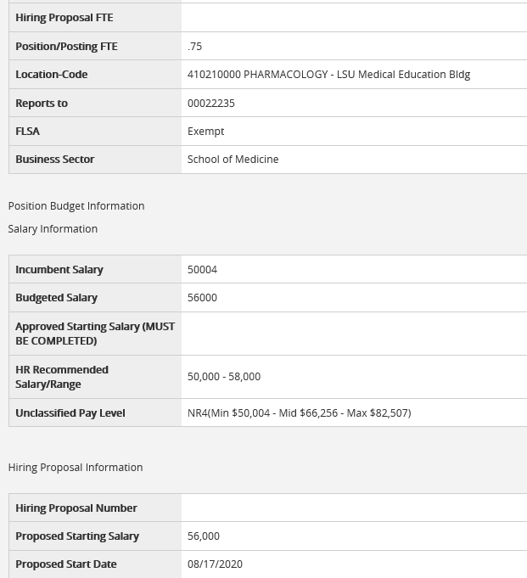
PeopleAdmin

Slide 8
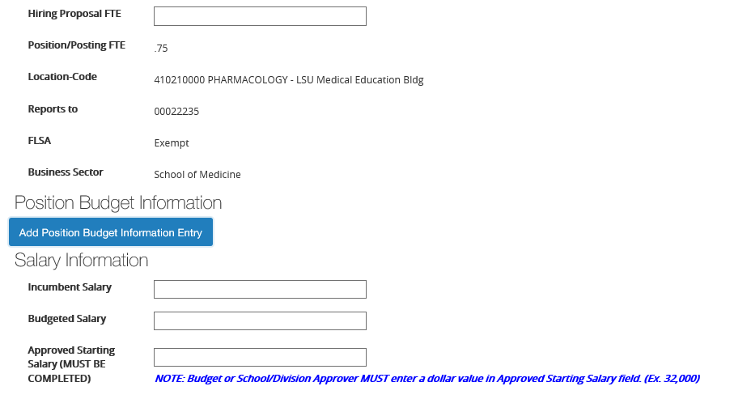
PeopleAdmin

Slide 9
Melissa Eckroth
Benefits Guidance
National COVID-19 Emergency Relief FSA Status Change Form
Open Enrollment approaching quickly!
October with January 1st effective date
Please be patient as we reach full staffing in Benefits
New Employee Orientation (NEO) covers benefits information extensively, so encourage your new hires to attend!
See this month’s HRM Guidance for details

Slide 10
Shauna Caputo
PeopleSoft – TERM Process
Please see updated procedures and information for this PeopleSoft process attached to the written guidance
See this month’s HRM Guidance for details

Slide 11
Mark Gele
HR Staff Updates
Tannia
Tasha Treuil retired earlier this month
Tannia Jacob - New Front Desk Administrator
HRM Current Contact List
Other VCAF Staff Update
Monique Smith – New Records Officer
See this month’s HRM Guidance for details

Slide 12
Questions, Comments, Concerns?

Slide 13
Thank you!
Next Liaison Meeting
August 27th
via Zoom

