Slide 1
March 17, 2022
HRM Liaisons Meeting
March 2022 Meeting

Slide 2
HRM General Updates
Juli Sholar, HRM Assistant Director Talent Management

Slide 3

HRM General Updates
nohrm@lsuhsc.edu
HRM General Updates
Employee Relations Email / Distribution List
  HRM Employee Relations
  nohrmlabrel@lsuhsc.edu
HRM Staff Update
  Contracted Staffing – Leila McConnell

Slide 4
HRM General Updates
nohrm@lsuhsc.edu
HRM Staffing Updates
Updates on open positions and progress.
“The Great Resignation”
“The Great Re-evaluation”
  Staffing Stressors – Let’s talk!

Slide 5
HRM General Updates
nohrm@lsuhsc.edu
Campus Covid Guidelines
February 28, 2022 Guidelines
Mask mandate still in place across campus
  KN-95 Mask not required.
Recommendation for all employees to be optimally vaccinated
Academic/curricular gatherings, should be held in rooms with a defined occupancy to accommodate.
Non-academic gatherings are not permitted under current guidelines.
Campus COVID Resource Page

Slide 6
HRM Talent Acquisition
Shauna Caputo, Talent Acquisition Manager

Slide 7
HRM Talent Acquisition recruittalent@lsuhsc.edu
Applicant Final Dispositions – People Admin
Disposition applicants once decided there is no interest in their candidacy for the position
If an applicant may be of interest/possible second or third choice, you may leave in either under review by department or an interview status
Faculty positions – Applicants are not automatically notified – non-selected applicants should be notified by department
Once a new hire packet is sent to HR (offer accepted and all clearances are completed successfully) disposition all non-selected candidates
Important for accurate reporting and record keeping

Slide 8
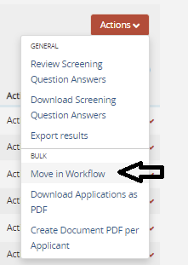
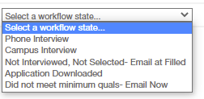
HRM Talent Acquisition recruittalent@lsuhsc.edu
People Admin Role – Applicant Reviewer
Action - Move in Workflow
*Only use did not meet minimum qualifications if applicant does not meet the minimum qualifications as defined in the approved position description/posting

Slide 9
HRM Talent Development
Matt Copeland, HRM Talent Development Manager

Slide 10
HRM Talent Development
TalentDevelopment@lsuhsc.edu
2022 Unclassified Performance Evaluations
Updates in progress for Unclassified Employee Performance Evaluation Process
Evaluating performance for period 07/01/2021 – 03/31/2022
Evaluation Period 4/1 – 5/20
Questions and Feedback to HRM Talent Development
Notes:
HRM is supporting interests of Dr. Nelson through the update and streamline of the Performance Evaluation process.

Slide 11
HRM Talent Development
TalentDevelopment@lsuhsc.edu
2022 Unclassified Performance Evaluations
Information Workshops / Training Programs [3/28 – 4/30]
  Process Overview (Form & Submission)
  Giving Effective Performance Feedback
  Conducting Effective Performance Evaluations
Website Updates
  https://www.lsuhsc.edu/administration/hrm/tandd-about.aspx
  FAQ
  Process / Resource Guides
  Training / Workshop Calendar
  Video Resource Links
Notes:
HRM is supporting interests of Dr. Nelson through the update and streamline of the Performance Evaluation process.

Slide 12
HRM Talent Development
TalentDevelopment@lsuhsc.edu
2022 Unclassified Performance Evaluations
Process Milestone | Complete by Date
Managers complete evaluation form/ratings for their employees. | by April 20, 2022
2nd Level Review 2nd Level Review signature required only for any rating other than “(3) Meets Expectations.” Obtain 2nd Level Review signatures Check with Business Manager or HRM to identify this person. | by May 1, 2022
Managers hold Performance Evaluation Conversations with all employees. | by May 15, 2022
Submit all complete/signed forms to HRM | by May 20, 2022 Deadline
Notes:
HRM is supporting interests of Dr. Nelson through the update and streamline of the Performance Evaluation process.

Slide 13
HRM Talent Development
TalentDevelopment@lsuhsc.edu
Performance Category | Criteria
Delivers Results | Quality of Work Productivity Job Knowledge
Builds Relationships | Teamwork Collaboration Service Orientation
Integrity | Dependability Compliance Diversity & Inclusion
Communication | Written & Oral Communication Information Sharing Effective Listening
Critical Thinking | Problem Solving & Decision Making Adaptability Initiative & Innovation
Leading Others (Supervisor/Manager Only) | Develops Others Managing Performance Champions Diversity & Inclusion
Notes:
HRM is supporting interests of Dr. Nelson through the update and streamline of the Performance Evaluation process.

Slide 14
HRM Talent Development
TalentDevelopment@lsuhsc.edu
2022 Unclassified Performance Evaluations
Faculty Evaluations
  Existing Evaluation Forms
  Supplemental Rating Form
Notes:
HRM is supporting interests of Dr. Nelson through the update and streamline of the Performance Evaluation process.

Slide 15
HRM Talent Development
TalentDevelopment@lsuhsc.edu
2022 Unclassified Performance Evaluations
Updated 2022 Forms
Completed Eval Submission Portal
Notes:
HRM is supporting interests of Dr. Nelson through the update and streamline of the Performance Evaluation process.

Slide 16
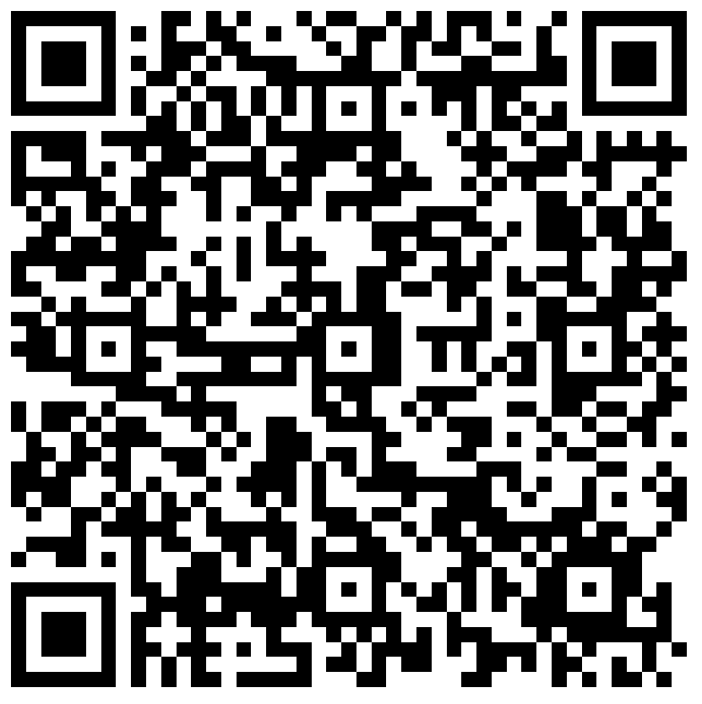
HRM Liaison Questionnaire
2022 Unclassified Performance Evaluation Process Update

Slide 17
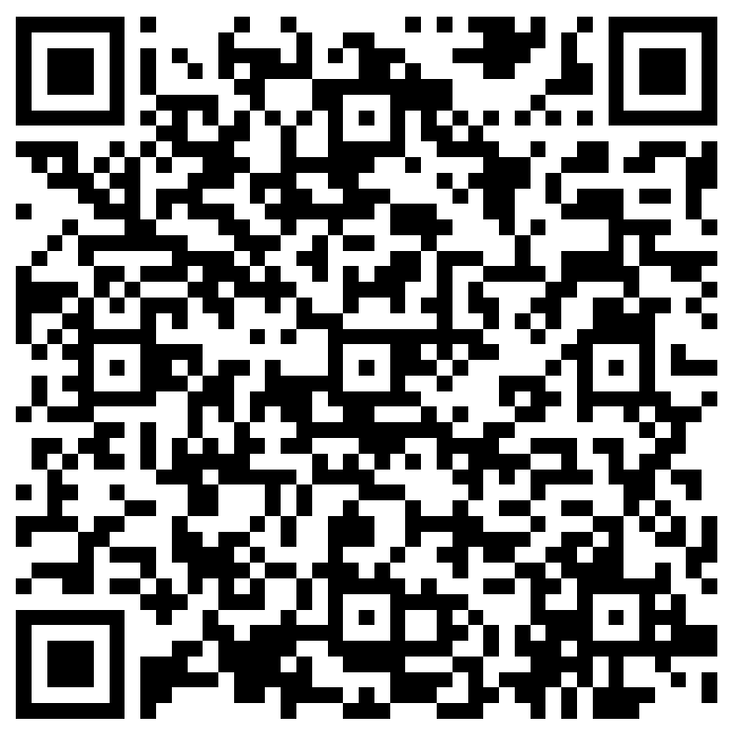
The next Zoom Liaisons Meeting will be held on
Thursday, April 21, 2022 (1000a-1100a)
Please let us know if there is a topic that you would like to hear about!
MS Forms: LINK HERE

Slide 18
HRM Department Contacts
Human Resource Management
Employee Relations
Employee Relations Consultant | ---- | #3-4947
Compensation & Benefits
Compensation Manager | Sara Schexnayder | #3-4226
Benefits & Retirement Manager | Kacy Smith | #3-8740
Benefits Consultant | Laurie Kirzner | #3-8741
Benefits Generalist (Leave Administrator) | Mark Gele | #3-7812
Benefits Specialist | Chakia Hebron | #3-2455
Compensation & Compliance Analyst | Maddie Hopkins | #3-7378
Benefits Analyst | Kel Brownfield | #3-7780
Human Resource Information Systems (HRIS)
Assistant Director, HRIS | Michelle Sharp | #3-2029
HRIS Manager | Jane Behlen | #3-1616
File Room Coordinator | Janet Magee | #3-8158
HRIS Administrative Coordinator | Dee Bonvillian | #3-4834
Talent Management
Assistant Director, Talent Management | Juli Sholar | #3-2954
Talent Acquisition Manager | Shauna Caputo | #3-2047
HR Analyst | Timethia Brown | #3-4835
HR Analyst | Briana Williams | #3-4832
Talent Development Manager | Matt Copeland | #3-1609

Slide 19
Questions?

