Slide 1
May 19, 2022
HRM Liaisons Meeting
May 2022 Meeting

Slide 2
HRM General Updates
Juli Sholar, HRM Assistant Director Talent Management

Slide 3
HRM Benefits
Kacy Smith, HRM Benefits & Retirement Manager

Slide 4

HRM Benefits
nohrmbenefits@lsuhsc.edu
Residents 2022
∙ ~ 260 Residents joining LSU Health in 2022
∙ Online Orientation Portal opened May 15th
∙ On-Boarding Days – June 27th & 28th
∙ HRM assists with badging and benefit enrollments

Slide 5
HRM Benefits
nohrmbenefits@lsuhsc.edu
Rapid Covid-19 Tests
∙ Eight over-the-counter at-home test
∙ Covered by insurance
∙ Major retailers (CVS, Walgreens, etc.) require that
you order online
∙ REMINDER: Follow-up negative at home test with
PCR test

Slide 6
HRM Talent Acquisition
Shauna Caputo, Talent Acquisition Manager

Slide 7
HRM Talent Acquisition recruittalent@lsuhsc.edu
Prior State Service Form
Clearer description/instructions for employee on how to fill out form
When onboarding new employee, please ensure form is filled out accurately/completely so HRM can expedite confirming/recording any leave balances and add to current LSUHSC-NO record
Please ask employee to put N/A and sign& date if no Louisiana prior state service applies so HRM has this record for employee file

Slide 8
HRM Talent Development
Alexander-Quang Tran, Talent Development Coordinator

Slide 9
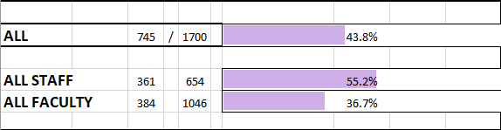
HRM Talent Development
TalentDevelopment@lsuhsc.edu
Unclassified and Faculty Performance Evaluation Updates
DEADLINE: May 20, 2022
Thank you to those who have completed your evaluations!
Email confirmations are not currently active. If you would like to confirm your submission was successfully received, please reach out to Talent Development at the email address provided.
HRM will be sending out reports next week detailing the findings.
Completions as of 5/18/2022

Slide 10
HRM Talent Development
TalentDevelopment@lsuhsc.edu
State Civil Service Classified Performance Evaluation System
Mark your Calendars!
With the conclusion of the Unclassified and Faculty Employee Evaluation process, we are preparing for the 2021-2022 PES Evaluation Period and the 2022-2023 Planning Period.
Be on the lookout for messages from Talent Development about training opportunities and due dates!

Slide 11
Working With Minors – Summer Programs
HRM Talent Development
TalentDevelopment@lsuhsc.edu
Any LSUHSC Faculty or Staff who supervise or work in the same space with minors (individuals under the age 18)
  Per PM-16, “minors” does not include individuals under 18 years who are registered students at LSU, nor emancipated individuals.
  “Work in same space” has a general rule of occupying same space or being in contact with any minor for more than 15-minutes.

Slide 12
HRM Talent Development
TalentDevelopment@lsuhsc.edu
Working With Minors – Summer Programs
Talent Development has created and distributed guides to assist participants of the Student Summer Camp in:
  Creating LCWTA accounts
  Registering for the Mandatory Reporter Training
Training Requirement per PM-16:
  Protection of Minors Participating in University Programs
  https://www.lsuhsc.edu/administration/pm/pm-16.pdf
“Each Authorized Adult must have completed all training and certifications required by law and the University including but not limited to training for Mandatory Reporters. Training for Mandatory Reporters may be completed via the standards and requirements set by the Louisiana Department of Children and Family Services (See Appendix 1).
Authorized Adults shall be re-trained at least once every three years after their initial training. The Campus Administrator shall determine how and where documentation of training is to be maintained. Unless maintained centrally by the Campus Administrator, the Program Administrator shall retain documentation that each Authorized Adult has completed the required training and shall produce written evidence of such training on demand. Adults participating in an LSU Supervised Program and who will have supervisory responsibility for minors shall undergo training that meets the same minimum standards as that required for Authorized Adults. The campus administrator may determine what additional training other participating adults must have.”

Slide 13
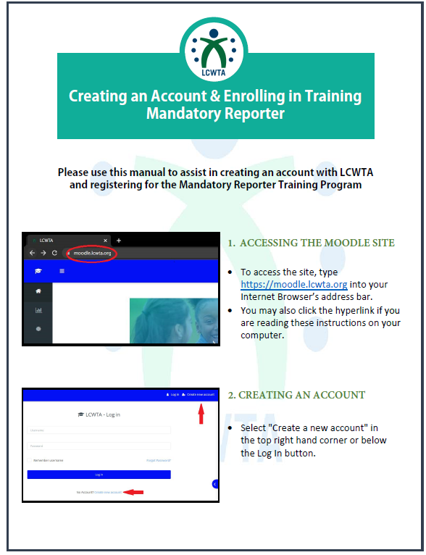
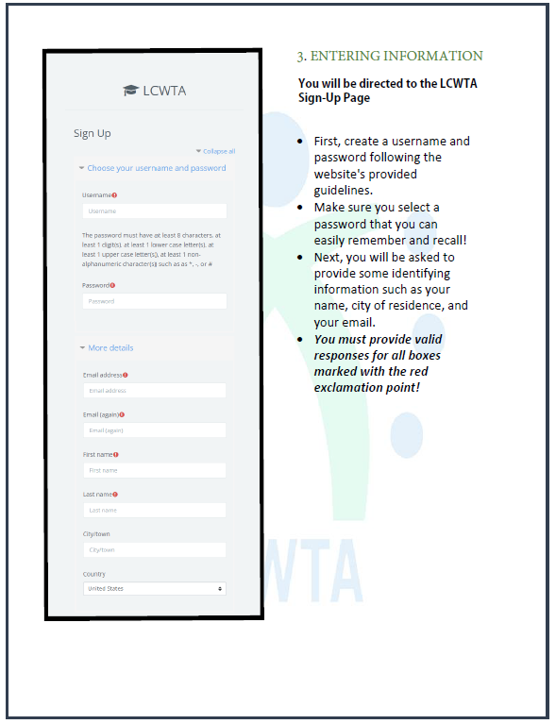
Creating an LCWTA Account
HRM Talent Development
TalentDevelopment@lsuhsc.edu
Form designed to assist in creating an LCWTA account

Slide 14

HRM Talent Development
TalentDevelopment@lsuhsc.edu
Working With Minors
Training Resources:
Create Account Link
Access Training Link
Remember to send certificates of completion to TalentDevelopment@lsuhsc.edu

Slide 15
HRM Updates
Sara: Review of Student Worker Compensation and Pay Rates
Michelle: Badge Operations Out of Service | June 27th – 28th

Slide 16
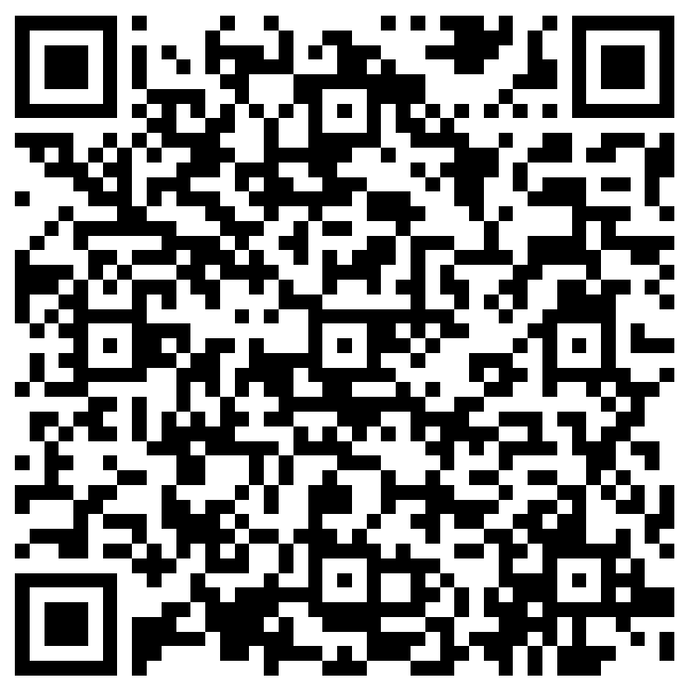
The next Zoom Liaisons Meeting will be held on
Thursday, June 23, 2022 (1000a-1100a)
Please let us know if there is a topic that you would like to hear about!
MS Forms: LINK HERE

Slide 17
Human Resource Management Contacts
Employee Relations
Employee Relations Consultant | Leila McConnell | #3-4947
Compensation & Benefits
Compensation Manager | Sara Schexnayder | #3-4226
Benefits & Retirement Manager | Kacy Smith | #3-8740
Benefits Consultant | Laurie Kirzner | #3-8741
Benefits Generalist (Leave Administrator) | Mark Gele | #3-7812
Benefits Specialist | Vacant
Compensation & Compliance Analyst | Maddie Hopkins | #3-7378
Benefits Analyst | Kel Brownfield | #3-7780
Human Resource Information Systems (HRIS)
Assistant Director, HRIS | Michelle Sharp | #3-2029
HRIS Manager | Jane Behlen | #3-1616
File Room Coordinator | Janet Magee | #3-8158
HRIS Administrative Coordinator | Dee Bonvillian | #3-4834
Talent Management
Assistant Director, Talent Management | Juli Sholar | #3-2954
Sr. Talent Acquisition Consultant | Shauna Caputo | #3-2047
HR Analyst | Timethia Brown | #3-4835
HR Generalist | Aminah Moody | #3-4832
HR Analyst | Cristina Guillory | #3-2044
Talent Development Manager | Matt Copeland | #3-1609
HRM/Talent Development Department Coordinator | Alexander-Quang Tran | #3-2214

Slide 18
Questions?

