Slide 1
HRM Liaisons Meeting
March 2023 Meeting

Slide 2
HRM Updates
Denise D. Robinson, Talent Development Manager

Slide 3
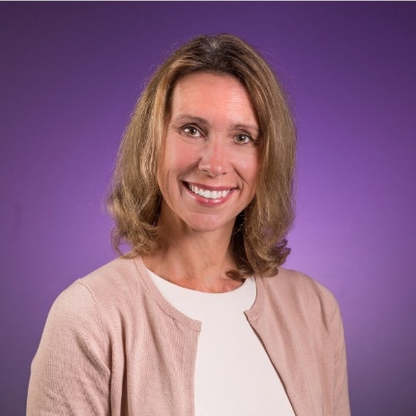
Human Resources Management
nohrm@lsuhsc.edu
HRM Leadership News!
Jill Fragoso
jfrago@lsuhsc.edu
Chief Human Resources Officer (CHRO)
If you would like to have an introductory chat with Jill, please reach out.

Slide 4
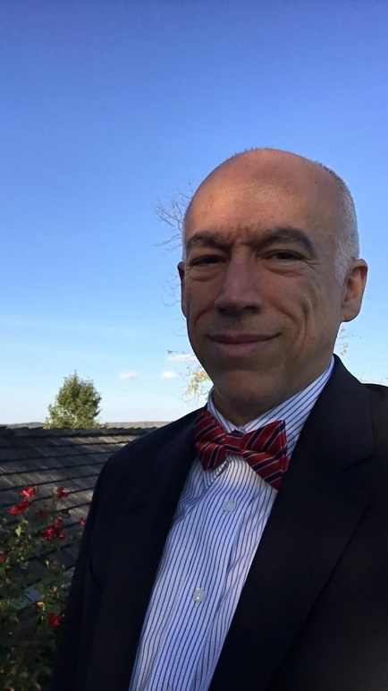
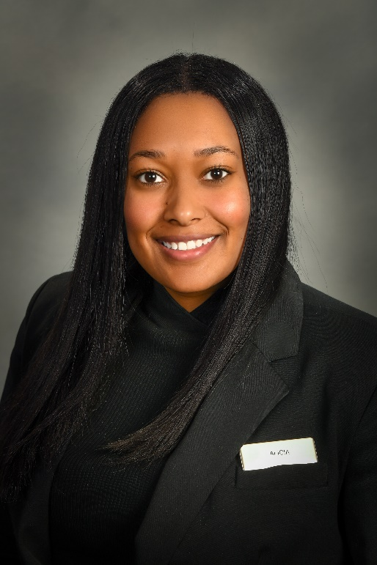
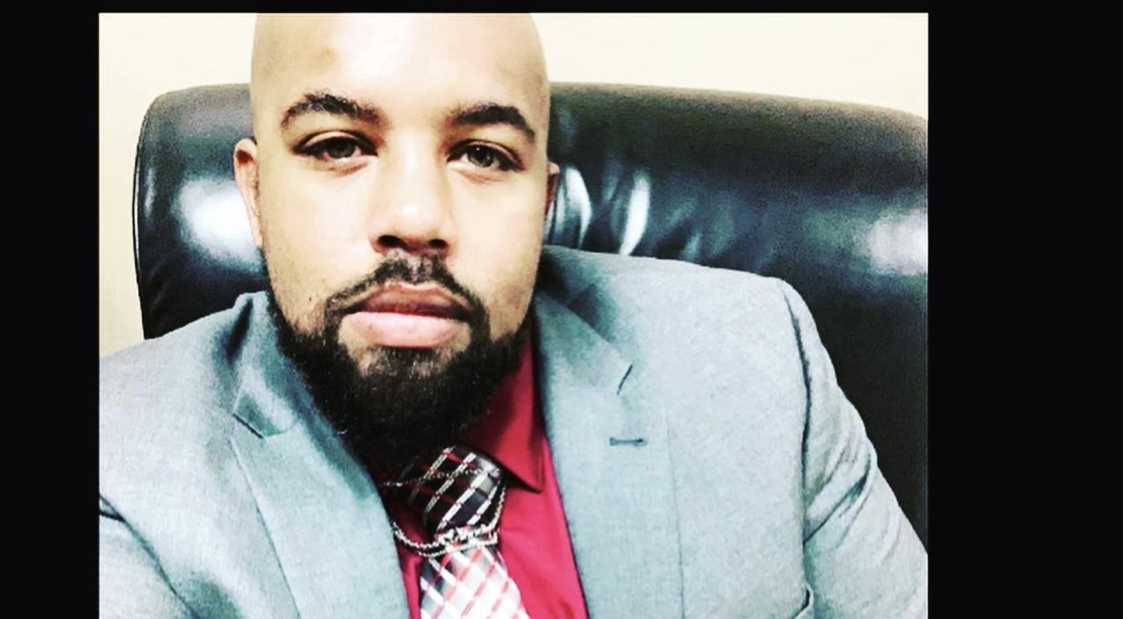
HRM Talent Development talentdevelopment@lsuhsc.edu
NEW HRM STAFF!
Michael Mosley
HRM – Administrative Coordinator 3
Alicia Rodriguez
Talent Acquisition-HR Generalist
Mike Jarvis
Employee Relations – ER Consultant

Slide 5
HR Information Systems
Michelle Sharp, HRM Assistant Director of HRIS

Slide 6
Human Resource Information Systems
HRIS@lsuhsc.edu

Slide 7
HRM Employee Relations
Leila McConnell, Employee Relations Manager

Slide 8
HRM Talent Acquisition
Shauna Caputo, Talent Acquisition Manager

Slide 9
HRM Talent Acquisition
recruittalent@lsuhsc.edu
Talent Acquisition & Operations Team
recruittalent@lsuhsc.edu
Introducing - Alicia Rodriguez HR Generalist, Talent Acquisition
Cristina Guillory - HR Generalist
Timethia Brown - Human Resources Specialist
Tannia Jacob – Human Resources Department Coordinator
Shauna Caputo - Talent Acquisition & Operations Manager

Slide 10
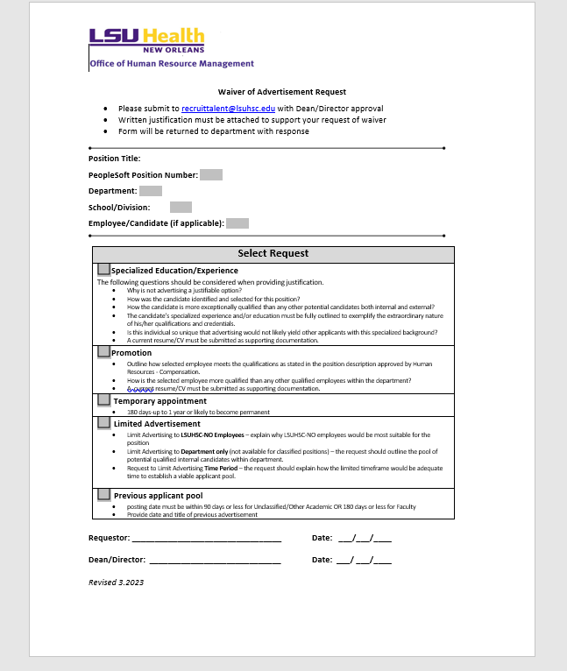
HRM Talent Acquisition
recruittalent@lsuhsc.edu
Waiver of Advertisement Request Form

Slide 11
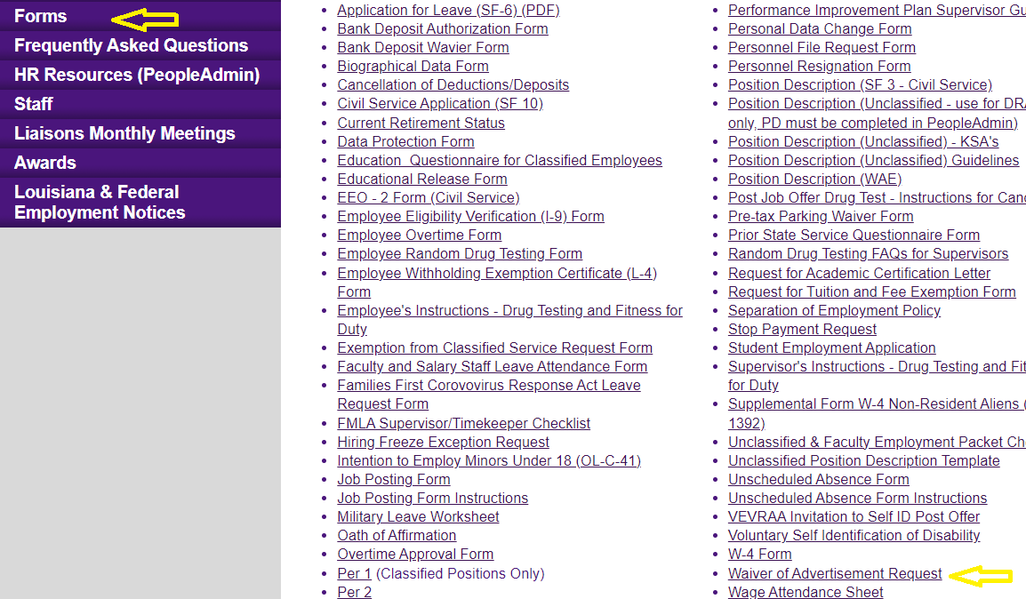
HRM Talent Acquisition
recruittalent@lsuhsc.edu
Where to find form on Website
https://www.lsuhsc.edu/administration/hrm/forms.aspx

Slide 12
HRM Benefits
Beth Worthen, Benefits & Retirement Manager

Slide 13
HRM Benefits
nohrmbenefits@lsuhsc.edu
2022 Tax Information
Form 1095-C have been mailed and are electronically available
All employees can view their 1095-C electronically
In PeopleSoft, follow the path: Main Menu | Self Service | Benefits | View 1095-C

Slide 14
HRM Benefits
nohrmbenefits@lsuhsc.edu
457(b) Supplemental Retirement
Will Parrie with Empower will be scheduling sessions on April 12, 2023.
Location: Study Room 3110 (across from the MEB cafeteria)
To schedule a meeting go to Will Parrie Booking Site or call 504-247-5996.
More information regarding supplemental retirement benefits can be found at : https://www.lsuhsc.edu/administration/hrm/supplemental_retirement.aspx

Slide 15
HRM Benefits
nohrmbenefits@lsuhsc.edu
403(b) Supplemental Retirement
Louis Bundy with TIAA will be scheduling sessions on March 16, 2023.
Location: Study Room 3108 (across from the MEB cafeteria)
To schedule a meeting contact louis.bundy@tiaa.org
More information regarding supplemental retirement benefits can be found at : https://www.lsuhsc.edu/administration/hrm/supplemental_retirement.aspx

Slide 16
HRM Talent Development
Denise D. Robinson, Talent Development Manager

Slide 17
HRM Talent Development talentdevelopment@lsuhsc.edu
Performance Evaluations for Unclassified Staff & Faculty
Thank you for your participation in the evaluation processes!
We will continue to accept late submissions through Monday, March 20th.
DECEMBER - JANUARY
Training & Education
FEBRUARY
Submission Portal Opened 2.1.23
MARCH
Manager & Self-Evaluations are submitted through the Portal
Self-Evaluations Begin
Manager Evaluations Begin
Evaluation Meetings Begin
Submission Deadline – March 15th

Slide 18
HRM Talent Development talentdevelopment@lsuhsc.edu
Supporting Members with Disabilities
ADA for Supervisors & Departments
PILOT TRAINING SESSION: March 27, 2023 | 12:00 PM – 1:00 PM
This pilot training session is being offered to a select group of individuals as a preliminary rollout.
If you would like to participate and provide feedback on the training experience, please email TalentDevelopment@lsuhsc.edu.

Slide 19
Payroll
Terry LeBoeuf, Assistant Director Payroll
Notes:
Kacy is the Benefits Manager but Michelle will be presenting on her behalf.

Slide 20
Payroll
noacctpayroll@lsuhsc.edu
Payroll Calendar Location
https://www.lsuhsc.edu/administration/accounting/payroll.aspx
Direct Deposits
Your first check will be a paper check until your direct deposit accounts go through the prenote process. Please note that anytime you change your banking information your next check will be a paper check until your direct deposit accounts go through the prenote process.

Slide 21
Payroll
noacctpayroll@lsuhsc.edu
Timekeeper responsibilities
Timekeepers should review employee's time information on a weekly basis to identify and correct any discrepancies before the correction cutoff deadline.
The correction cutoff deadline for timekeepers to make corrections such as enter leave time, enter missed punches, etc. is 11:59pm on the Monday after the pay period ends unless otherwise specified by the Payroll Office.
Timekeepers should run and review Time Detail reports for each employee after the pay period ends to check for any discrepancies.
Timekeepers should work with the employee or the employee’s supervisor to resolve any discrepancies before the correction cutoff deadline.
Each employee should be allowed to view and sign their time detail reports.
Please keep records of the time detail reports, leave requests and time modification sheets in your office.

Slide 22
Payroll
noacctpayroll@lsuhsc.edu
Please find the timekeeper training manual below to be used as a reference guide for making corrections to employee’s timesheets.
https://www.lsuhsc.edu/ps/support/docs/TimeKeeper/Time%20and%20Labor%20-%20Timekeepers%20-%20LSUNO%20V9_1_TRAIN.pdf
Also, I have included several short web-based training courses below to demonstrate how to make corrections to timesheets as well as run reports.
https://www.lsuhsc.edu/ps/support/tl_9_1_web-based_lsuno.aspx

Slide 23
Questions?

Slide 24
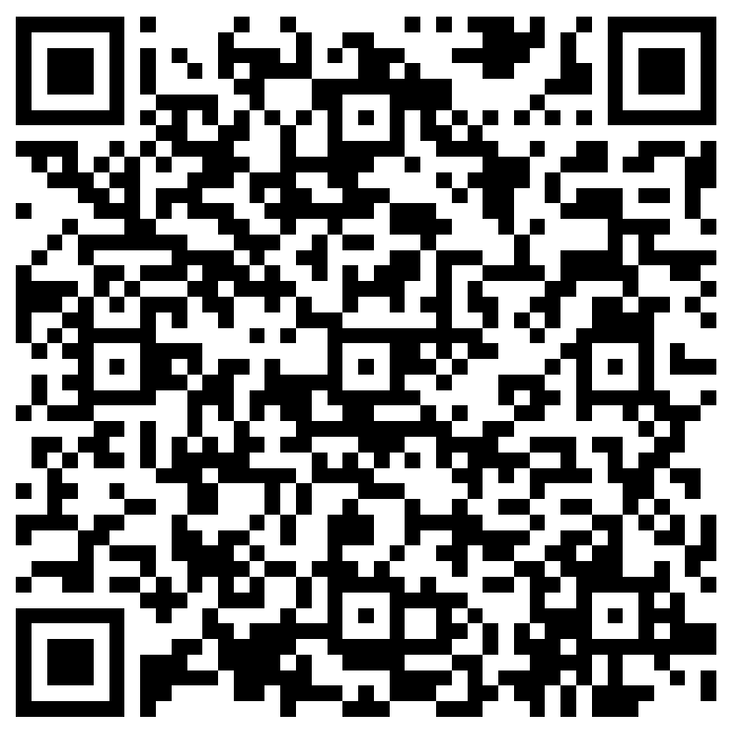
The next Zoom Liaisons Meeting will be held on
Thursday, April 20, 2023 (10:00a-11:00a)
Please let us know if there is a topic that you would like to hear about!
MS Forms: LINK HERE

Slide 25
Human Resource Management Contacts
Chief Human Resources Officer | Jill Fragoso | #3-2634
Employee Relations
Employee Relations Manager | Leila McConnell | #3-4947
Employee Relations Consultant | Carla Popularas | #3-5798
Employee Relations Consultant | Mike Jarvis | #3-1680
Compensation & Benefits
Compensation Manager | Sara Schexnayder | #3-4226
Benefits Manager | Beth Worthen | #3-8742
Benefits Consultant | Laurie Kirzner | #3-8741
Benefits Generalist (Leave Administrator) | Mark Gele | #3-7812
Benefits Consultant | Maddie Hopkins | #3-2455
Compensation & Compliance Analyst | Kel Brownfield | #3-7378
Human Resource Information Systems (HRIS)
Assistant Director, HRIS | Michelle Sharp | #3-2029
HRIS Manager | Jane Behlen | #3-1616
File Room Coordinator | Janet Magee | #3-8158
Administrative Coordinator 3 | Michael Mosley | #1-4834
Talent Management
Talent Acquisition Manager | Shauna Caputo | #3-2047
HR Analyst | Timethia Brown | #3-4835
HR Generalist | Cristina Guillory | #3-2044
HR Generalist | Alicia Rodriguez | #3-8740
HRM Talent Acquisition Coordinator | Tannia Jacob | #3-4832
Talent Development Manager | Denise Robinson | #3-1609
Learning & Development Trainer | Tranell Barton | #3-8640
HRM Talent Development Coordinator | Alexander-Quang Tran | #3-2214

