Slide 1
HRM Liaisons Meeting
October 2022 Meeting

Slide 2
HRM Benefits
Laurie Kirzner, Benefits Consultant
Notes:
Kacy is the Benefits Manager but Michelle will be presenting on her behalf.

Slide 3
HRM Benefits
nohrmbenefits@lsuhsc.edu
2023 Annual Enrollment
Benefits Fair
When? Tuesday, October 25th 2022 10:00am – 2:00pm
Where? School of Allied Health & Nursing Building, 2nd Floor
Meet with representatives from our insurance and retirement vendors. HRM Benefits will be on site to help answer questions and assist with Annual Enrollment paperwork.
Important Dates
October 1st, 2022 – Annual Enrollment begins
November 15th, 2022 – Last day to submit changes
January 1st, 2023 – New plan year begins and changes become effective
Document Submission & Questions
Email: nohrmbenefits@lsuhsc.edu

Slide 4
HRM Compensation
Sara Schexnayder, HRM Compensation Manager

Slide 5
HRM Compensation nohrmcompensation@lsuhsc.edu
STUDENT WORKERS
New structure and rates effective today!!
The type work required and the education level of the incumbent define student worker roles at LSUHSC-NO.
Foundational – Performing standard or routine tasks, clerical support, manual labor, non-technical laboratory tasks. Some specialized training may be required to fill these roles.
Professional – Requires use of college level education to perform complex tasks requiring independent judgement.
Specialized Technical – Performing highly specialized professional and technical duties directly related to their field of study. Only open to students who are working towards an advanced degree in healthcare related professions.

Slide 6
HRM Compensation nohrmcompensation@lsuhsc.edu
STUDENT WORKERS
Starting salaries should be determined based on the complexity of the work to be performed and the student’s prior work experience/skills and education.
Include brief summary of duties and resume with salary proposal
Current student workers below new ranges should be adjusted 7/1/23, or prior if funding/budget allows

Slide 7
HRM Compensation nohrmcompensation@lsuhsc.edu
STUDENT WORKERS
As we transition to the new structure:
Students may be paid below this level based on available funding until the start of the next fiscal year.
The PER 1, 2, and 3 should include the Responsibility Level in the comments section and accompanied by the students resume and up to 3 brief bullets of the duties to be performed.
Going forward:
Exceptions to these rates should be rare for extraordinary situations and discussed with the compensation department prior to extending offers.
After a full year in the department and at the department’s discretion, the student’s rate may be increased by up to $1 per hour, if performance warrants and budget allows.

Slide 8
HRM Talent Acquisition recruittalent@lsuhsc.edu
STUDENT WORKERS
Reminders on hiring packets for student workers must include:
A copy of their social security card
Verification of enrollment as a full-time student
Brief description of job duties

Slide 9
Announcement
Cathy Torres, Director of Faculty Affairs

Slide 10
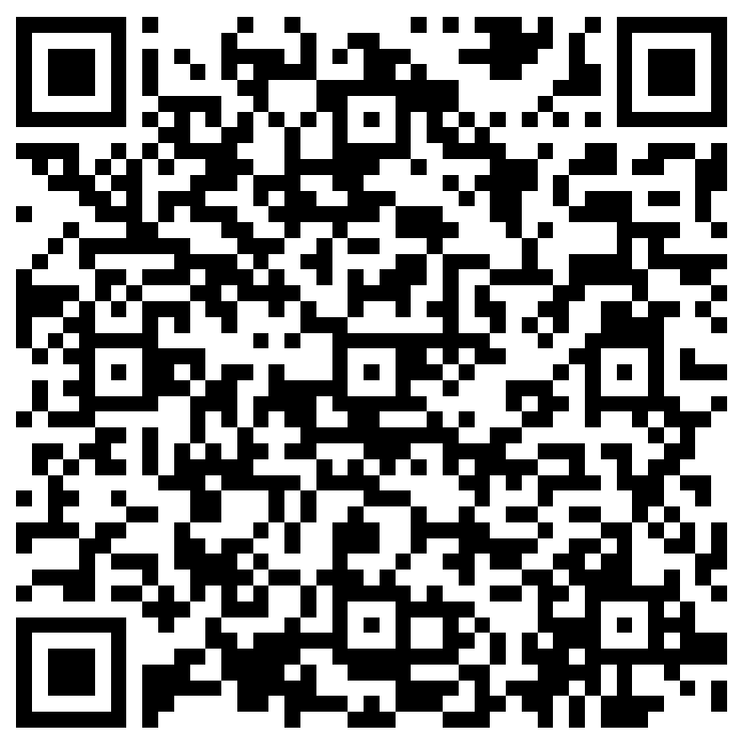
The next Zoom Liaisons Meeting will be held on
Thursday, November 17, 2022 (10:00a-11:00a)
Please let us know if there is a topic that you would like to hear about!
MS Forms: LINK HERE

Slide 11
Human Resource Management Contacts
Employee Relations
Employee Relations Manager | Leila McConnell | #3-4947
Employee Relations Consultant | Carla Popularas | #3-5798
Compensation & Benefits
Compensation Manager | Sara Schexnayder | #3-4226
Benefits Consultant | Laurie Kirzner | #3-8741
Benefits Generalist (Leave Administrator) | Mark Gele | #3-7812
Benefits Specialist | Maddie Hopkins | #3-2455
Compensation & Compliance Analyst | Kel Brownfield | #3-7378
Human Resource Information Systems (HRIS)
Assistant Director, HRIS | Michelle Sharp | #3-2029
HRIS Manager | Jane Behlen | #3-1616
File Room Coordinator | Janet Magee | #3-8158
HRIS Administrative Coordinator | Dee Bonvillian | #3-4834
Talent Management
Talent Acquisition Manager | Shauna Caputo | #3-2047
HR Analyst | Timethia Brown | #3-4835
HR Generalist | Cristina Guillory | #3-2044
Talent Development Manager | Denise Robinson | #3-1609
Learning & Development Trainer | Tranell Barton | #3-8640
HRM/Talent Development Coordinator | Alexander-Quang Tran | #3-2214

Slide 12
Questions?

