Slide 1
Online Performance Evaluation System (PES)
Supervisor Training
2022-2023 Season

Slide 2
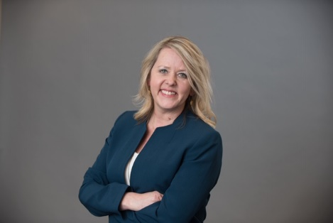
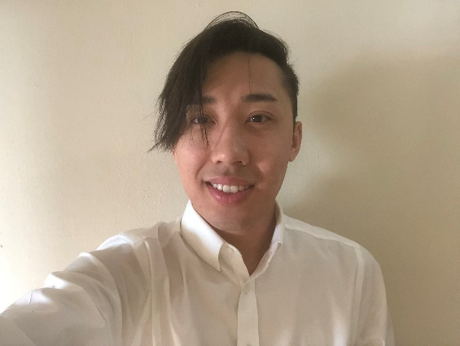
Meet your HRM PES Team
Denise Robinson
Talent Development Manager
Juli W. Sholar
Assistant Director – Talent Management
Alexander-Quang Tran
Talent Development Coordinator
Notes:
There are intentionally no notes on this page.

Slide 3
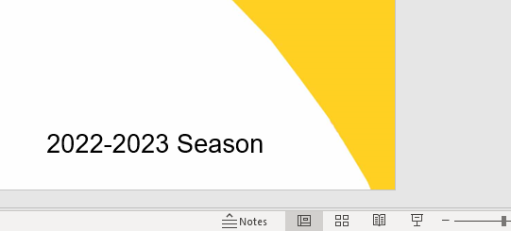
PLEASE NOTE
Review presentation in normal view to see notes providing more in-depth details for your convenience.
Notes:
There are intentionally no notes on this page.

Slide 4
PeopleAdmin Online Performance Evaluation System Tool
PeopleAdmin.com
Notes:
Click “Open Hyperlink” on the link above to go to PeopleAdmin Online PES

Slide 5
PES Timeline
Annual Performance Cycle
Evaluation
2021 – 2022
July 1 -August 8, 2022
Planning
2022-2023
July 1 -September 9, 2022
July
Aug
Sept
Oct
Nov
Dec
Jan
Feb
Mar
Apr
May
June
July
Aug
Sept
Annual Performance Cycle 2022-2023
July 1, 2022– June 30, 2023
Collect performance documentation for evaluation
Evaluation
2022-2023
July 1 –
August 11, 2023
Planning
2023-2024
July 1 -September 8, 2023
Notes:
Depicted above is the Performance Evaluation System timeline. This timeline depicts the end of the performance cycle for 2021-2022 and the full performance cycle for 2022-2023 and the upcoming 2023-2024 planning.
You may have noticed that the submission deadlines are a little bit earlier than the deadlines set by state civil service. This is to allow Talent Development to review the submissions and meet the state deadlines.

Slide 6
PES Timeline
Annual Performance Cycle
Evaluation
2021 – 2022
July 1-Aug 8, 2022
Evaluation in People Admin
Planning
2022-2023
July 1st - September 9th
July
Aug
Sept
Oct
Nov
Dec
Jan
Feb
Mar
Apr
May
June
July
Aug
Sept
Annual Performance Cycle 2022-2023
July 1, 2022 – June 30, 2023
Collect performance documentation for evaluation
Evaluation
2022-2023
July 1st -August 8th
Planning
2023-2024
July 1st -September 9th
Notes:
There are intentionally no notes on this page.

Slide 7
PES Timeline
Annual Performance Cycle
Evaluation
2021 – 2022
July 1st -August 8th
Planning
2022-2023
July 1-September 9, 2022
Planning in People Admin
July
Aug
Sept
Oct
Nov
Dec
Jan
Feb
Mar
Apr
May
June
July
Aug
Sept
Annual Performance Cycle 2022-2023
July 1, 2022 – June 30, 2023
Collect performance documentation for evaluation
Evaluation
2022-2023
July 1st -August 8th
Planning
2023-2024
July 1st -September 9th
Notes:
There are intentionally no notes on this page.

Slide 8
PES Timeline
Evaluation
2021 – 2022
July 1st -August 8th
Annual Performance Cycle
Planning
2022-2023
July 1st – September 9th
Annual Performance Cycle 2022-2023
July 1, 2022 – June 30, 2023
Collect performance documentation for evaluation
July
Aug
Sept
Oct
Nov
Dec
Jan
Feb
Mar
Apr
May
June
July
Aug
Sept
Evaluation
2022-2023
July 1st –
August 8th, 2023
Evaluation in People Admin
Planning
2023-2024
July 1st –September 9th
Notes:
Fast forward to the end of the performance year. Supervisors have conducted the performance plan with your employees and submitted them into the Online Performance Evaluation System. You have met with your employees throughout the performance year and have provided proper coaching. Now it is time to conduct the performance evaluation. The performance evaluations for the 2022-2023 performance year are due by August 8, 2023.

Slide 9
PES Timeline
Evaluation
2021 – 2022
July 1st -August 8th
Annual Performance Cycle
Planning
2022-2023
July 1st - September 9th
Annual Performance Cycle 2022-2023
July 1, 2022 – June 30, 2023
Collect performance documentation for evaluation
July
Aug
Sept
Oct
Nov
Dec
Jan
Feb
Mar
Apr
May
June
July
Aug
Sept
Evaluation
2022-2023
July 1st -August 8th
Planning
2023- 2024
July 1st –September 9th, 2024
Planning in People Admin
Notes:
Finally, we are ready to start a new performance cycle. The plan forms for 2023– 2024 will be due on September 9, 2023.

Slide 10
Performance Evaluation System
The yearly performance cycle from planning to appraisal
HR PES Final Review
2
10
3
4
5
6
7
8
9
1
PES Plan Review
The Human Resources representative reviews the evaluation for accuracy.
Supervisor enters the employee’s work and behavior expectations in accordance with the guidelines of Louisiana State Civil Service.
Employee Acknowledges Evaluation Meeting
Second Level Approval of PES Plan
After the PES evaluation meeting has taken place, the Employee acknowledges.
The second level Supervisor reviews the plan for accuracy.
Supervisor Acknowledges Evaluation Review Meeting
PES
Supervisor Acknowledges Plan Review Meeting
After the PES evaluation meeting has taken place, the Supervisor acknowledges.
After the PES plan meeting has taken place, the Supervisor acknowledges.
Second Level Supervisor Approval
Employee Acknowledges PES Plan
After reviewing the Supervisor’s evaluation, the second level Supervisor approves.
After the planning meeting has taken place, the Employee acknowledges.
Supervisor Evaluation
HR Reviews PES Plan
At the end of the performance cycle, the Supervisor appraises the Employee.
The Human Resources representative reviews the plan for accuracy.
PES TIP | PLAN AHEAD!
Multiple evaluator processes takes time. Please use the Milestones timeline listed on Slide #11!
Notes:
Steps 1 -5 are colored in blue. These are the steps that will be completed in the planning period.
Steps 6-10 are colored in red. These are the steps that will be completed in the performance evaluation period.

Slide 11
PES Milestones
Step |  | Suggested Dates
6 | Supervisor PES Evaluation | July 1 – July 8, 2022
7 | Second Level Approval | July 11 – July 15, 2022
8 | Supervisor Acknowledges Evaluation Meeting Occurred | July 18 – July 29, 2022
9 | Employee Acknowledges Evaluation | August 1 – August 8, 2022
10 | HRM Reviews and Approves
1 | Supervisor PES Plan Review | August 1 – August 8, 2022
2 | Second Level Supervisor Approval | August 9 – August 16, 2022
3 | Supervisor Acknowledges Planning Meeting Occurred | August 17 – August 31, 2022
4 | Employee Acknowledges PES Plan | September 1 – September 9, 2022
5 | HRM Reviews and Approves
2021-2022 PES
2022-2023 PES
Notes:
HRM suggests following these milestones to complete the various steps of the PES process in a timely manner, ensuring everyone has ample time to complete their PES steps.

Slide 12
PES Navigation Tips
PeopleAdmin.com
Module Indicator.
Three Blue Dots
Hyperlinks are an important navigation tool! Clicking hyperlinks redirect you to different pages in the PES system. They are differentiated in PeopleAdmin by blue text.
Using “Save & Continue” button to proceed through the tasks while saving your progress.
You may also use the “Save Draft” button and return to the program when you are ready to complete.
Left-hand side Menu allows you to view time and date confirmations.
Progress Notes allow you to house documentation in order to track your employees’ performance. Progress notes can be added to the system in three formats (Word, Excel, and/or pdf).
Attachment allow you to attach additional documentation in the system.
Notes:
Right-click the link above and select “Open link” to access the PeopleAdmin Online PES
Here’s a list of common tools that will be extremely important to you in the Online Performance Evaluation System.
You are going to see what module indicators are and why they are important to you.

Slide 13
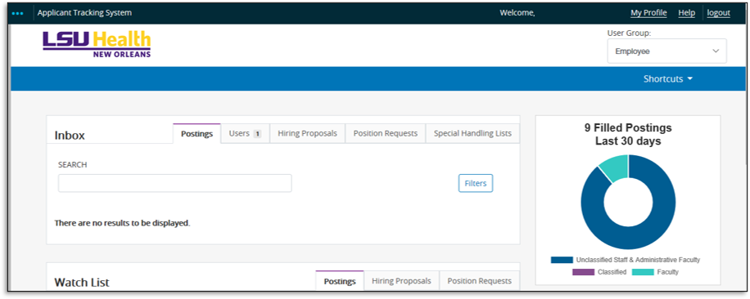
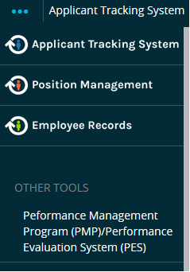
PeopleAdmin Landing Page
Module Indicator
Module Indicators
Supervisor
Select to access the Performance Evaluation System
Notes:
Online PES is housed in the Performance Management Module of the PeopleAdmin system.
After signing into the system, you will be directed to the landing page. Your landing page may appear different depending on your role at the University.
Once you are on the landing page, click the three blue dots in the upper left-hand corner; these are called module indicators.
After clicking on the module indicators, a dropdown box will appear. Scroll to the bottom of the list and click on the Performance Management Module. Once you click on PM module you will be directed to the next page.

Slide 14
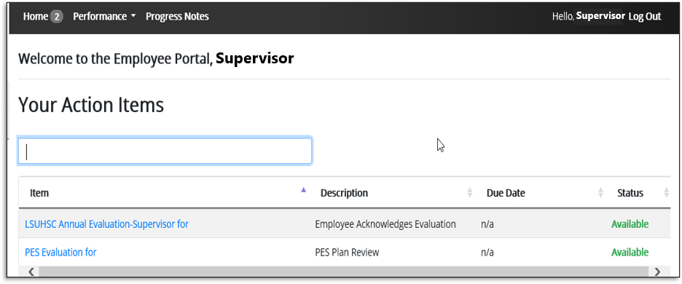
PES Landing Page
Employee Name
Employee Name
Notes:
On this landing page, you will be able to view your Action Items. Select the hyperlink for the employee you are working on.

Slide 15
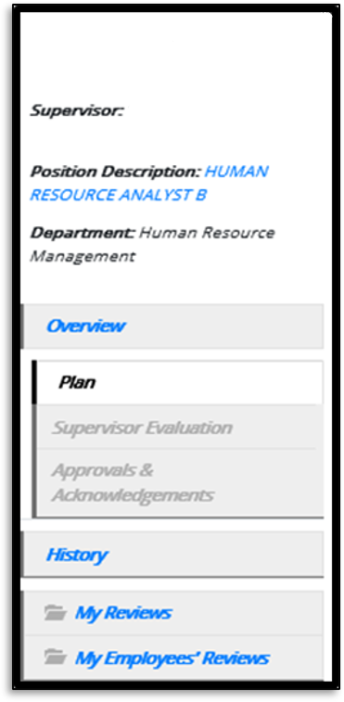
Navigation Menu
Employee Name
Position Description
Print or save as reference
Supervisor’s Name
Overview
Step completion chart
Plan
Access, print or save
Supervisor Evaluation
Access, print or save
Approvals & Acknowledgements
Documented history (time/date) for all Approvals and/or Acknowledgements
My Reviews
Access to all past and current PES years
Notes:
On the lefthand side of the page, you will find the helpful hyperlinks to navigate where you are in the process with each employee.

Slide 16
Supervisor Performs the Evaluation
Classified Employees with a Plan Already in Place:
This section pertains to evaluating Classified employees that have received PES Planning for plan year 2021-2022. If your employee already has a Plan in place, please proceed to the next slide.
Classified Employees Within Their First 90 Days:
If you have any new hires that are within the first 90 days, please skip to slide # 23 to develop the PES Plan first.
The PES Evaluation is due no later than August 8, 2022.
Notes:
There are intentionally no notes on this page.

Slide 17
Supervisor Performs the Evaluation
First access the Employee’s Progress Notes before completing the performance evaluation
PES TIP | Track Successes and Shortcomings!
Ratings of “Exceptional” or “Needs Improvement” require supportive evidence as justification. Throughout the evaluation period, submit documentation of notable behaviors (i.e. exceeds goals in number of tickets, collections, did not meet deadlines, etc.) to use as references in informing your ratings.
*Progress Notes can be submitted in Word, Excel, and/or pdf formats.
Notes:
You will begin with the evaluation for most employees** (See Slide # 16) and rate them based on their performance from:
July 1, 2021- June 30, 2022
-OR-
If within 90 days-their start date – June 30, 2022.
***For these employees within their first 90 days you will begin with the plan and can skip to slide 23***
At the top of the page, you will see the option to submit progress notes. Progress notes can only be submitted in the following three formats; pdf, word, and excel. Remember no gif or pic files. There is a section to add attachments. We strongly suggest providing attachments of supportive evidence!
The Mission Statement & Work display statements and expectations determined in the planning phase. Proceed to the Overall Results and Resources to complete the evaluation process.

Slide 18
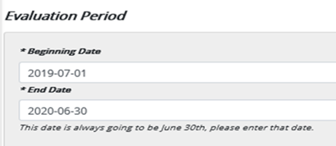
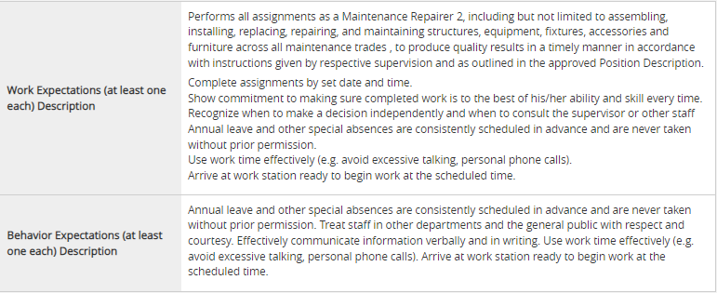
Supervisor Performs the Evaluation
Section 1: Mission Statement
LSUHSC’s mission statement and the established evaluations period are displayed.
“Louisiana State University Health Sciences Center in New Orleans Mission (LSUHSC-NO) is to provide education, research, and public service through direct patient care and community outreach”
Section 2: Work and Behavior Expectations Displays the expectations set during the planning period.
Use this section to refresh yourself on the established expectations when determining the employee’s performance rating.

Slide 19
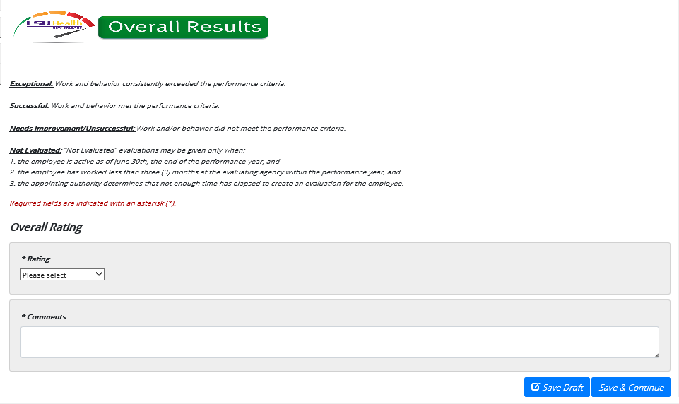
Supervisor Performs the Evaluation
PES TIP | Be Specific! Your feedback is essential in informing employees of their performance in comparison to expectations of the positions they hold.
Notes:
Once you have reviewed the progress notes, make sure to review the ratings definitions. Next, click on the ratings dropdown box and select the overall rating, make sure to comment on your employee’s performance! Just like on the paper form comments are required! Finally, save draft if you would like to return to the evaluation or save & continue to be directed to the Resources page.
If an employee receives a rating of “Needs Improvement” encourage them to reach out to the Talent Development team for guidance.
If an employee receives a rating of “Exceptional”, proper documentation is needed to support this rating.

Slide 20
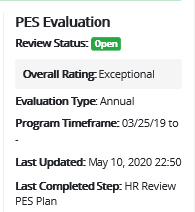
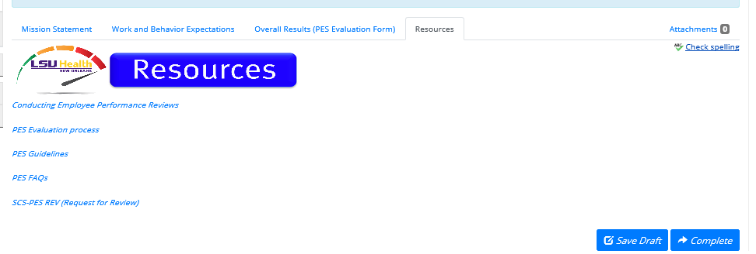
Supervisor Performs the Evaluation
PES TIPS | What NOT To Do!
Do not refer to other others in another individual’s evaluation.
Do not include any medical information in an evaluation or planning. (i.e. FMLA, LOA, etc.)
Be sure to select the “Complete” button in this section to move forward to the next step!
Links to access resources from State Civil Service website about the Performance Evaluation System.
Save Draft & Complete Buttons
Notes:
The resources page is very important because it is where the complete button is housed. On the upper righthand side of the page, you’ll see the evaluation status as well as the assigned rating and a time and date stamp of the last update. Once again, you will have the opportunity to view the hyperlinked resources. After you have finished completing the evaluation, click save draft or complete.
As a reminder, the complete button will initiate the next step the process.

Slide 21
Second-Level Evaluator Approves
The 2nd Level Evaluator approves
the Evaluating Supervisor’s evaluation of the employee
Employee name
Notes:
Second Level Evaluators, assess the evaluation and determine whether the rating provided is fair/equitable.

Slide 22
Supervisor Acknowledges
After the performance review meeting has taken place, the supervisor confirms
Notes:
With second-level evaluator approval, proceed to hold a formal performance evaluation meeting with your employees. Once the meeting has taken place, supervisor acknowledges an evaluation meeting has been held in the PeopleAdmin system.

Slide 23
Employee Acknowledges
Employee acknowledges the performance evaluation
Employee name
Notes:
At this stage, the employee views step instructions/guidelines, assigned rating and supervisor comments. Here, employees can add their comments to the record regarding their rating.
Please remember that the acknowledgement is not approval, it simply means that there is a record of the meeting. If an employee refuses to sign, notate in comments box ‘refused to sign’ and click acknowledge to move the evaluation along to the HR review. Refusal to sign does not change assigned rating. If employee disputes rating assigned, they will need to complete an official appeal.

Slide 24
Supervisor Creates the Plan
The next section will explain the steps to create the performance plan for 2022-2023 performance period.
The PES Plan is due no later than September 9, 2022.

Slide 25
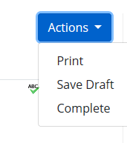
Supervisor Creates the Plan
Three Tab Menu
Notes:
In the center of the page, you can find tabs labeled “Mission Statement, Work and Behavior Expectations and Resources.”
It is important that you proceed through each of the tabs to properly complete the task. The resources page is significant because it houses useful resources and is the last section in Step 1. (Navigate to the 3rd choice in the action drop down box with the choice to print the plan. Although the system is automated, you can still print the plan or evaluation if needed.)

Slide 26
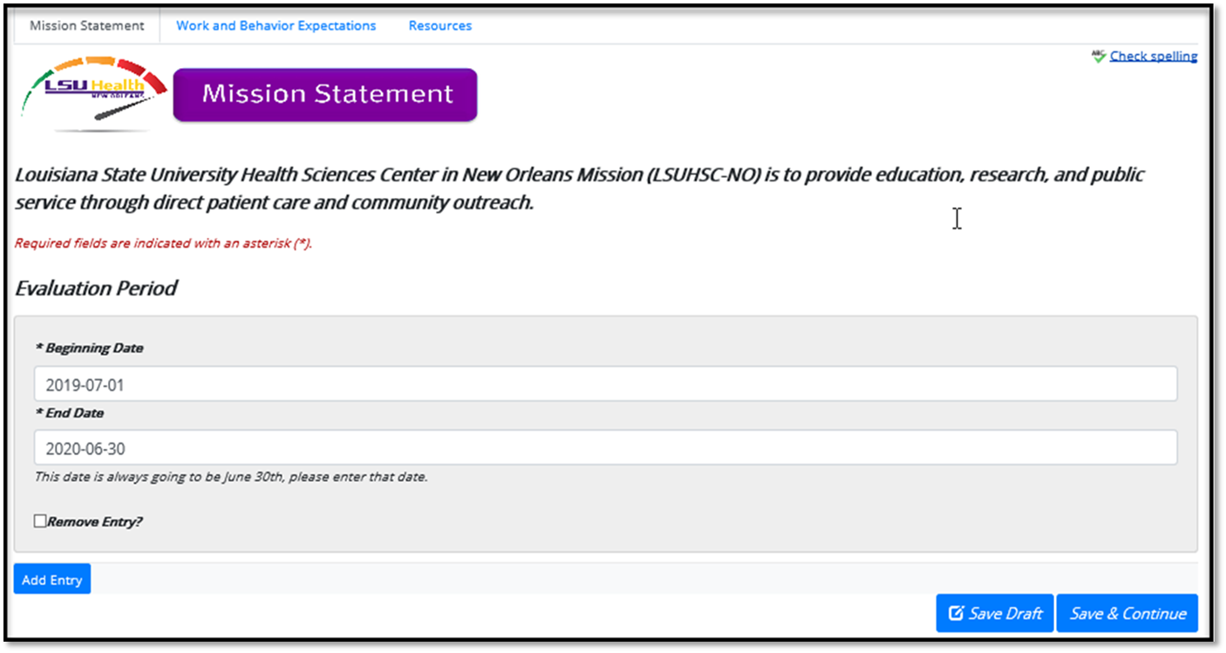
Supervisor Creates the Plan
Step Instructions
Mission Statement
Evaluation Period
Employee name
Notes:
The Online Performance Evaluation System is for the supervisor to create the performance plan based on LSUHSC’s Mission Statement, the Job Description, and guidance from State Civil Service’s resources and Bank of Expectations.
In the evaluation period section, the selected period should reflect the following format:
July 1, 2021- June 30, 2022 (Current Employees)
-OR-
Start Date – June 30, 2022 (Employees Hired after the completion of the Initial Planning Period).

Slide 27
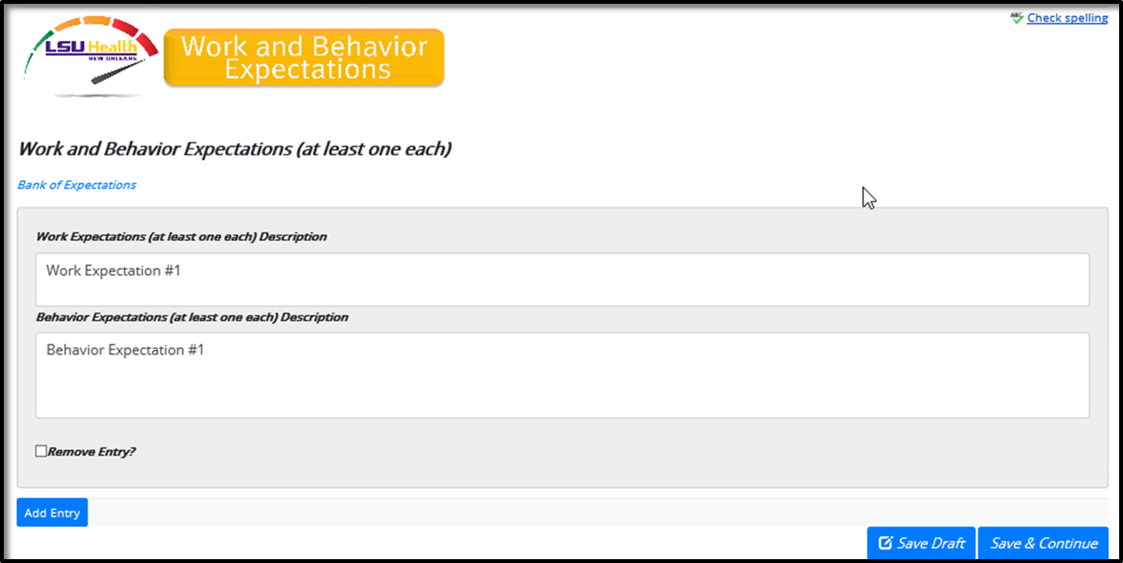
Supervisor Creates the Plan
Work and Behavior Expectations
Link to State Civil Service Bank of Expectations
PES TIPS | BE SPECIFIC! Do not include any medical information in an evaluation or planning. (i.e. FMLA, LOA, etc.)
PES TIPS | BE SPECIFIC! When formulating these expectations, follow the SMART model. Be Specific, and make goals Measurable, Attainable, Realistic, and Time-Based.
Notes:
Further down on the same page, you will see the fields to enter the work and behavior expectations….you have two options for creation of the work and behavior expectations.
You can either use the bank of expectations link above, which will direct you to the State Civil Service website with a list of sample expectations.
-OR-
Is to create three to five well thought out SMART Expectations.
Specific
Measurable
Attainable
Realistic
Time-Based.

Slide 28
Supervisor Completes the Plan
Resources
Before submitting, review resources to resolve any questions you may have.
Select “Save Draft” to save progress and return later or “Complete” to initiate the next step.
Hyperlinks to the State Civil Service website are provided as resources!
Notes:
On the Resources page you can find hyperlinks to State Civil Service website. Once you have viewed the resources of your choosing, you may select “Save Draft” if you wish to finish the task later or select “Complete” to submit the plan. Once again, it is important that you navigate through all tabs and remember to hit complete so the plan may be moved to the next step in the process.

Slide 29
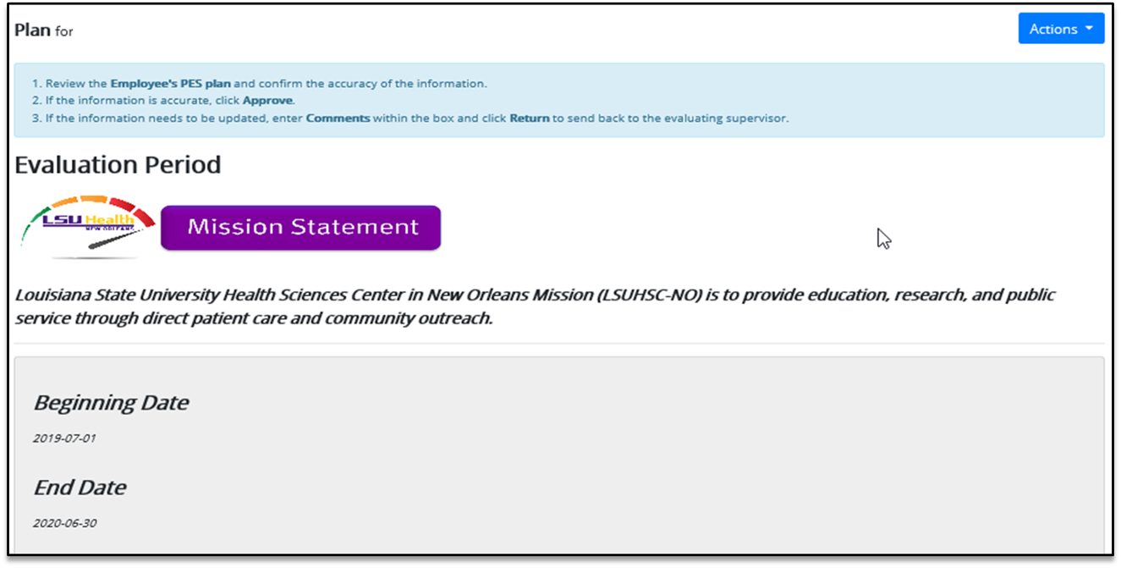
Second-Level Approves the Plan
Employee name
Employee name
Employee name
Notes:
After the evaluating supervisor completes the plan, a hyperlink will appear in the Action Items of the second-level evaluator. The second-level evaluator will review the step instructions and verify the evaluation period.

Slide 30
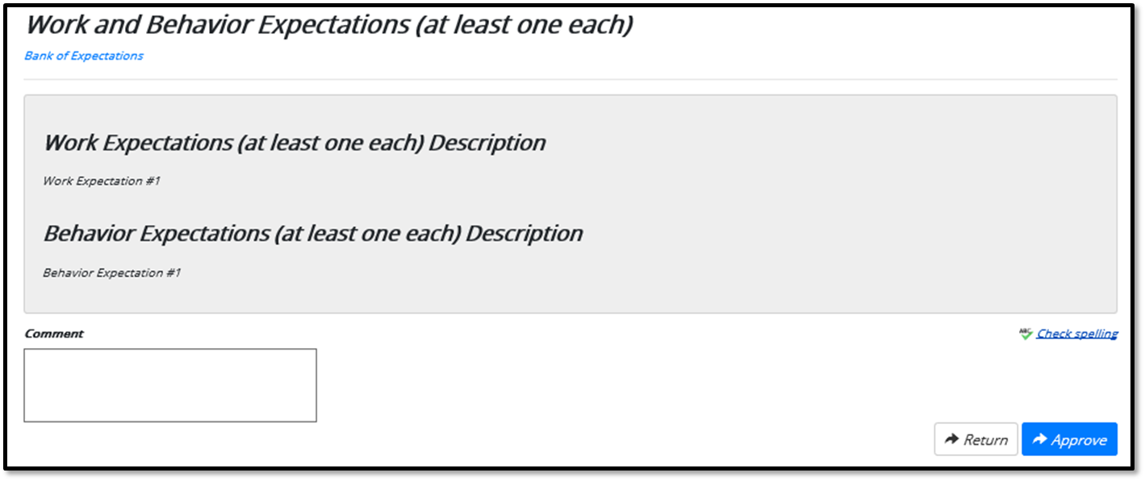
Second-Level Approves the Plan
Notes:
Remember, if you click Return, it will go back into your evaluating supervisor’s Action Items to be revised and re-completed. Once the supervisor has made revisions, it will be sent back to your Action Items to be Approved in order to move through the workflow.

Slide 31
Supervisor Acknowledges
After the performance plan meeting has taken place, the supervisor confirms
State Civil Service MANDATES the Evaluating Supervisor meet with the employee to go over the planning form every performance year.
Failure to comply may cause a rating of “Needs Improvement” to be overturned!
Notes:
The next step is so important, State Civil Service (SCS) required we add it as a necessary step before they would be approving of the Online PES model.
As with the paper form, the evaluating supervisor MUST have a formal meeting with the employee to review the performance plan. After you have met with the employee, simply click complete, to verify the meeting has taken place. Please remember that failure to comply may cause a rating of “Needs Improvement” to be overturned.

Slide 32
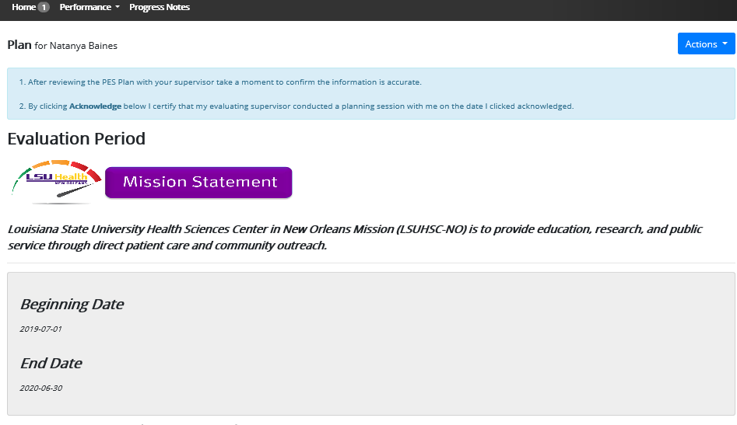
Employee Acknowledges
Employee acknowledges the performance plan
Employee name
employee
Notes:
Once you acknowledge the plan review meeting has taken place, the plan will automatically populate in the Employee’s Action Items. Just like the evaluating supervisor and second-level evaluator, the employee will click on the hyperlink. They will review the step instructions, evaluation period, work behavior expectations, etc.

Slide 33
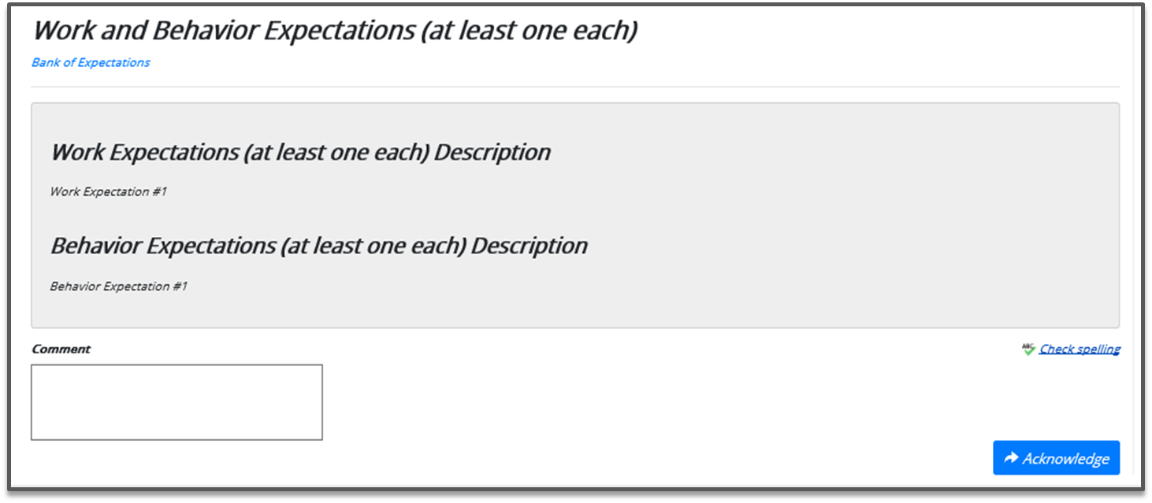
Employee Acknowledges
Employee acknowledges the performance plan
Notes:
Previously, classified employees did not have the ability to comment on plan or evaluation forms; however, that standard has changed. Employees may utilize the comment section to voice their opinions and concerns of the plan. Employee comments are not mandatory and will not stop a plan from being effective but does provide the employee with an opportunity to use their voice and feel inclusion in the process.
Once the plan is reviewed the employee will simply acknowledge by clicking the acknowledge box. Please keep in mind that acknowledgement does not signify agreement; it simply means the employee acknowledges they have reviewed the plan.

Slide 34
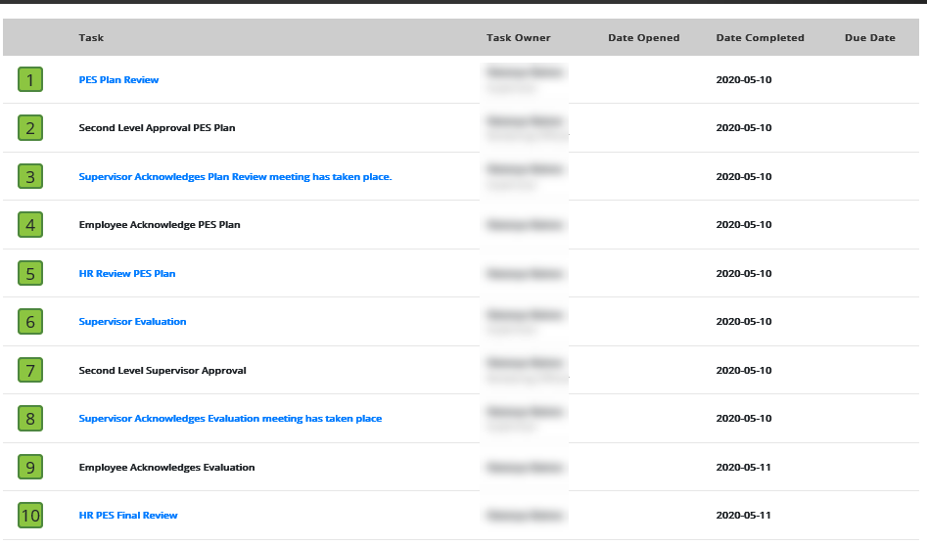
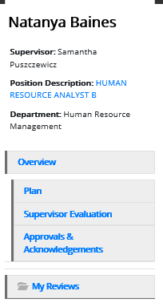
Audit Trails
Approvals & Acknowledgements
History
Employee Name
Supervisors name
Notes:
Blue hyperlinks redirect you to the pages housing information from the various steps completed.

Slide 35
Important Information!
Promotions and Reallocations
When an employee is promoted or reallocated during the performance evaluation period, their evaluation for their current role MUST be completed prior to the start date of their new role.
When a classified employee begins their new position during the performance evaluation period, the Planning for the current year’s PES MUST be completed within 90 days of their start date.

Slide 36
Employee Right to Appeal
Permanent Classified Employee(s) who receive a rating of “Needs Improvement” may request an Official Agency Review
Request for Review can be obtained online or through The Office of Human Resource Management
Form must be postmarked or received by the HR no later than September 15th
Supporting documentation must be attached
Agency Reviewer will review the employee’s request, evaluation given and supporting documentation
Notification of decision will be provided by October 15th
Notes:
Supervisors, please keep in mind if you have an employee that receives a rating of needs improvement, they have a right to appeal their rating. It is important that you read over the employee rights because this information will be communicated to them.

Slide 37
Thank you all for your continued hard work!
If you have any questions, feel free to contact Talent Development team at talentdevelopment@lsuhsc.edu
Notes:
There are intentionally no notes on this page
ADD PAGE ABOUT EMPLOYEE RELOCATIONS OR PROMOTIONS

