Slide 1
Ergonomics Working from Home
Julia Brantley, MOTS
LSUHSC Occupational Therapy Department
Workplace Wellness Capstone

Slide 2
Ideal Body Position: Difficult to Achieve at Home
Feet flat on the floor
Hips and Knees at 90° angles so that thighs are parallel to floor
Elbows bent at 90° and wrists at neutral position
Monitor- top of screen should sit just below eye level
Monitor should be arms length away (18”-36”)
Should have 2-3 inch gap between back of knees and front edge of chair

Slide 3
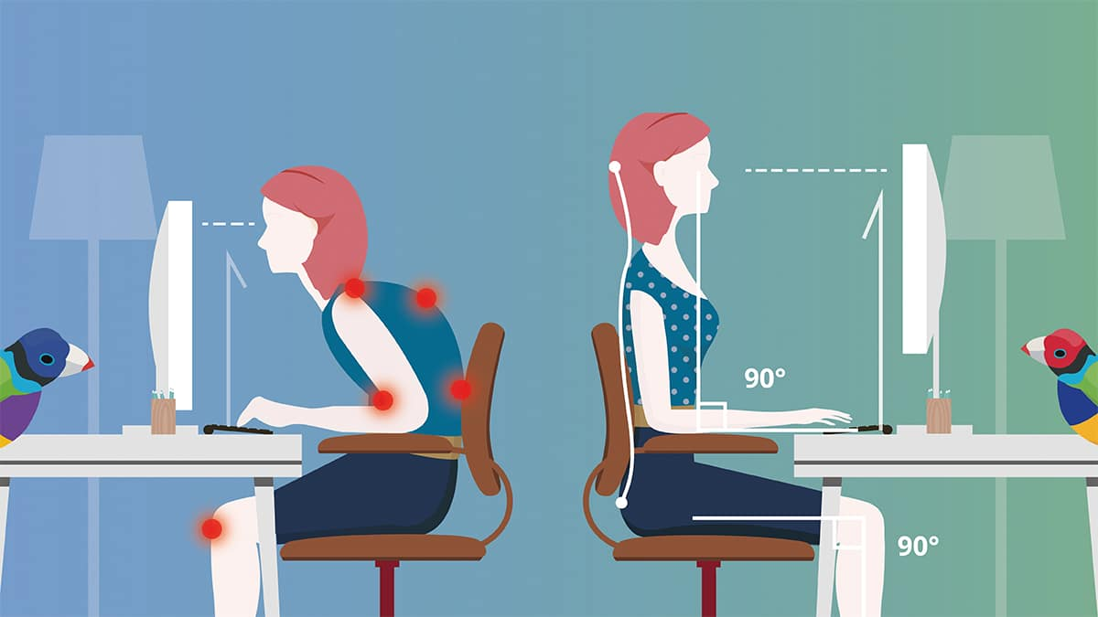
Ideal Body Position

Slide 4
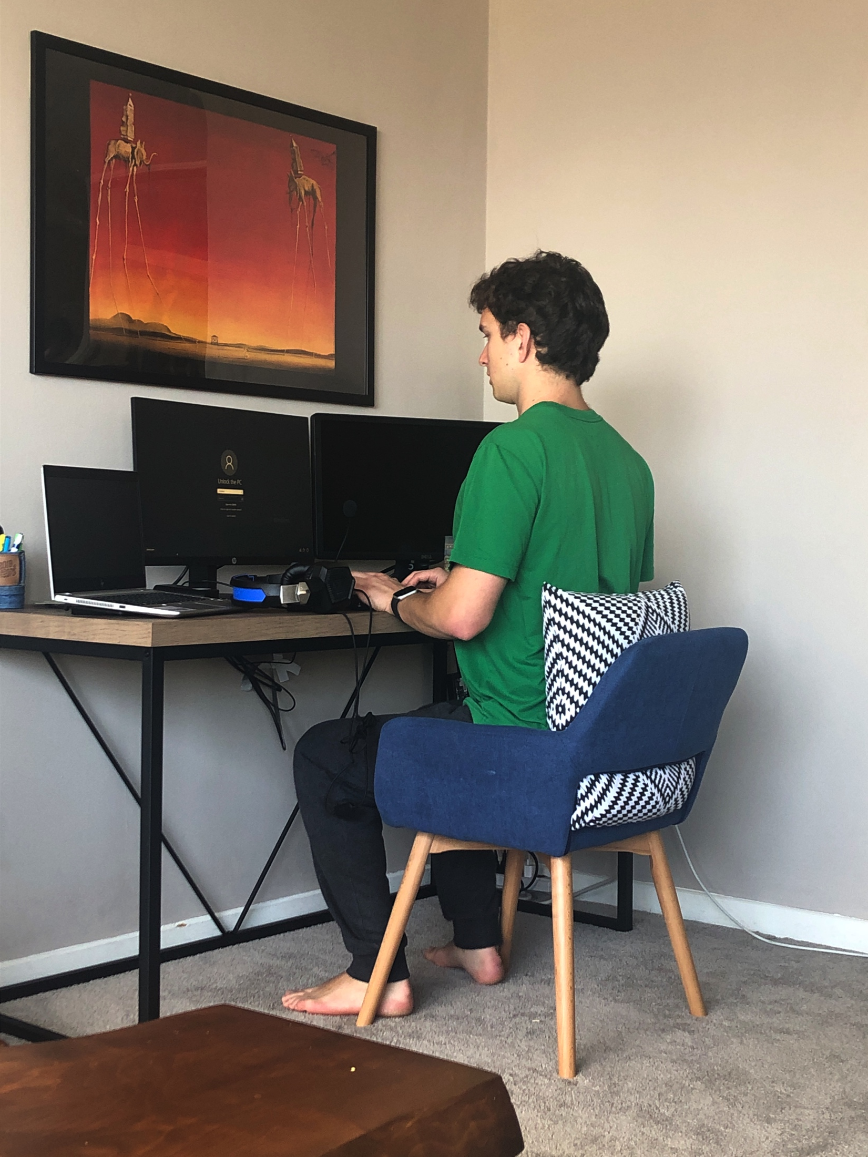
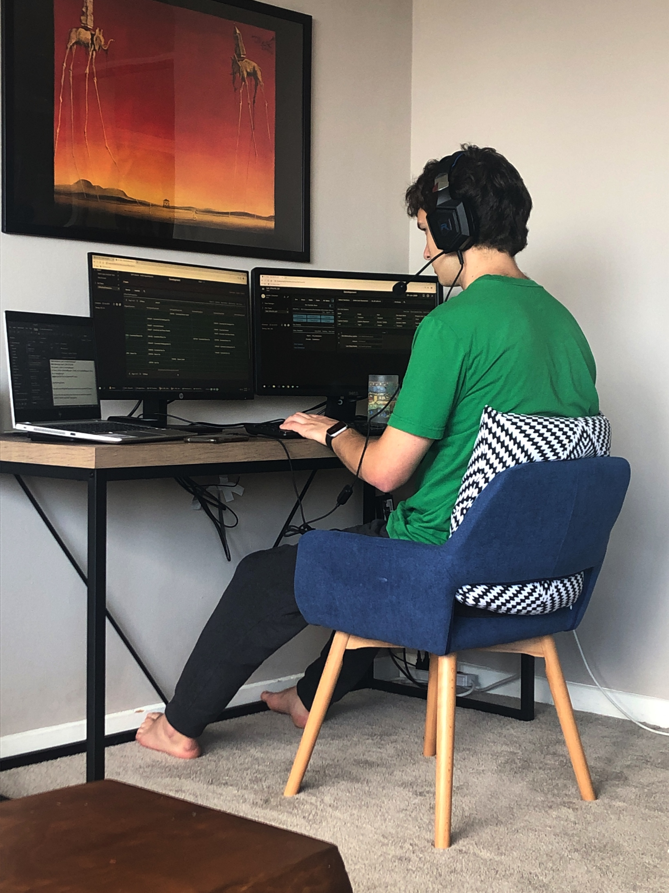
10 Quick Tips for Easy Ergo at Home
1. Look at your angles
Use your phone’s timer or have a family member take a side profile picture of you at your work station—this will give you an idea how far off you are from ideal position.
expectations
vs.
reality

Slide 5
10 Quick Tips for Easy Ergo at Home
2. No position should be adopted for excessive amounts of time; aim for 5 minutes of movement per hour.
Set a timer to change position and/or get up and stretch.
ErgoMinder: a streamlined way to set workday timers
3. Sitting, more than standing, places strain on the back.
Get creative with standing desk options. (More on this later.)
4. Lumbar support
Tight roll a towel and place at lumbar spine for additional support of curvature.

Slide 6
10 Quick Tips for Easy Ergo at Home
5. Set up primary and secondary reach zones
Items you are using consistently (mouse, keyboard, phone, chargers, notepad/pen) should be placed close to decrease reaching. Secondary items towards back of desk area (water, coffee, textbooks).
6. Bifocals
If you wear bifocals, you will need to lower the monitor screen slightly so that you are not tilting your chin up to compensate.
7. Have tumbler (with lid) filled with water at work station at all times
This will promote hydration and keep water from getting on electronics.

Slide 7
10 Quick Tips for Easy Ergo at Home
8. Consider the cognitive workload: how much mental effort is used to accomplish a task; this includes new learning of virtual platforms!
Schedule your day to include items that are higher in cognitive workload at the beginning of the day; put more streamlined, rote tasks towards the end of the day.
9. Consider switching your work place with family members
Give everyone equal time at the “good spot” or standing option.
10. Consider purchasing blue light blocking glasses
There are several inexpensive options from Amazon. Also see next slide for digital eye strain prevention ideas.

Slide 8
From the American Optometric Association:

Slide 9
Items from around the house
Boxes & books
Plastic bins or containers
Take a removable shelf out of Ikea furniture to use on top
Towels
Pillows
Couch cushions (could be a foot prop)

Slide 10
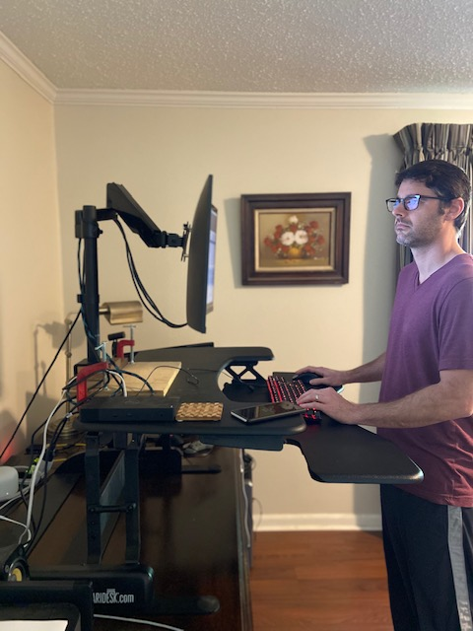
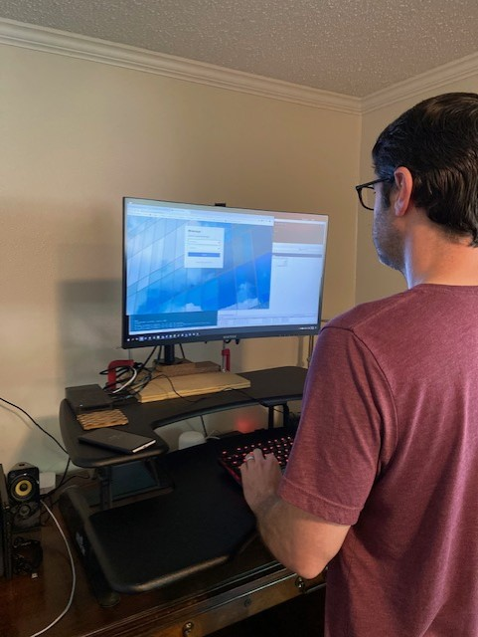
Examples of Ergonomic Home Workspaces
Notes:
Left:
Top of monitor just below eye level
It would be ideal if his forearms were more parallel with the floor and wrists more neutral
Right:
- Primary and secondary reach zones

Slide 11
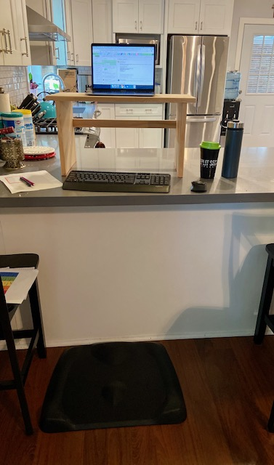
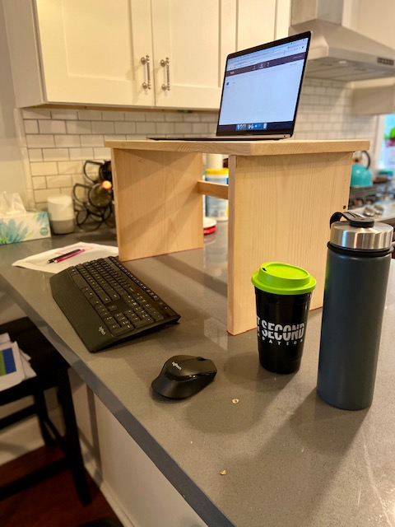
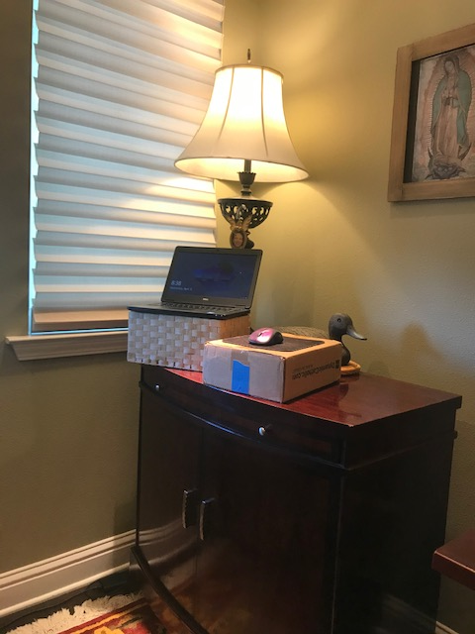
Makeshift Standing Desks
Notes:
Left:
uses stool
notice waterbottles on side!
when using a standing desk or elevation, you really need a wireless keyboard and mouse to make this successful
Right:
various boxes
don’t forget to

Slide 12
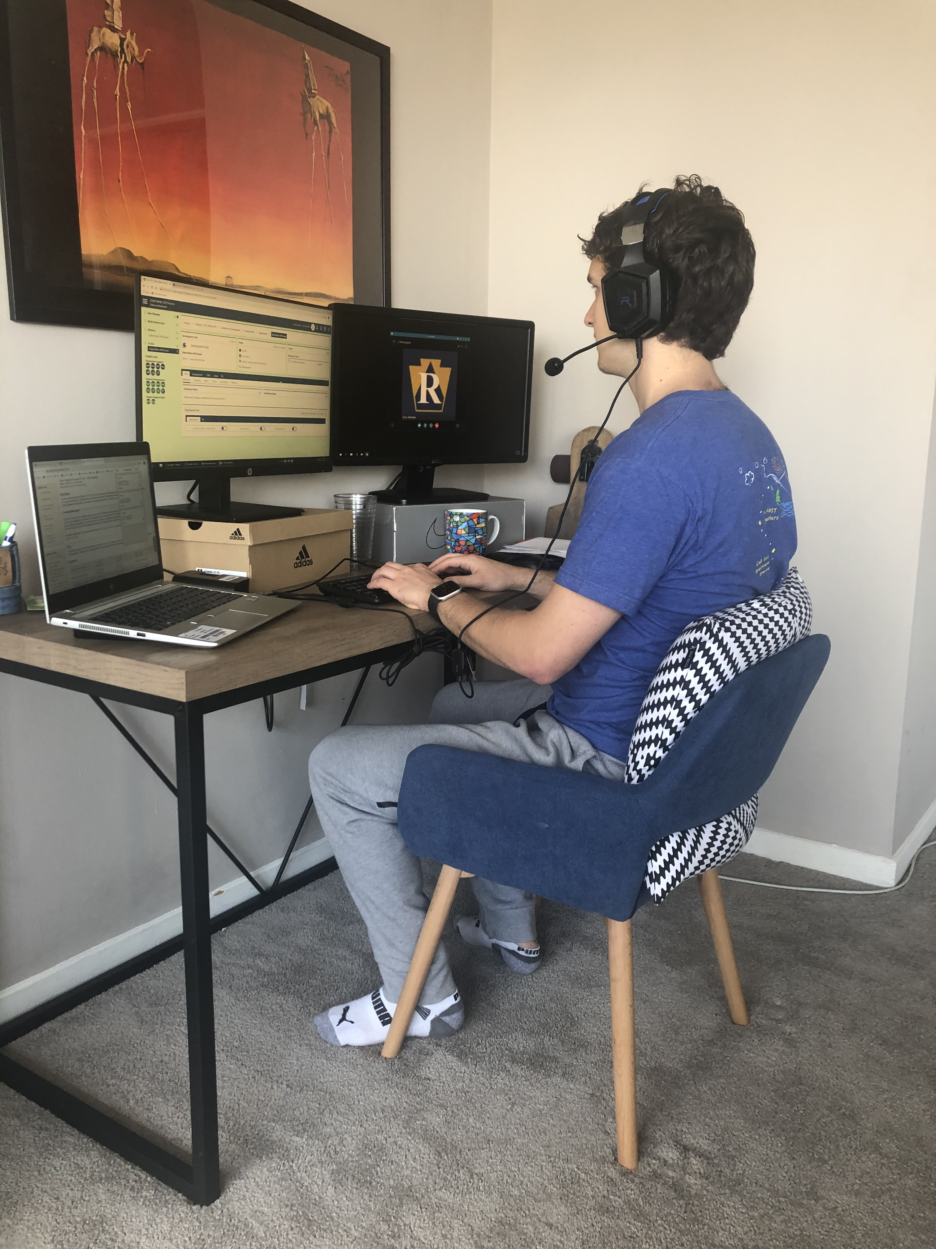
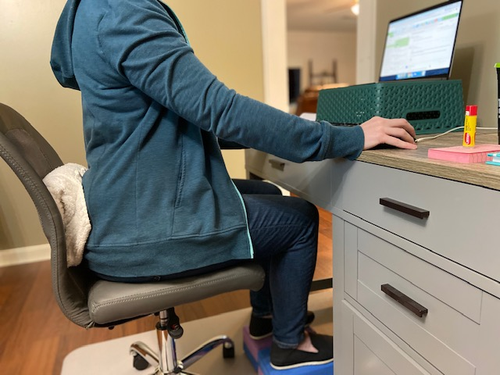
Examples of Ergonomic Sitting Desks
Notes:
Left:
Shoeboxes to raise the height of the monitors
Wrists in a nice neutral position
Pillow for lumbar support
Right:
Storage box to raise the height of the monitor
Towel for lumbar support
Notice the yoga blocks to ensure the knees are at 90 deg!!

Slide 13
For Questions: Please contact:
Mary Delahoussaye, MOT, LOTR
Occupational Therapy Instructor
mdelah@lsuhsc.edu

