Slide 1
Medicaid
Managed Care Incentive Payment
Program (MCIP)
Louisiana Quality Network
July 19, 2019

Slide 2
What is MCIP
  Leverages federal regulation to allow LDH to include incentive arrangements in Managed Care Organization (MCO) contracts.
  Participation is voluntary for MCOs and hospitals
  For a fixed time (5 years)
  LDH has established specific metrics and milestones that must be met by participating MCOs and hospitals.

Slide 3
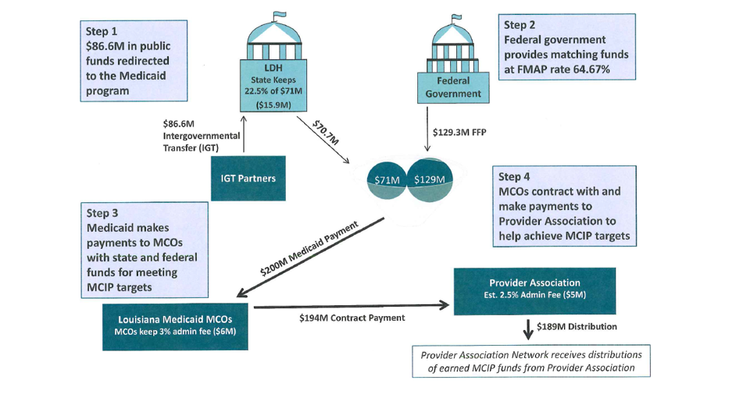
MCIP Funding Flow

Slide 4
Louisiana Quality Network (LQN)
One of two hospital networks formed to contract with participating MCOs on behalf of participating hospitals
LSUHSC-NO functions as network administrator and liaison with the MCOs for LQN.
Hospitals who elect to participate must be a member of one of the two established Networks
Operating Committee has oversight of the operations of the network

Slide 5
Participating Hospital Responsibilities
Participation in MCIP network contracts
Incentive payments are based on each organization achieving specific metrics and milestones
Validate, analyze, and report data related to metric achievement
Share best practices and protocols
Adhere to any protocols and standards approved by the network
Meet reporting deadlines to LSUHSC-NO, MCOs and LDH

Slide 6
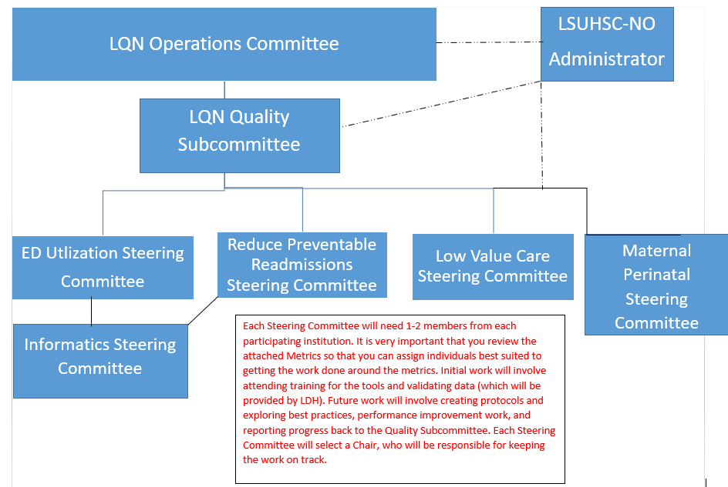
LQN Committee Structure

Slide 7
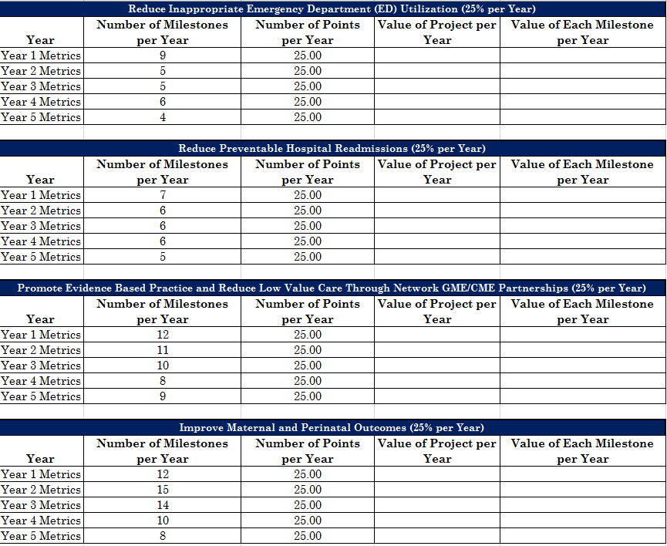
LQN Metrics

Slide 8
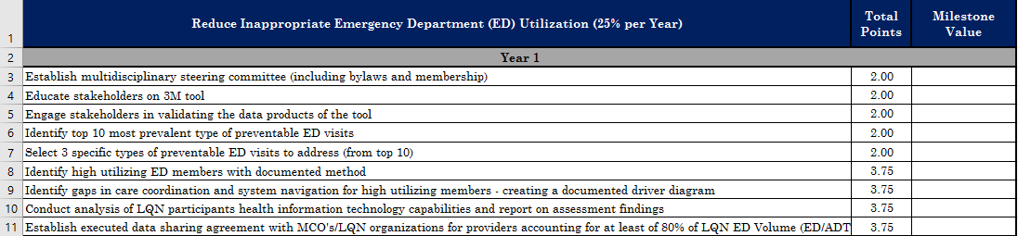
Example of Year 1 Milestone

Slide 9
Updates
LSUHSC-NO is establishing Steering Committees for each measure
Quality Plan has been developed, awaiting approval
Contract negations are ongoing between the MCOs, Representatives of the Network, and LSUHSC-NO
Contracts must be fully executed by July 31, 2019 in order to proceed with the MCIP Program.

Slide 10
Next Steps
Schedule training on the 3m and Milliman tools with LDH for Network Members sometime in early August
Set-up bi-weekly conference calls to update network members on progress starting August 1
Set-up LQN Steering Committee meetings to begin work on each individual measure starting August 1
Set-up a meeting with LDH and the LQN Informatics Steering Committee to better understand LDH’s vision for real time feeds between hospitals, MCOS and PCPs related to ED Utilization and Admissions ASAP
Convene LQN network hospitals representatives to facilitate coordinated ED ADT feeds and sharing ASAP

