Slide 1


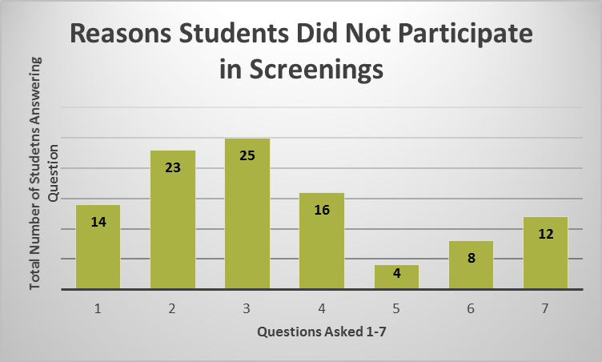
Ryan Pasternak, MD¹, Colleen Bodet, BSN, ARPN¹, Temple Barkate², Katie Wendt³ , Jake Quinton, MPH² , Kelsey Hundley² , Jeff Kendrick² , Kelsey Hundley², Farinaz Khan, MPH², Monica Lai², Josh Plant, MD², Alyssa Russell², Sara Winkler, MPH⁴, Anna Bailey Gibson⁵ , Danielle Stewart⁵
Implementation of STI Screenings in
New Orleans High Schools
The Problem
Figure 1. NOARHP STI Screening Timeline
Results
The State of Louisiana…..
Ranks 1st in the US for GONORRHEA with 8,669 reported cases (188 per 100,000 population)
Ranks 2nd in the US for CHLAMYDIA with 28,739 reported cases (625/100,000)
Ranks 3rd in SYPHILIS (primary and secondary) with 423 reported cases (9.2/ 100,000)
Does NOT MANDATE SEXUAL EDUCATION in its public schools, reflected by a series of legislative events occurring in May 2015:
  House bill mandating comprehensive sexual education (Orleans Parish only) was turned down 59 to 34 during floor debate.
  Both Senate and House introduced bills authorizing all Orleans Parish public school students to complete the full YRBS* Louisiana legislative session ended before either bill could be discussed.
*While Louisiana participates in the CDC’s “Youth Risk Behavior Surveillance System” the only
question out of 14 about sexual health that students are allowed to answer is if they were ever
taught about HIV/ AIDS. 26.9% of Louisiana students report that they have never been taught
about HIV/AIDS compared to only 16.9% nationwide.
Screening day in school nurse’s office during week of STI lesson
Figure 3: Self-Reported Non-Participation in NOARHP Screenings
Opt-In screening consent handed out
Students return consents by day of screening
STUDENT RESPONSES
1: I was absent
2: Screen available to me at a doctor’s office/ clinic
3: I do not need to be screened
4: I did not want to be screened at school
5: I was not sure who would know the results
6: My family/ partner did not want me to be screened
7: Other
Students testing positive given medication for themselves + partner(s)
Results given back by LSU Pediatrics residents 2 weeks after screening
Samples sent to OPH for testing and returned to SBHC office
Results
Limitations
Figure 2. Standard SBHC screenings compared to
NOARHP-implemented screenings
Number of individuals screened is limited to those who return their parental consent packets by the day of the screening.
Students must be pulled out of class in order to participate in screenings.
SBHC staff/ residents are pulled away from their regular clinic duties in order to perform these off site screenings. Lack of laptop for data entry creates additional work for SBHC staff.
A school nurse’s office is not the ideal setting for discussing confidential health information.
Our Solution
The mission of New Orleans Adolescent Reproductive Health Project (NOARHP) is to ensure that all Orleans Parish public high school students will have access to age-appropriate, evidence-based, culturally sensitive and comprehensive reproductive health education, leading to safer, more responsible reproductive health decisions. This mission is accomplished through a 10-course curriculum implemented in New Orleans public high schools.
LSU Health Sciences Center-New Orleans Department of Pediatrics oversees School Based Health Centers (SBHCs) on the grounds of three local high schools; centers provide many health services to students, including confidential STI screenings.
In an attempt to expand the reach of these services, NOARHP implemented STI screenings—in conjunction with reproductive health education– at high schools without an on campus SBHC.
SBHC staff and NOARHP volunteers set up confidential testing sites, collected urine samples for chlamydia and gonorrhea PCR testing and returned to campus with results two weeks later. These screenings occurred the same week as the NOARHP lesson on STIs.
\
STI screening data is presented here in Figure 2.
Future Directions
NOARHP will implement 2 more screenings in the 2015-2016 school year.
NOARHP has secured a laptop computer to help streamline data entry for all future screenings.
LSU Dept. of Pediatrics and the SBHCs will continue to expand support of these screenings. This will include the addition of dedicated clinic personnel to these screenings and sending NOARHP leaders to national training seminars.
Many students reported on their follow-up survey that the reason why they did not get screened was because screening is available at their doctor’s office. This could be one of the reasons why the total number of students screened at each screening is not very high. Further elucidation as to whether students are actually taking advantage of screenings at their doctor’s office is warranted.
NOARHP will continue to look into ways to increase the number of STIs screened, such as HIV.
 | SBHC Screenings | NOARHP Screenings
Total Participants | 1373 | 71
Positive Dx (CT and/or GC) | 65 | 6
% of Total Participants | 5% | 8%
Above data represents four different screenings performed at three different New Orleans high schools between the Spring of 2014 and the Spring of 2015
(1) LSUHSC Department of Pediatrics School Based Health Centers (2) LSUHSC New Orleans MD candidate (3) LSUHSC New Orleans PA candidate (4) LSUHSC New Orleans MPH candidate (5) LSUHSC New Orleans BSN candidate

