Slide 1
REGULATORY BINDERS
APRIL 4, 2023

Slide 2
Objectives
To provide guidance for research investigators and study teams on organizing regulatory binders.

Slide 3
Regulatory Binders
What is a purpose?
Provides a framework for organizing essential study documents
Ensures compliance with Good Clinical Practices
Who is responsible for maintaining the regulatory binder?
A delegated member of the study team, usually a coordinator
How can a regulatory binder be stored?
On paper in physical binders or electronic (i.e., secure drive, eReg system)
What types of studies should maintain a regulatory binder?
ALL STUDIES SHOULD HAVE A REGULATORY BINDER, NOT JUST CLINICAL TRIALS

Slide 4
Regulatory Binders Tips
Documents should be stored in reverse chronological order
The basic regulatory binder and the study subject binder should be separate
Study subject binders should be stored securely
If paper, in a locked office
If electronic, in a password-protected folder
Binders should be maintained for the life of the study plus 10 years, or more if dictated by a sponsor

Slide 5
Basic Regulatory Binder Sections

Slide 6
Personnel
Personnel
Documentation | Additional Information
Curriculum Vitae (CV) | • Required for PI and Sub-investigators • Signed and dated • Updated every 2 years
Current license and/or certifications | • Required for all professional study staff • Dental, medical, pharmacology, etc.
FDA 1572, as applicable
CITI Training Completion Certificates | • Required for all study team members • Biomedical Research • GCP Drug or Device Development, for clinical trials
Delegation Log | • Signed and dated
IRB
Sponsor
Monitoring
Lab
RNIs
Drug/Device
Other
Notes:
Delegation Log: Documents the signatures and initials for all staff that collect and record study data, and lists the study-related procedures each staff member has been delegated by the PI

Slide 7
IRB Approvals &
Correspondence
Personnel
IRB
Documentation | Additional Information
Submission Forms | • Initial Submission • All Amendment Submissions • All Renewal Submissions • All Renew/Amend Submissions • Closure Form
Outcome Letters | • Approvals of initial, amendment, renewal, and renew/amend submissions • MRSA Letters • Deferral Letters
Other IRB Correspondence
Protocol | • All IRB-Approved Versions
Sponsor
Monitoring
Lab
RNIs
Drug/Device
Other

Slide 8
IRB Approvals &
Correspondence
Personnel
IRB
Documentation | Additional Information
Consent and/or assent forms, as applicable | • All IRB-Approved Versions
HIPAA Authorization, as applicable | • All IRB-Approved Versions
Blank Study Instruments, as applicable | • Data collection forms • Questionnaires • Case Report Forms (CRFs) • Other instruments • Emails • Flyers • Other materials
IRB-approved Educational Materials or other study information designed for subjects | • Brochures • PowerPoint Slides • Study-Specific Instructions • Other materials
Sponsor
Monitoring
Lab
RNIs
Drug/Device
Other

Slide 9
Sponsor Documents
Personnel
Documentation | Additional Information
Award Documents | • Grant application • Notice of Grant Award (NGA) or clinical trial agreement (CTA) • Progress reports
Sponsor Correspondence
IRB
Sponsor
Monitoring
Lab
RNIs
Drug/Device
Other

Slide 10
Monitoring Records
Personnel
Documentation | Additional Information
Monitoring Log
Data & Safety Monitoring Board (DSMB) Reports
Sponsor Monitoring Correspondence | • Emails • Monitor report
Audit Reports | • Internal audit reports • External audit reports
IRB
Sponsor
Monitoring
Lab
RNIs
Drug/Device
Other
Notes:
Monitoring Log: Document any study-related activity performed to monitor the progress of the study or the accuracy/completeness of study records

Slide 11
Laboratory Documents
Personnel
Documentation | Additional Information
Copies of Laboratory Certifications | • Up-to-date
CV for Lab Director
Lab Policies & Procedures
Normal Lab Values | • For Reference
IRB
Sponsor
Monitoring
Lab
RNIs
Drug/Device
Other

Slide 12
Reportable New
Information
Personnel
IRB
Documentation | Additional Information
Event Tracking Log | • Protocol deviations (PD) • Related Adverse Events (AE) • Unrelated AEs • Unanticipated Problems (UP) • Off-site PDs, AEs, UPs
Reportable Event Form | • Initial Forms • Outcome Information
Sponsor
Monitoring
Lab
RNIs
Drug/Device
Other

Slide 13
Drug/Device Information
Personnel
IRB
Documentation | Additional Information
Investigator Brochures & Safety Update Letters | • All versions
Policies and Procedures | • Dispensing of study drug/device • Security of study drug/device • Storage of study drug/device
IND/IDE Application(s)
Drug/Device Shipment and Receipt records | May be maintained by Pharmacy
Drug/Device Accountability Log | May be maintained by Pharmacy
Drug/Device Disposal records | May be maintained by Pharmacy
Sponsor
Monitoring
Lab
RNIs
Drug/Device
Other

Slide 14
Drug/Device Information
Personnel
IRB
Documentation | Additional Information
Temperature Logs for Drug/Device Storage | May be maintained by Pharmacy
FDA Correspondence | • Email, mail communications • Annual report
Sponsor
Monitoring
Lab
RNIs
Drug/Device
Other

Slide 15
Other Documentation
Personnel
Documentation | Additional Information
Other Regulatory Review Documents | • IBC • Radiation Safety • Other IRB approval letters
Other Documentation | • Anything not outlined above that the study team wants to maintain with the rest of the study files
IRB
Sponsor
Monitoring
Lab
RNIs
Drug/Device
Other
Other

Slide 16
Study Subject
Binder Sections

Slide 17
Individual Study Subject Information
Subject Logs
Eligibility
Documentation | Additional Information
Logs | • Screening • Enrollment/ Randomization • Compensation
Eligibility Checklist | • Signed & dated by staff confirming eligibility • Lists specific inclusion/exclusion criteria
Consent Form(s), HIPAA Authorization(s), and Notice of Privacy Practice | • Signed & dated • All versions
Individual Case Report Forms
Completed Study Instruments
Visit Schedule Log
ICF, HIPAA, NPP
Subject CRFs
Instruments
Schedule

Slide 18
eReg Binders at LSUHSC

Slide 19
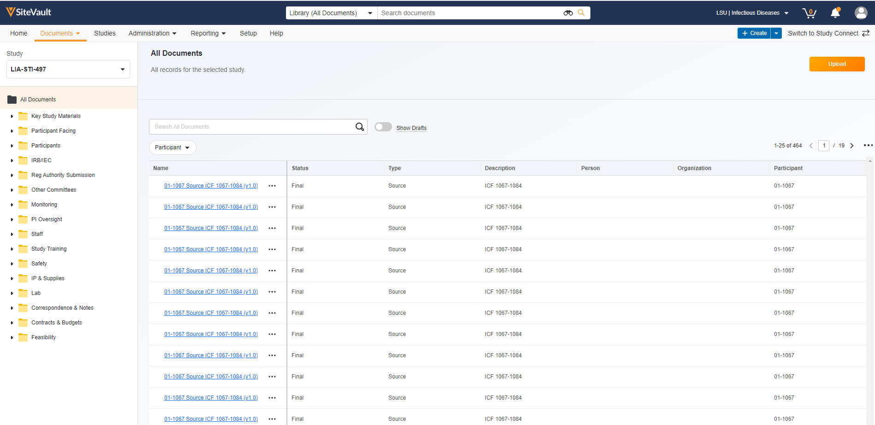

Slide 20
Save the Date!
Date | Time | Topic
05/03/2023 | 12:00PM | Expanded Access Use of a Test Article
06/07/2023 | 12:00PM | Non-Human Subjects Research Determinations
07/05/2023 | 12:00PM | Reliance/Single IRB

