Slide 1
CLOSING A STUDY
March 6, 2024

Slide 2
Objectives
Describe the three types of study closures that occur
Discuss PI responsibilities after closure
Walk through submitting a closure request

Slide 3
Types of Closures
There are three types of closures that can occur for IRB Protocols:
Study closures that are requested by the PI when study conduct is complete
Administrative closures by the IRB due to lapse in approval
Termination of IRB approval by the IRB due to non-compliance or misconduct

Slide 4
Study Closure by PI
A PI may request that a study be closed when:
All research participants have completed all study-related activities (i.e., interventions, procedures, follow-up); and/or the research team has collected all PHI/specimen from participants and their charts; AND,
The research team has completed analysis of all identifiable data and specimens as described in the protocol.
Note: De-identified data analysis can continue even after the IRB is closed.

Slide 5
Administrative Closures
A lapsed study that has not obtained Renewal approval by the Expiration Date will be administratively and permanently closed.
Expiration date = 60 calendar days after Continuing Review Date
continuing review date
Admin closure date if CR not approved

Slide 6
Termination of IRB Approval
The IRB may terminate IRB approval at any time in any of the following circumstances:
Serious Non-Compliance that cannot be resolved
Continuing Non-Compliance that has not been resolved
Concerns for the safety/welfare of subjects
Any other serious or continuing misconduct
Note: Except in the case where there is an imminent threat to subject safety/welfare, the IRB will usually first suspend the study to conduct an investigation into non-compliance or misconduct. The IRB will try to work with the study team to resolve any issues.

Slide 7
PI Responsibilities After Closure
Record Retention
After study closure, the PI and the study team are required to keep all research-related files, with the exception of PHI, for ten years
The files can be kept on campus or sent to storage (i.e., Vital Records or Iron Mountain)
Data Security
If the study was approved for the collection and storage of PHI, the PI must ensure the PHI is only maintained for the specified time period approved by the IRB.
After that point, the PI must destroy the PHI
Commitments to Participants
If the PI made any commitments in the consent to participants (i.e., providing information about study results, payment, etc.), s/he must honor those commitments

Slide 8
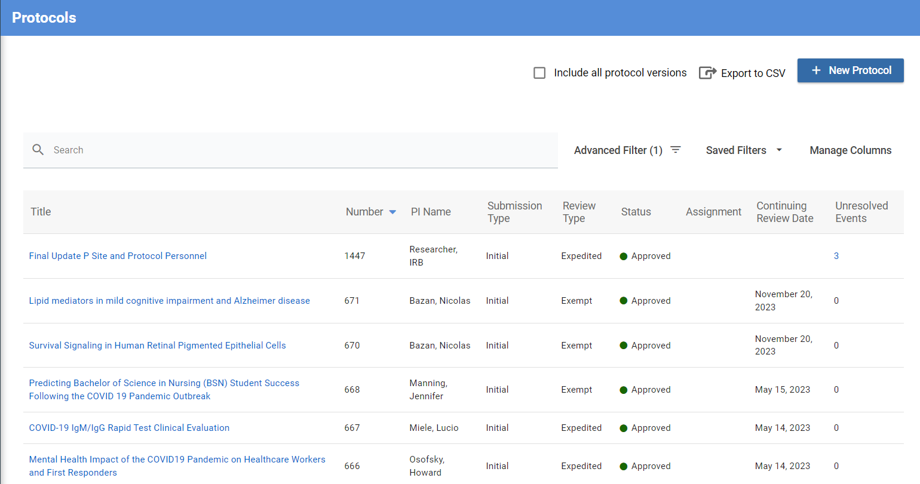
Submitting a Closure Request
1. Initiate a closure by first selecting the study you want to close.

Slide 9
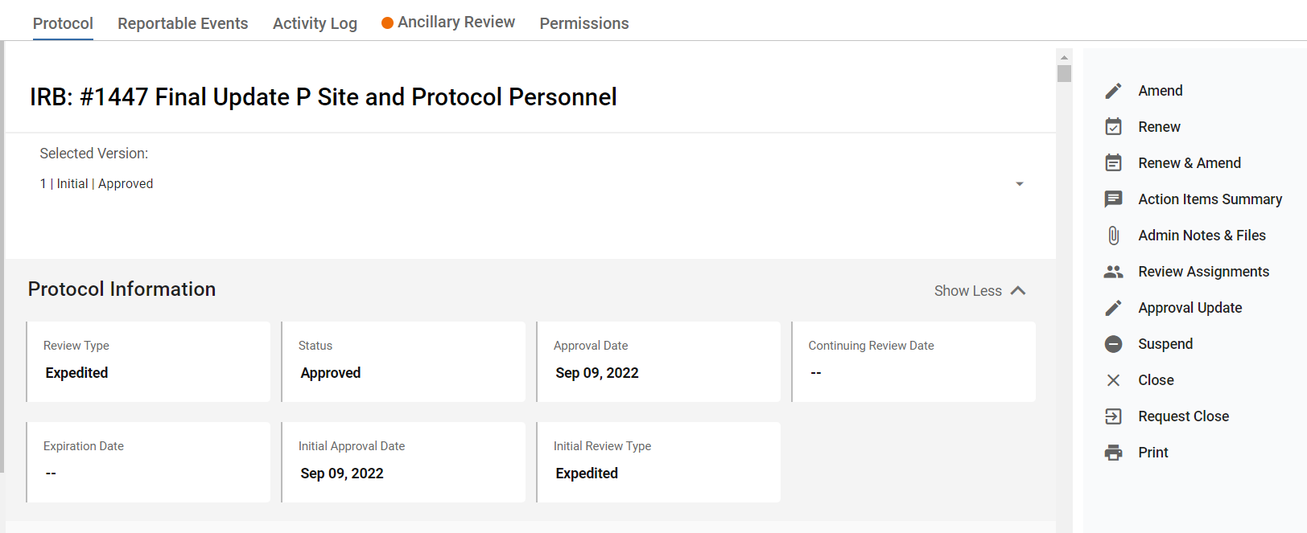
Submitting a Closure Request
2. Select the Request Close option in the right-hand menu

Slide 10
Submitting a Closure Request
3. Complete the information in the Closure Request application.
Questions include:
Reason for requesting closure
Collection/storage of PHI
Summary of progress
Enrollment numbers
Reportable New Information updates
Clinical Trial Requirements

Slide 11
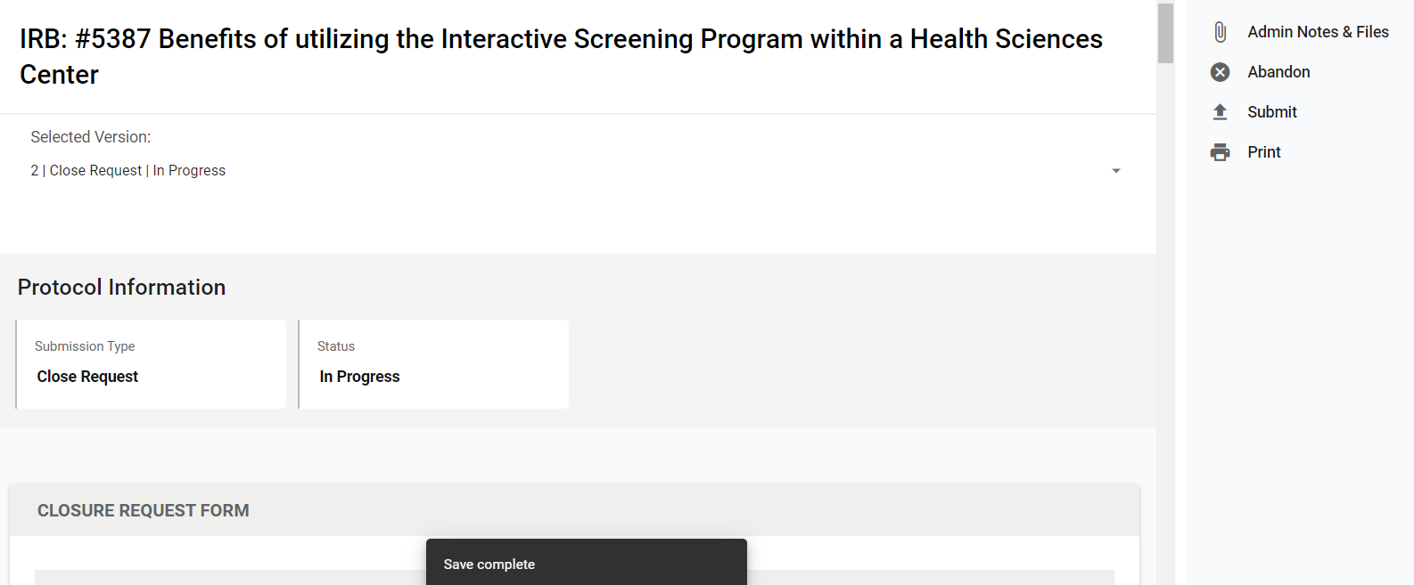
Submitting a Closure Request
4. Select the Submit option in the right-hand menu once ready for IRB review.

Slide 13
Save the Date!
April Lunch & Learn
Date: April 3, 2024
Time: 12:00 PM
Topic: Overview of the Office of Research Services

