Slide 1
HRM Liaisons Meeting
August 2023 Meeting

Slide 2
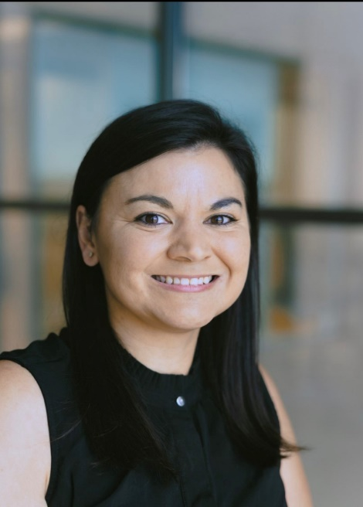
Human Resources Management
nohrm@lsuhsc.edu
HRM Leadership News!
Braylin Artigues
Manager, Talent and Organization Development
bartig@lsuhsc.edu
If you would like to have an introductory chat with Braylin, please reach out.

Slide 3
Talent Development
Braylin Artigues, Talent & Organizational Development Manager

Slide 4
HRM Talent Development
TalentDevelopment@lsuhsc.edu
Performance Evaluation System (PES) Reminder | Deadlines
2022 – 2023 Evaluation Deadline: August 11, 2023
2023 – 2024 Planning Deadline: September 8, 2023

Slide 5
HRM Talent Development
TalentDevelopment@lsuhsc.edu
Performance Evaluation System (PES)
While Talent Development is assessing the submitted evaluations, we may identify ratings of “Needs Improvement” or “Exceptional” that require supportive evidence.
Please inform your employees that Talent Development may be following up with them if they provided ratings of “Exceptional” or “Needs Improvement”.

Slide 6
HRM Talent Development
TalentDevelopment@lsuhsc.edu
Announcing In-Person Liaisons Meetings
We are excited to announce that Liaisons meetings will now be held in person!
We are utilizing a hybridized model to accommodate our stakeholders who cannot feasibly attend an in-person meeting in our Downtown Campus.
Monthly Liaisons Meetings will now be held in the Lion’s Building 6th Floor Conference Room.
Updated Outlook invitations will be distributed after this meeting!

Slide 7
HRM Talent Acquisition
Shauna Caputo, Talent Acquisition Manager

Slide 8
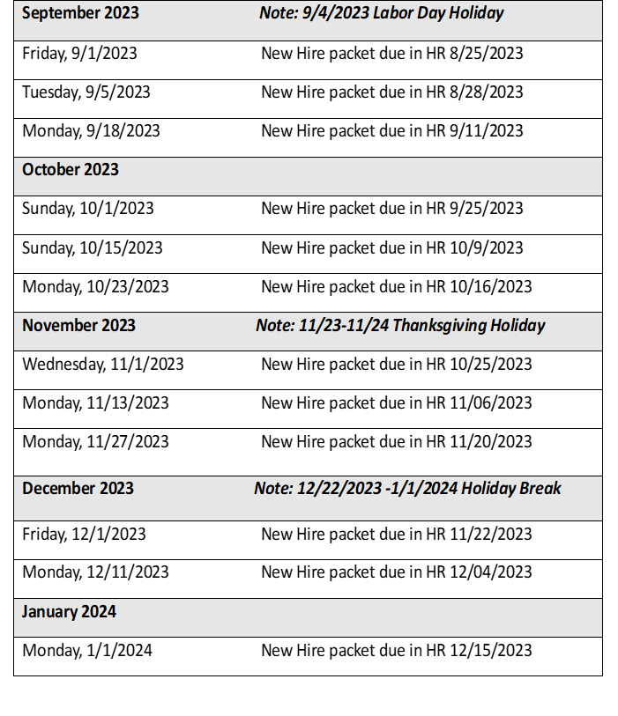
HRM Talent Acquisition
recruittalent@lsuhsc.edu
Reminder: Set Unclassified Start Dates Effective 9/1/2023
(Excludes Gratis, Classified, & Faculty)

Slide 9
HRM Talent Acquisition
recruittalent@lsuhsc.edu
Other 9/1/2023 Process Updates
All employees with an effective start date of 9/1/2023 and after, including gratis, are required to have a cleared criminal background check prior to start.
For all employees with an effective start date of 9/1/2023 and after,
I-9 documents will be completed electronically in Hire Right, including gratis employees.

Slide 10
HRM Talent Acquisition
recruittalent@lsuhsc.edu
PeopleAdmin Enhancements
  Enhancements went live 8/7/2023.
  If you had an Administrative Faculty/Unclassified position request in process prior to 8/7/2023 that did not include posting details, please complete your posting request in PeopleAdmin ATS module.
  As of 8/7/2023, HRM is posting Administrative Faculty/Unclassified positions to the LSUHSC Career Opportunities page once a position is approved and posting details have been included in the position request. The department is still responsible for external postings.
  Initiators and Department Approvers will no longer have the ability to initiate a posting request for Administrative Faculty/Unclassified positions beginning 8/21/2023.
  New PeopleAdmin Process Workflows and Guides have been uploaded to the HR website under the PeopleAdmin tab.

Slide 11
HRM Compensation
Sara Schexnayder, Assistant Director, Compensation and Talent Acquisition

Slide 12
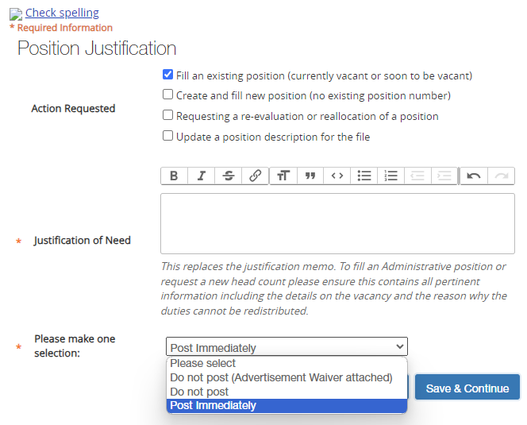
Compensation nohrmcompensation@lsuhsc.edu
PeopleAdminATS@lsuhsc.edu
All Unclassified and Administrative Faculty positions now have this new option.
Selection must be made to move the request
“Do not post” is used for re-evaluations of current jobs or updates for the file.
All in process position request should be moved through to posting ASAP.

Slide 13
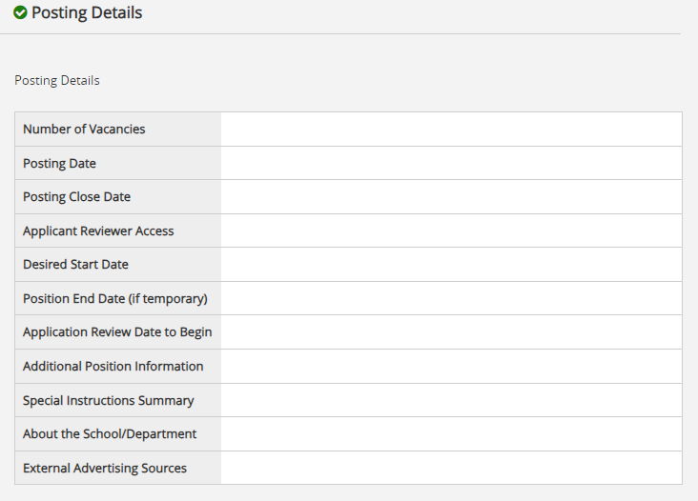
Compensation nohrmcompensation@lsuhsc.edu
PeopleAdminATS@lsuhsc.edu

Slide 14
HRM Benefits
Beth Worthen, Benefits & Retirement Manager

Slide 15
HRM Benefits
nohrmbenefits@lsuhsc.edu
2024 LSU First Wellness Credit
To qualify or to continue the $25/month premium wellness credit ($35/month for those with a covered spouse) for the 2024 plan year, the following requirements must be met:
Continue to be enrolled in LSU First for the 2023 and 2024 plan years.
Employee and covered spouse (if applicable) must have a preventive visit with a Primary Care Physician (PCP) that includes biometric screening (height, weight, BMI, & blood pressure) and preventive lab work that includes a basic metabolic panel between November 1, 2022 - October 31, 2023.
Active participation in care coordination, if identified as a candidate by HighCare, is required to maintain the wellness credit. Plan members will be contacted directly by the care coordination team through HighCare.
Both the employee and spouse must meet the requirements to qualify for the credit. If either the employee or covered spouse fails to meet the requirements to qualify for the wellness credit, no premium credit will be awarded.

Slide 16
HRM Benefits
nohrmbenefits@lsuhsc.edu
2024 OGB Wellness Credit
To qualify or to continue the $10/month premium wellness credit for the 2024 plan year, the following requirements must be met:
Continue to be enrolled one of the Pelican or Magnolia OGB healthcare plans for the 2024 plan year.
Participate in a Catapult Health Clinic or submit Primary Care Physician (PCP) Form November 1, 2022 – September 29, 2023.
  See schedule of clinics at www.TimeConfirm.com/OGB
  Access the PCP form @ https://info.groupbenefits.org/docs/OGBforms/LiveBetterLouisiana/OGBPCPForm2022-2023.pdf

Slide 17
HRM Benefits
nohrmbenefits@lsuhsc.edu
Corebridge (403b/ORP)
WEBINAR TOPIC: Enroll. Take Control of Your Future Today.
HOST: Ronnie Rodriguez
DATE: Thursday, August 24, 2023
TIME: 10:00 AM to 10:30 AM Central
LOCATION: Virtual Presentation
Register now

Slide 18
HRM Benefits
nohrmbenefits@lsuhsc.edu
TIAA (403b/ORP)
HOST: Louis Bundy
DATE: Wednesday, September 20, 2023
LOCATION: Study Room 3109 (across from the MEB cafeteria)
To schedule a meeting contact louis.bundy@tiaa.org
More information regarding supplemental retirement benefits can be found at : https://www.lsuhsc.edu/administration/hrm/supplemental_retirement.aspx

Slide 19
Working with
Facility Services
Steven Zimmerman, Director of Facility Services

Slide 20
Facility Services
szimm1@lsuhsc.edu
(504) 655-7673
Today’s Topics:
Facility Services
Submitting Work Requests
Key Policy
Building Use Policy
Signs

Slide 21
Facility Services
szimm1@lsuhsc.edu
(504) 655-7673
Facilities Services Organization Chart
Director, Facility Services
Manager of Operations
Building Systems
Building Maintenance
Housekeeping
Grounds Maintenance
Preventive Maintenance

Slide 22
Facility Services
szimm1@lsuhsc.edu
(504) 655-7673
Facilities Services
Some of what we do:
  Repairs and maintenance of facilities including:
    Plumbing
    Electrical
    Painting
    General Maintenance
    Signs
    Lock Shop
  HVAC issues
  DI water issues if from the building system
  Fire Alarm and Detection Systems
  Housekeeping
  Grounds Maintenance
  Elevators
  Pest Control
  Garbage pick-up
  Furniture Cleaning in common areas
  Sterilizers, Glass Washers, Cage Washers
  Etc.
Service Desk – (504) 568-7716

Slide 23
Facility Services
szimm1@lsuhsc.edu
(504) 655-7673
Submitting Work Requests
There are 11 different types of requests, each with different timelines.
  General Admin
  Auxiliary Enterprises
  Capital Project
  EHS
  Inspections
  Minor Projects
  PM
  Project (Planning & Const)
  Small Capital Project
  Specific Project
  Service Request

Slide 24
Facility Services
szimm1@lsuhsc.edu
(504) 655-7673
Work Requests
Service Request
  In-house work that will take 32 person-hours or less to complete and/or is less than or equal to $1000 (material/equipment costs). Work contracted out is considered a minor project.
Priority
  Emergency – respond immediately – goal to repair in 3 days
  Urgent – respond immediately but up to an hour – goal to repair in 5 days
  Routine – complete in 10 working days
  Scheduled – must provide at lease 10 working days to complete
  Service requests have a goal time but due to availability of materials or a need to contract the work out, they may take longer than the goal and/or may switch to a different type of work order.
  Call-in and then submit a request for emergencies and urgent requests.
Work Orders (Minors, EHS, Auxiliary Services)
  These do not follow the Service Request timelines.
  Generally contracted out so contract-based completion dates.

Slide 25
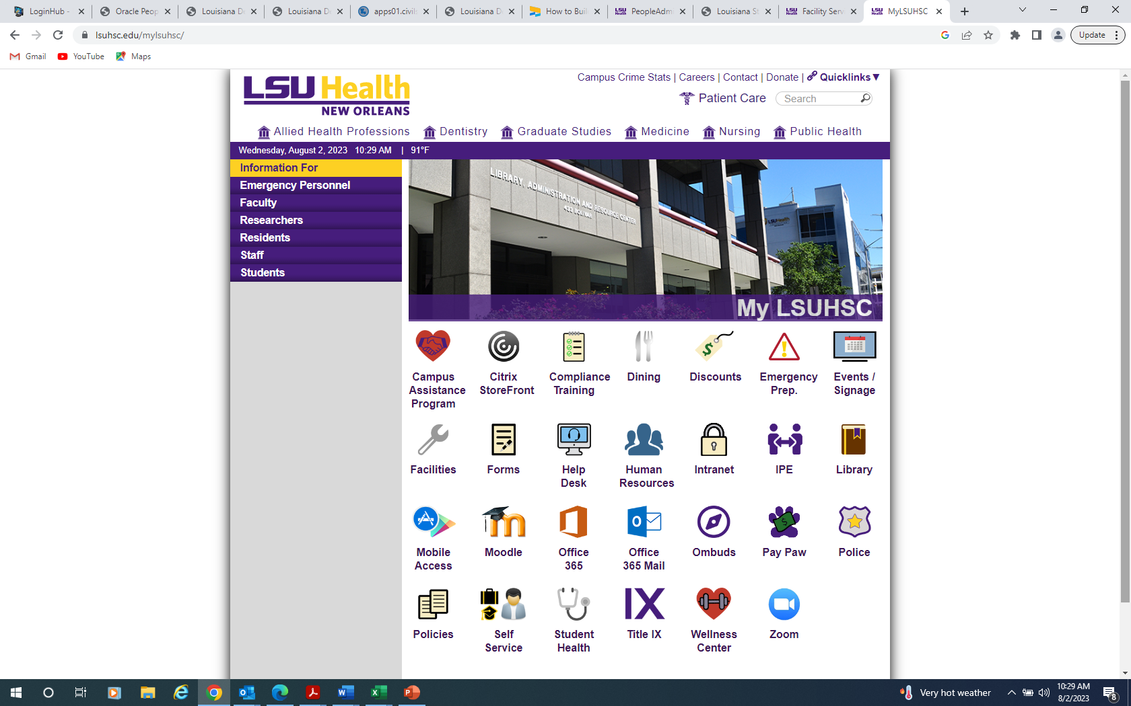
Facility Services
szimm1@lsuhsc.edu
(504) 655-7673
Submitting Work Requests
A work request is what is submitted in Maintenance Connection – Link can be found on the MYLSUHSC website. Click on the Facilities Link. On the Facilities page, scroll down to the “Submit a work Request” link.

Slide 26
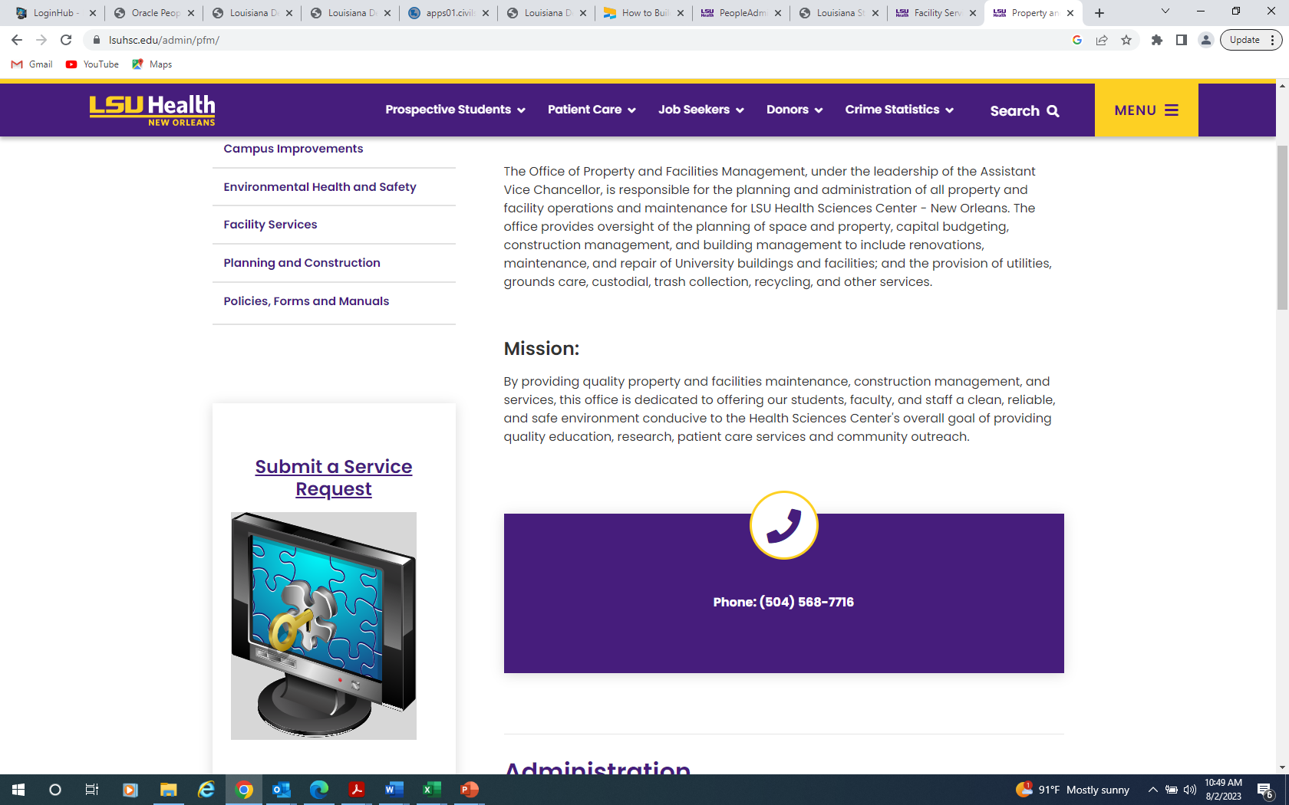
Facility Services
szimm1@lsuhsc.edu
(504) 655-7673
Submitting Work Requests
A work request is what is submitted in Maintenance Connection – Link can be found on the MYLSUHSC website. Click on the Facilities Link. On the Facilities page, scroll down to the “Submit a work Request” link.

Slide 27
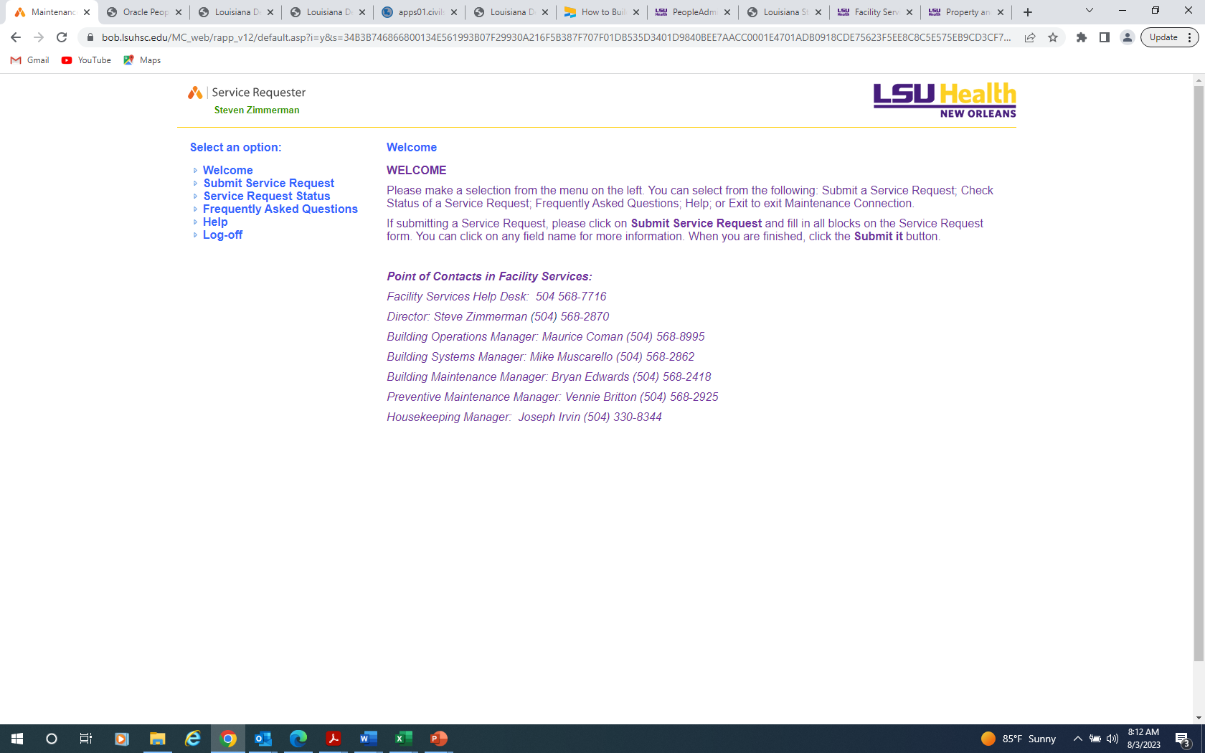
Facility Services
szimm1@lsuhsc.edu
(504) 655-7673
Submitting Work Requests

Slide 28
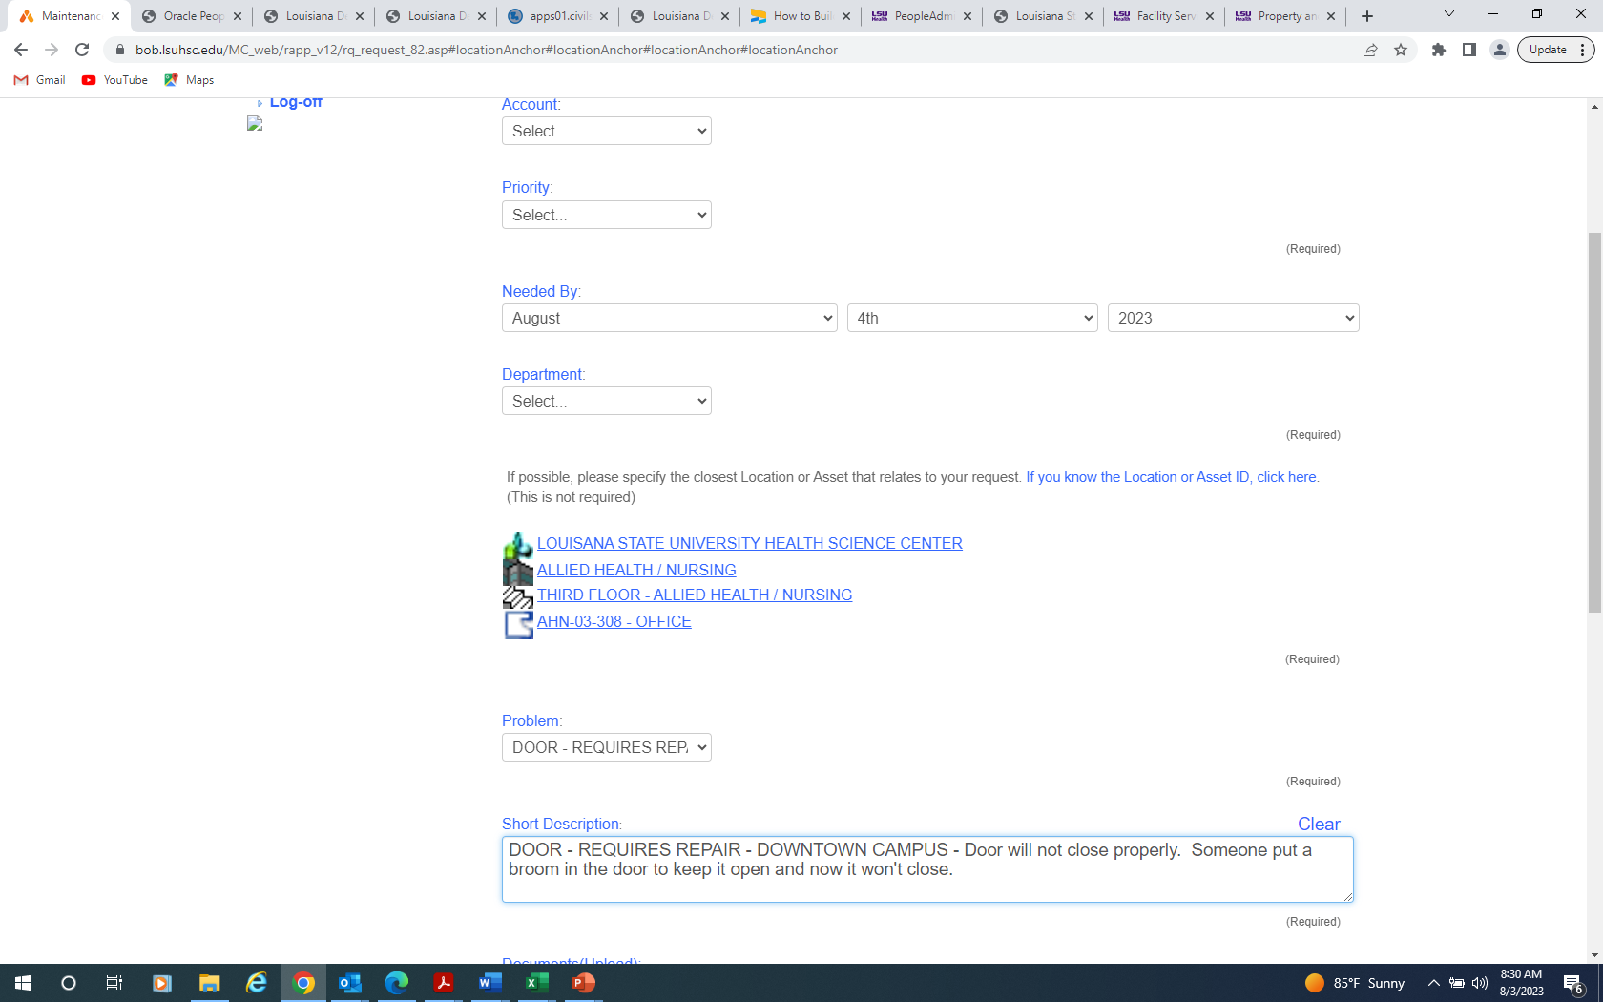
Facility Services
szimm1@lsuhsc.edu
(504) 655-7673
Submitting Work Requests

Slide 29
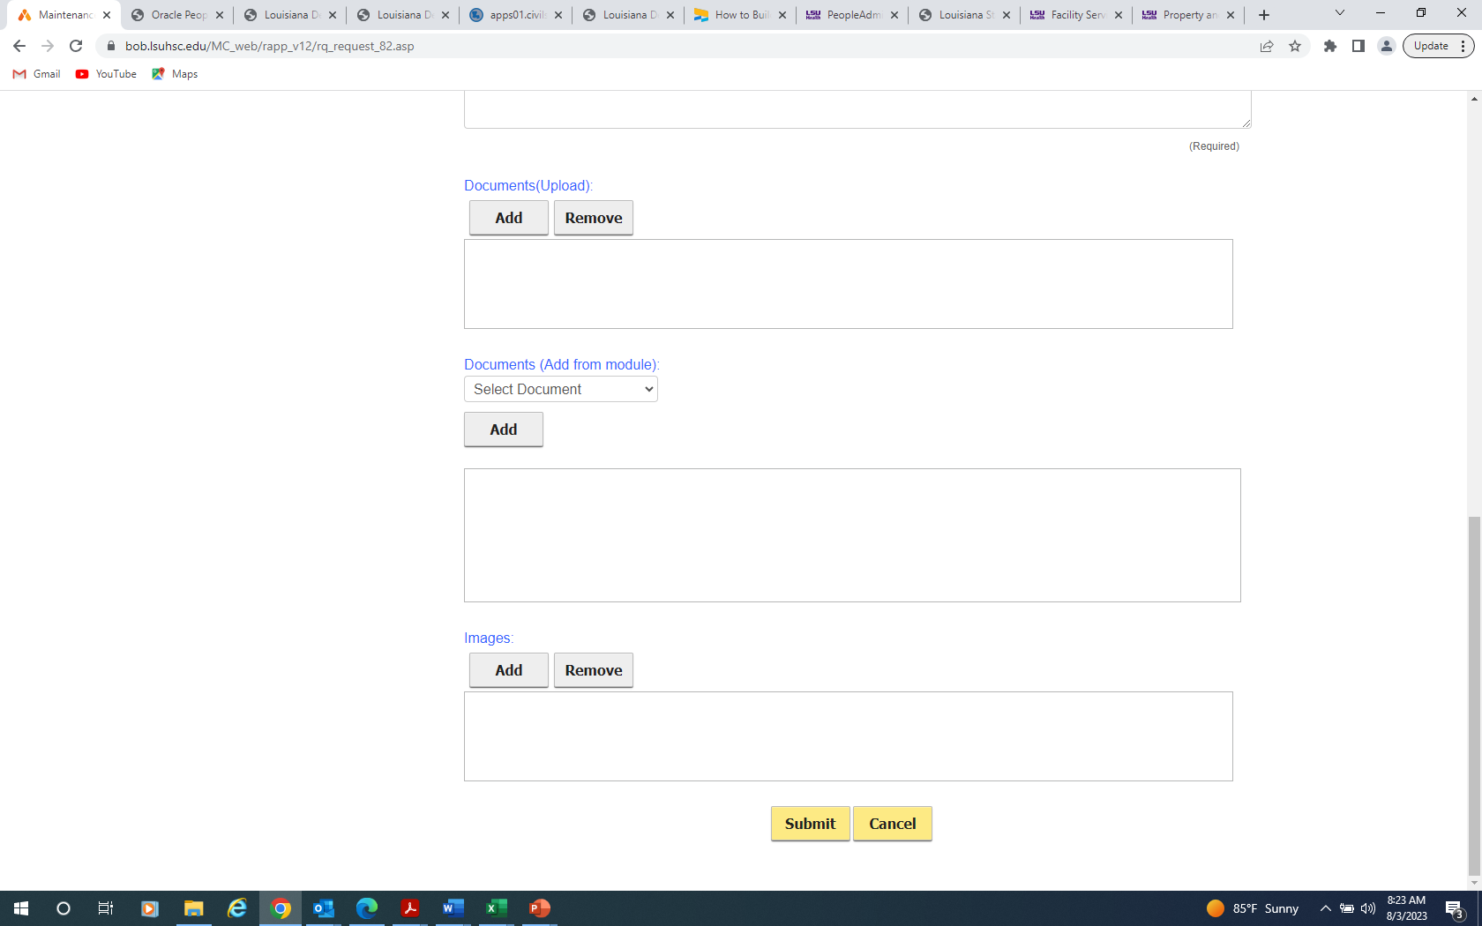
Facility Services
szimm1@lsuhsc.edu
(504) 655-7673
Submitting Work Requests

Slide 30
Facility Services szimm1@lsuhsc.edu
(504) 655-7673
Work Requests
Provide Facility Services the names of who you want to be able to put in work requests. Due by September 30.
Routine, scheduled, some urgent are to be put in by these individuals.
Emergency can be called in by anyone. Please submit a work request after.
Emergency is immediate safety issue that can cause injury or threat to life, immediate threat to causing major damage to facility, or major security issue.
Urgent is has potential to cause bodily harm, damage to the facility, problems in security, and temperature problems (Room temps is 72 F +- 2 degrees range).

Slide 31
Facility Services
szimm1@lsuhsc.edu
(504) 655-7673
Key Policy
Policy Updated: 15 December 2022. Located the Facilities website under Policies, Forms and Manuals
Authorization: Facilities Building Use Manual
PICK UP HOURS: Monday – Friday | 8:30 am – 11:45 am, 1:15 pm – 4:00 pm
LOCATION: MEB Room 2214
Changes/Highlights:
  Schools, departments, programs, etc. are to maintain a list of who is assigned keys.
  A key custodian and alternate key custodian must be assigned and the names provided to Facility Services – we will only accept key requests from these individuals.
  Key request for initial issue are routine priority.
  Key request for broken keys are urgent priority.
  Key request for lost keys are routine priority.
  Lock out should not be addressed to Facility Services. The key custodian, alternate key custodian, and others in the department are assigned keys.
  After hours, contact the police.
  Every room requires a service request. If a key opens multiple rooms, try to select the lowest number room it open.
  All keys must be returned when an individual is no longer authorized to have the keys.

Slide 32
Facility Services
szimm1@lsuhsc.edu
(504) 655-7673
Facilities Building Use Manual
Follows State of Louisiana guidelines as well as Fire Codes and University policy.
Highlights of Policy
  Do not place signs, scotch tape, or marks on interior or exterior walls, interior or exterior doors, etc. These items will be removed without notification. All signs, artwork, or similar items must be appropriate for a business setting and subject to approval from Property and Facilities.
  Do not prop open doors with anything other than a doorstop designed for that purpose (e.g., jamming broom handles in hinges). Doors designed to shut automatically are never to be propped open.
  Keep corridors, elevator lobbies, hallways, electrical closets, HVAC equipment rooms, and elevator equipment rooms clear of furniture, equipment, boxes, and storage of any type.
  Coordinate with Facilities when arranging furniture. (To avoid extension cords, telephone, cable, and damage to walls and floors.)
  Report deficiencies in construction or maintenance, or accidents caused by deficiencies to Facilities and the Safety Officer.
  Personal food storage or food prep items are to be stored in the kitchen refrigerators or cabinets, not on countertops, tables, on top of refrigerators, or in offices.

Slide 33
Facility Services
szimm1@lsuhsc.edu
(504) 655-7673
Facilities Building Use Manual
Highlights of Policy
  Coffee makers are to be unplugged when not in use.
  No tape etc. is to be applied to doors, wall surfaces, built-in millwork, free standing furniture, or system/modular furniture - resultant costs from damage shall be borne by the end user.
  No portable heaters are allowed in the building or any open flames (i.e., candles, incense burners, potpourri burners). All toasters, toaster ovens and any other small appliance which would be subject to activating smoke alarms and/or fire alarm systems are prohibited.
  No coffee makers, mini-refrigerators, microwaves, or other small appliances are allowed in private offices; these appliances are to be located in kitchens or break areas only.
  No pets or animals are allowed in buildings. (Exception: Service and support animals).
  Promptly notify Facilities of maintenance problems/needs by submitting a service request or calling 504- 568-7716.

Slide 34
Facility Services
szimm1@lsuhsc.edu
(504) 655-7673
Facilities Building Use Manual
Highlights of Policy
  Notices, Advertisements and Soliciting Solicitation is not permitted within the building, nor on its grounds and parking lots. Digital bulletin boards are provided in various places throughout the buildings for posting purposes. Notices and advertisement postings are limited to these bulletin boards and must be approved in advance. Any posting of items on doors, walls, hallways, windows in halls and common areas, or campus grounds is prohibited and such items will be removed without notice.

Slide 35
Facility Services
szimm1@lsuhsc.edu
(504) 655-7673
Facilities Building Use Manual
  Interior Plant Policy This policy has been set to protect the interior surfaces of state office buildings, protect the health of employees working in these facilities, insure the aesthetic quality of the building, and insures good pedestrian traffic flow through the offices.
    A single desktop plant may be brought to the office for the enhancement of the work place. Size limit: 6” pot
    No plants are to be placed on the floor or on overhead storage bins.
    All plants must be set in saucers that are large enough to catch run off from the plants when watered. Foil from florists and thin plastic liners on baskets are inadequate and will not function as a saucer.
    Ivies must be contained and not allowed to vine along shelves, windows, and other furniture.

Slide 36
Facility Services
szimm1@lsuhsc.edu
(504) 655-7673
Facilities Building Use Manual
Highlights of Policy
  Interior Decorations Policy This policy has been set to protect the interior surfaces of the office buildings, ensure the aesthetic quality of the building, and insures good pedestrian traffic flow through the offices. 6
    Interior Decorations are allowed from approximately November 20-January 10.
    Decorations should be limited to the interior of offices and cubicles; decorations should not interfere with other offices, nor should they block entrances/exits to rooms or buildings.
    Scotch tape may be utilized for interior office doors for decorations.
    All types of lighting will be limited to the interior offices
    No lighting or decorations are to be hung from ceiling light fixtures, ceiling tiles, ceiling grids or Fire Alarm devices located within the facility.
    Decorations are allowed on desktop and workspaces in offices and cubicles. Excessive knickknacks & collectibles in open cubicles are prohibited. Decorations are not allowed to be taped or glued to exterior doors, interior or exterior walls or other areas that may be damaged by tape or glue.
    Decorations are allowed in departmental entrance lobbies but should follow all above restrictions.
    Curtains/Blinds/Window tint are not allowed except those supplied by Facilities or specifically approved by Facilities.
    Decorations of walls must meet fire code requirements not exceeding the percentage of walls space for the area they are placed.
    Offices with glass walls to the hallways shall not place items on the ledges of the window system.

Slide 37
Facility Services
szimm1@lsuhsc.edu
(504) 655-7673
Facilities Building Use Manual
Highlights of Policy
    All events of any type (i.e. Food drives/collection, Fund raisers, book sales, plant sales, food/bake sales, etc.) must be requested in writing and in advance to Facilities after the applicable Dean’s office has approved the request. Only event requests that are non-profit will be considered. CM-1 provides detailed guidance about allowable events, sponsors, and approval processes.
    The request will need to include, but not limited to the following:
    • Description of the event being requested
    • Building area (inside or outside) that event will be held.
    • Building location (lobby, room, floor) that event will be held.
    • Contact Person and contact numbers (i.e. office, cell phone, fax, etc.)
    • Dates and Times of event
    • Anticipated number of people to attend
    An approved permit will be placed on the collection container with the name of the sponsoring organization.
    Items without the approved permit will be removed without notice.

Slide 38
Facility Services szimm1@lsuhsc.edu
(504) 655-7673
Signs:
We make all sorts of signs and we can purchase signs.
No cost to requester
Types of signs:
  Paper signs on stands for events
  A-frame signs
  Stickers
  Door numbering signs
  Make the name piece to go in the office signs
  Magnetic Signs
  If we can’t make it, we can purchase it
Our paper signs on stands are a standard format – Just provide the wording
If you want some signs made for an event and have artwork you want on them, send us the artwork. Prefer Illustrator. PDF doesn’t enlarge well, Bitmap bad.
Don’ts:
  Simple answer, you are not authorized to put out your own signs.

Slide 39
Facility Services szimm1@lsuhsc.edu
(504) 655-7673
Some Take Aways:
Work Orders: If you are wondering if you should put in a work request, the answer is yes. Be as descriptive and accurate as possible. Enter down to specific room. Think 10 workdays. Plan ahead, it is not an emergency or urgent because someone waited to put in the request. Provide names of individuals that can submit service requests.
Key Policy: Read it. Submit names of key custodians by end of Sept. After that, keys won’t be issue unless we have their name on our list. Maintain your own list of who is provided keys. Each room for a key request needs a service request. Someone in your department has a key to the room someone is locked out of. Please use it.
Building Use Policy: Read it and pass on to your departments. No hanging items on the walls or door in hallways. I am required to remove them and we can’t go hunting down the owners. Please pass it on. Plant policy. Decorations policy. Collections policy.
Signs – We make them. We are only ones authorized to put them out. They are free. Make sure you give us enough time to make or purchase them.

Slide 40
Questions?

Slide 41
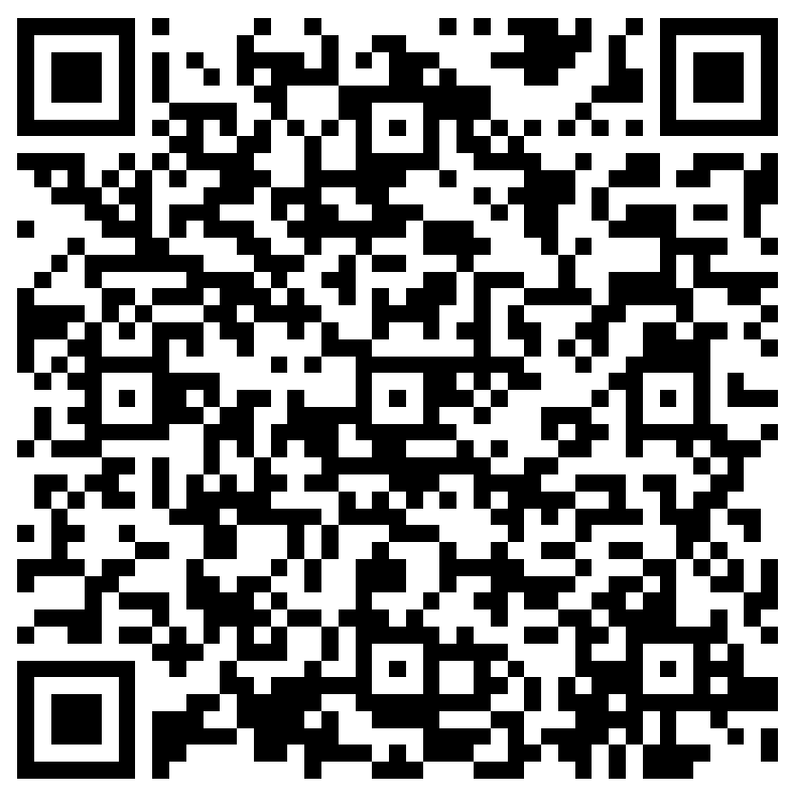
The next Hybrid Liaisons Meeting will be held on
Thursday, September 21, 2023 (10:00a-11:00a)
Please let us know if there is a topic that you would like to hear about!
MS Forms: LINK HERE

Slide 42
Human Resource Management Contacts
Chief Human Resources Officer | Jill Fragoso | #3-2634
Employee Relations
Employee Relations Manager | Leila McConnell | #3-4947
Employee Relations Consultant | Carla Popularas | #3-5798
Employee Relations Consultant | Mike Jarvis | #3-1680
Benefits
Associate Director, Human Resources | Aaron Miley | #3-2954
Benefits Manager | Beth Worthen | #3-8742
Benefits Generalist (Leave Administrator) | Mark Gele | #3-7812
Benefits Consultant | Laurie Kirzner | #3-8741
Benefits Consultant | Maddie Hopkins | #3-2455
Benefits Consultant | Terry Varnado | #3-2799
Benefits Coordinator | Krystal Citty | #3-7780
Human Resource Information Systems (HRIS), Talent and Organizational Development
Assistant Director, HRIS and Talent/Organizational Development | Jane Behlen | #3-1616
File Room Coordinator | Janet Magee | #3-8158
Administrative Coordinator 3 | Michael Mosley | #3-4834
Human Resources Specialist | Myra Christophe | #3-1781
Human Resource Analyst | Beverly White | #3-3916
Manager, Talent and Organizational Development | Braylin Artigues | #3-1609
HRM Talent Development Coordinator | Alexander-Quang Tran | #3-2214
Compensation and Talent Acquisition
Assistant Director, Compensation and Talent Acquisition | Sara Schexnayder | #3-4226
Talent Acquisition Manager | Shauna Caputo | #3-2047
Human Resources Specialist | Timethia Brown | #3-4835
Compensation Analyst | Kel Brownfield | #3-7378
HR Generalist | Cristina Guillory | #3-2044
HR Generalist | Alicia Rodriguez | #3-8740
HRM Talent Acquisition Coordinator | Tannia Jacob | #3-4832

