Slide 1
February 17, 2022
HRM Liaisons Meeting
February 2022 Meeting

Slide 2
HRM General Updates
Juli Sholar, HRM Assistant Director Talent Management

Slide 3

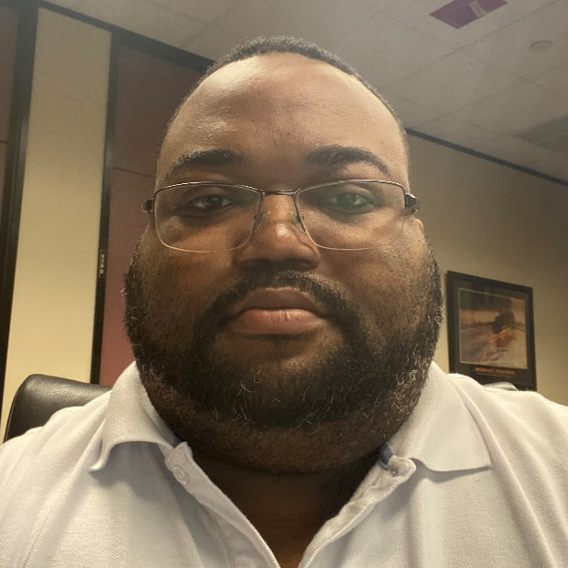
HRM General Updates
nohrm@lsuhsc.edu
HRM General Updates
Employee Relations Email / Distribution List
  HRM Employee Relations
  nohrmlabrel@lsuhsc.edu
HRM Staff Update
  HRM Benefits Analyst –
  Keljuane Brownfield

Slide 4
HRM Compensation
Sara Schexnayder, HRM Compensation Manager

Slide 5
HRM Compensation
HRMCompensation@lsuhsc.edu
Equity/Salary Review Update
Salary Structure
Salary structure will be updated, effective February 1
Employees below the new minimum will be brought to the new minimum when the structure changes.
  No other salary adjustments at this time
We will start using the new ranges in job postings and salary offers
Survey
94% Participation rate on survey
Analysis
Developed methodology to evaluate where adjustments are needed
We will share our recommendations by employee with the school financial leads and Deans
Financial leads will review the employees survey responses as well as our recommended ranges and make any adjustments needed.
Targeting equity increases for July 1.

Slide 6
HRM Benefits
Kacy Smith, HRM Benefits & Retirement Manager

Slide 7

HRM Benefits
NOHRMBenefits@lsuhsc.edu
Form 1095-C
∙ Will be made available through Self-Service and mailed out by the IRS
deadline of March 2nd
∙ ALL employees can view their 1095-C in Self-Service
∙ Employees who elected to only receive a digital Form 1095-C will not receive
a paper copy in the mail

Slide 8
HRM Talent Acquisition
Shauna Caputo, Senior Talent Acquisition Consultant

Slide 9
HRM Talent Acquisition recruittalent@lsuhsc.edu
PeopleSoft Electronic Separations - Helpful Hints
Reason Codes
When to use Term and Rehire
Eligible for Rehire
Supporting Documents
Saved Action

Slide 10
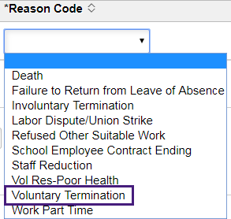
HRM Talent Acquisition recruittalent@lsuhsc.edu
Reason Codes
Most Common:
Voluntary Termination
Involuntary Termination – use in case of issuance of non-renewal notice
  *If involuntary termination, please work with Employee Relations team to determine that distinction prior to selection
School Employee Contract Ending – use in case of End of appointment/student graduating

Slide 11
HRM Talent Acquisition recruittalent@lsuhsc.edu
When to use Term and Rehire - if an employee is moving from the
following positions to the other within LSUHSC with no break in service.
If an employee is moving from Faculty, Unclassified or Other Academic appointment into another Faculty, Unclassified or Other Academic appointment a termination is not required, instead a Hiring Proposal/PER-3 is required.
Input notes in the Reason/Justification box to advise which new position the employee is moving to and confirm “no break in service.”
  From: Student Worker, Graduate Assistant, Fellow, Intern, or House Officer
  To: Faculty, Unclassified or Other Academic appointment
  OR
  From: Faculty, Unclassified or Other Academic appointment
  To: Student Worker, Graduate Assistant, Fellow, Intern, House Officer or Gratis

Slide 12
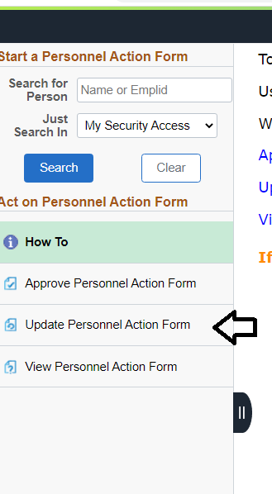
HRM Talent Acquisition recruittalent@lsuhsc.edu
Eligible for Rehire -
*not to be confused with Term and Rehire field
Supporting Documents
Not required for Fellows, Interns, Student Workers, Graduate Assistants, and House Officers - provide justification in the Reason/Justification box
No input in Reason/Justification box is needed if supporting document is uploaded for positions that do require supporting document
Saved Action
If you have saved a separation prior to submitting,
select Update Personnel Action Form to recall and
complete submission or withdraw if you would like to cancel

Slide 13
HRM Talent Development
Matt Copeland, HRM Talent Development Manager

Slide 14
HRM Talent Development
TalentDevelopment@lsuhsc.edu
2022 Unclassified Performance Evaluations
Updates in progress for Unclassified Employee Performance Evaluation Process
Includes revision of the form, reporting tool, and evaluative competencies.
Incorporates Perf Eval processes in place from LSUHSC, LSU Baton Rouge, and comparable institutions.
Completed in PDF Form, unrelated to PeopleAdmin site.
  Manager completes electronic form.
  Discuss with Employee
    Shares with employee (print or electronic)
  Form signed (mgr / employee)
  Submit to HRM.
Evaluating performance for period 07/01/2021 – 03/31/2022
Committee in place representative of roles and interests across LSUHSC and HRM
Questions and Feedback to HRM Talent Development
Notes:
HRM is supporting interests of Dr. Nelson through the update and streamline of the Performance Evaluation process.

Slide 15
HRM Talent Development
TalentDevelopment@lsuhsc.edu
2022 Unclassified Performance Evaluations
KEY EVENT TIMELINE:
3/1 – 4/8 | Training Workshop Series / Information Resources
3/28 – 4/22 | Managers complete evaluation forms. -Includes Dept/School Alignment Conversations (group review) -Self-evaluations are optional but encouraged.
4/22 – 5/15 | Performance Success Conversations held
5/20 | Submit Signed forms to HRM via MS Teams Forms by 5/20 -Submission form requires upload of signed & scanned PDF eval form. -Submission form requires entry of employee name, EMPLID, dept, and overall rating. -Additional files may be uploaded as well (self-eval, contestations, appended performance comments/details.
Notes:
HRM is supporting interests of Dr. Nelson through the update and streamline of the Performance Evaluation process.

Slide 16
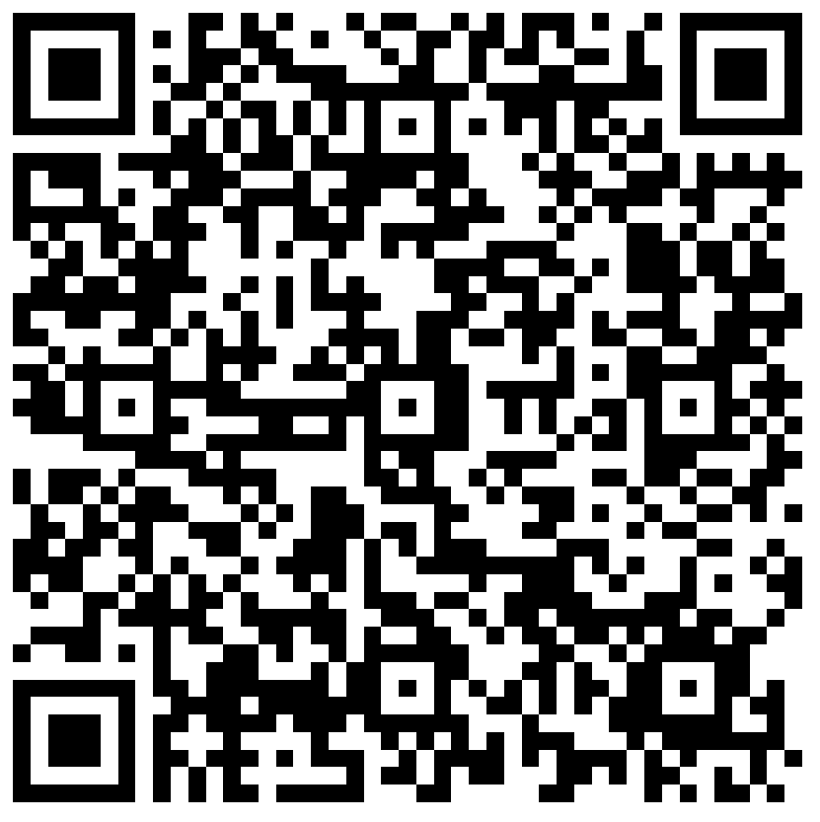
HRM Liaison Questionnaire
2022 Unclassified Performance Evaluation Process Update

Slide 17
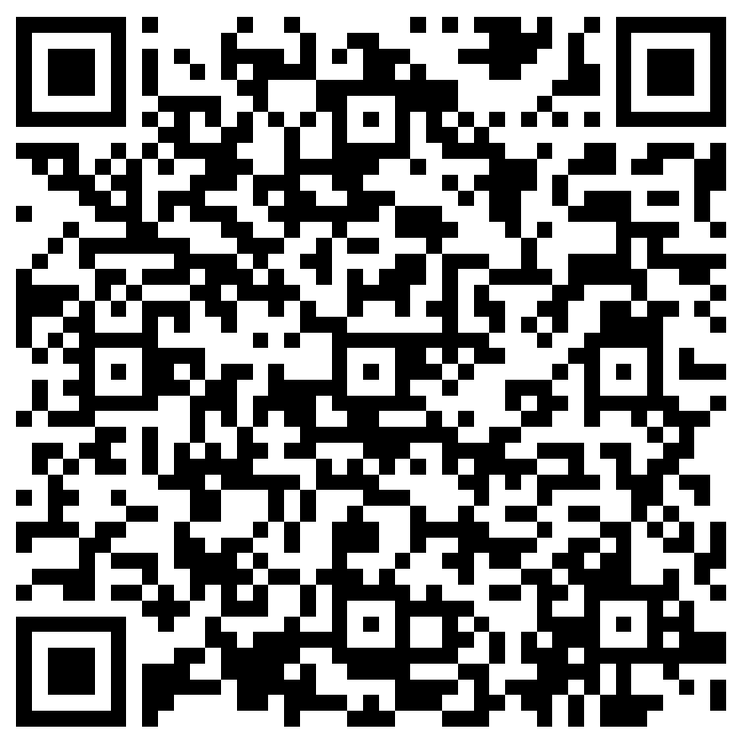
The next Zoom Liaisons Meeting will be held on
Thursday, March 17, 2022 (1000a-1100a)
Please let us know if there is a topic that you would like to hear about!
MS Forms: LINK HERE

Slide 18
HRM Department Contacts
Human Resource Management
Employee Relations
Employee Relations Consultant | ---- | #3-4947
Compensation & Benefits
Compensation Manager | Sara Schexnayder | #3-4226
Benefits & Retirement Manager | Kacy Smith | #3-8740
Benefits Consultant | Laurie Kirzner | #3-8741
Benefits Generalist (Leave Administrator) | Mark Gele | #3-7812
Benefits Specialist | Chakia Hebron | #3-2455
Compensation & Compliance Analyst | Maddie Hopkins | #3-7378
Benefits Analyst | Kel Brownfield | #3-7780
Human Resource Information Systems (HRIS)
Assistant Director, HRIS | Michelle Sharp | #3-2029
HRIS Manager | Jane Behlen | #3-1616
File Room Coordinator | Janet Magee | #3-8158
HRIS Administrative Coordinator | Dee Bonvillian | #3-4834
Talent Management
Assistant Director, Talent Management | Juli Sholar | #3-2954
Sr. Talent Acquisition Consultant | Shauna Caputo | #3-2047
HR Analyst | Timethia Brown | #3-4835
HR Analyst | Briana Williams | #3-4832
Talent Development Manager | Matt Copeland | #3-1609

Slide 19
Questions?

