Slide 1
HRM Liaisons Meeting
July 2023 Meeting

Slide 2
Human Resources Management
nohrm@lsuhsc.edu
HRM Leadership News!
Aaron Miley
Associate Director
amile1@lsuhsc.edu
If you would like to have an introductory chat with Aaron, please reach out.

Slide 3
HRM Compensation
Sara Schexnayder, Assistant Director, Compensation and Talent Acquisition

Slide 4
Compensation nohrmcompensation@lsuhsc.edu
Weather or Emergency Closure Policy
The Chancellor or his designee may declare an emergency closure when there is a threat, danger, or hardship to the institution or employees.
Upon declaration of emergency closure, the Chancellor declares Special Leave for normal working hours, paid at straight time for classified and unclassified employees.
In the event of an emergency closure, only designated essential employees should be on campus.

Slide 5
Compensation nohrmcompensation@lsuhsc.edu
Pay During Weather or Emergency Closures
Essential, non-exempt and classified exempt employees
Time and a half for hours worked in addition to special leave pay
Pay for all hours required to remain on campus except after 24 hours, bona fide sleeping periods of 5-8 hours per day are deducted
Unclassified and Faculty Exempt personnel
By Louisiana statute are not eligible for overtime
Continuous Operations Personnel are required to work on designated tasks but will not be eligible for overtime for working their normal work schedule.

Slide 6
HRM Talent Acquisition
Shauna Caputo, Talent Acquisition Manager

Slide 7
HRM Talent Acquisition
recruittalent@lsuhsc.edu
People Admin Enhancements
Three People Admin enhancements go into effect Monday, August 7, 2023
1) Removal of “Department Head” role in all People Admin Process flows
2) Upon UNCLASSIFIED position approval, TA/OPS will initiate posting on behalf of department and publish to LSUHSC, Career opportunities page
  Posting details will be included in position request process in position management Please be ready to include posting details at time of position request initiation
  There will be a grace period from 8/7/2023-8/20/2023 for position requests currently “in process” to follow current process
  As of 8/21/2023 Initiator and Department Approver roles will no longer have access to create a posting
  Departments will remain responsible for placement of external ads

Slide 8
HRM Talent Acquisition
recruittalent@lsuhsc.edu
People Admin Enhancements
3) Hiring proposals will be routed for Administrative approvals (VCAA/VCAF) earlier in approval flow process - directly after department updates to “offer accepted”
  Allows TA/OPS to enter new hire packet upon receipt in HRM as soon as packet is confirmed complete
  Final offer letter will need to be uploaded in People Admin by department PRIOR to updating to “offer accepted” for VCAA/VCAF review
  Hiring proposal documents will include draft and final offer letter fields to assist schools/departments that may use review of a draft letter as part of their internal review process
Resource guides and updated process flows will be provided to all initiators and department approvers prior to August 7th go-Live date and included on HR website
Go-Live Reminder will be added on People Admin home page effective August 7^{th,} 2023

Slide 9
HRM Talent Acquisition
recruittalent@lsuhsc.edu
Process Updates Effective Friday, September 1, 2023
Unclassified start dates will be available twice monthly
  calendar provided in attachment and will be uploaded on HR webpage
  Packet must be received in HRM 5 business days prior to next upcoming start date to be entered in People Soft (HRM will advise confirmation of receipt and start date)
  Drug test and criminal background check can be initiated at same time to streamline required pre-employment clearances and assist department’s ability to communicate accurate start date with new employee
2) All employees, including gratis, are required to have a cleared criminal background check prior to start
3) All I-9 documents will be completed electronically in Hire Right, including gratis employees
Please ensure you share liaison meeting updates and information with team members & direct reports, so they are aware of updated processes and information shared

Slide 10
HRM Talent Acquisition
recruittalent@lsuhsc.edu
Unclassified Bi-Monthly Start Dates for 2023
Effective 9/1/2023
September 2023 | Note: 9/4/2023 Labor Day Holiday
Friday, 9/1/2023 | New Hire packet due in HR 8/25/2023
Monday, 9/18/2023 | New Hire packet due in HR 9/11/2023
October 2023
Sunday, 10/1/2023 | New Hire packet due in HR 9/25/2023
Monday, 10/16/23 | New Hire packet due in HR 10/9/2023
November 2023 | Note: 11/23-11/24 Thanksgiving Holiday
Wednesday, 11/1/2023 | New Hire packet due in HR 10/25/2023
Monday, 11/13/2023 | New Hire packet due in HR 11/6/2023
December 2023 | Note: 12/22/2023 -1/1/2024 –Holiday break
Friday, 12/1/2023 | New Hire packet due in HR 11/22/2023
Monday, 12/11/2023 | New Hire packet due in HR 12/4/2023

Slide 11
Talent Development
Alexander-Quang Tran, Talent Development Coordinator

Slide 12
HRM Talent Development
TalentDevelopment@lsuhsc.edu
Performance Evaluation System (PES) Reminder | Deadlines
2022 – 2023 Evaluation Deadline: August 11, 2023
2023 – 2024 Planning Deadline: September 8, 2023

Slide 13
HRM Talent Development
TalentDevelopment@lsuhsc.edu
Performance Evaluation System (PES) Outstanding Actions
All classified employees who are eligible for the PES, are required to have a plan and evaluation on file. We have identified employees who require an evaluation for the 2022 – 2023 PES evaluation period but do not have a plan on file.
Please inform your staff that Talent Development will be reaching out to the supervisors and second-level evaluators of employees with outstanding plans.

Slide 14
Questions?

Slide 15
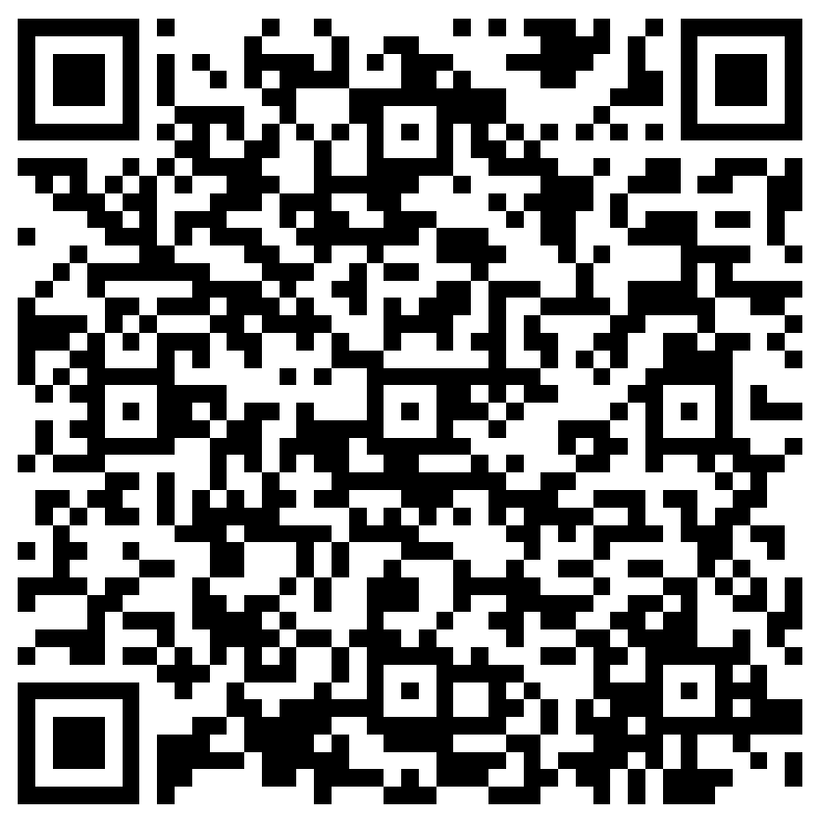
The next Zoom Liaisons Meeting will be held on
Thursday, August 17, 2023 (10:00a-11:00a)
Please let us know if there is a topic that you would like to hear about!
MS Forms: LINK HERE

Slide 16
Human Resource Management Contacts
Chief Human Resources Officer | Jill Fragoso | #3-2634
Employee Relations
Employee Relations Manager | Leila McConnell | #3-4947
Employee Relations Consultant | Carla Popularas | #3-5798
Employee Relations Consultant | Mike Jarvis | #3-1680
Benefits
Associate Director, Human Resources | Aaron Miley | #3-2954
Benefits Manager | Beth Worthen | #3-8742
Benefits Generalist (Leave Administrator) | Mark Gele | #3-7812
Benefits Consultant | Laurie Kirzner | #3-8741
Benefits Consultant | Maddie Hopkins | #3-2455
Benefits Consultant | Terry Varnado | #3-2799
Benefits Coordinator | Krystal Citty | #3-7780
Human Resource Information Systems (HRIS)
Assistant Director, HRIS and Talent/Organizational Development | Jane Behlen | #3-1616
File Room Coordinator | Janet Magee | #3-8158
Administrative Coordinator 3 | Michael Mosley | #3-4834
Human Resources Specialist | Myra Christophe | #3-1781
Compensation
Assistant Director, Compensation and Talent Acquisition | Sara Schexnayder | #3-4226
Compensation Analyst | Kel Brownfield | #3-7378
Talent Management
Talent Acquisition Manager | Shauna Caputo | #3-2047
Human Resources Specialist | Timethia Brown | #3-4835
HR Generalist | Cristina Guillory | #3-2044
HR Generalist | Alicia Rodriguez | #3-8740
HRM Talent Acquisition Coordinator | Tannia Jacob | #3-4832
HRM Talent Development Coordinator | Alexander-Quang Tran | #3-2214

