Slide 1
HRM Liaisons Meeting
June 2023 Meeting

Slide 2
VCAA - LAHEFSA
Remy Allen, Director of International Services
Leigh Smith-Vaniz, Director of Student Services & Title IX Coordinator
Notes:
Kacy is the Benefits Manager but Michelle will be presenting on her behalf.

Slide 3
VCAA-LAHEFSA
LAHEFSA@lsuhsc.edu
Louisiana Higher Education Foreign Security Act 2023
Effective July 1, 2023 (Act 106)
Requires Reporting of Gifts ≥$50,000 from Foreign Adversary Countries.
  Includes all gifts that together would be ≥$50,000 in one calendar year.
  Includes any reimbursement for travel expenses from a foreign adversary country, or an affiliated entity if the total annual amount ≥$50,000.
Screening of All Research and Research Support Positions BEFORE a Letter of Offer is issued for any professional affiliations, training, or previous employment in a Foreign Adversary Country.
  All preferred applicants would have to be screened (regardless of citizenship status or country of origin).
  Includes faculty, staff, postdocs, and graduate assistants.
Requires Reporting of International Travel to (or through) Foreign Adversary Countries.
  Requires preapproval and screening for any employment-related travel to and activities related to foreign adversary countries.
  Also requires follow up reporting from the traveler after their return.
Current Foreign Adversary Countries include: China, Iran, North Korea, Russia, Venezuela and Cuba. This list is subject to change. The current list is found here.

Slide 4
HRM Benefits
Beth Worthen, Benefits & Retirement Manager

Slide 5

HRM Benefits
nohrmbenefits@lsuhsc.edu

Slide 6
HRM Benefits
nohrmbenefits@lsuhsc.edu
2024 LSU First Wellness Credit
To qualify or to continue the $25/month premium wellness credit ($35/month for those with a covered spouse) for the 2024 plan year, the following requirements must be met:
  Continue to be enrolled in LSU First for the 2023 and 2024 plan years.
  Employee and covered spouse (if applicable) must have a preventive visit with a Primary Care Physician (PCP) that includes biometric screening (height, weight, BMI, & blood pressure) and preventive lab work that includes a basic metabolic panel between November 1, 2022 - October 31, 2023.
  Active participation in care coordination, if identified as a candidate by HighCare, is required to maintain the wellness credit. Plan members will be contacted directly by the care coordination team through HighCare.
Both the employee and spouse must meet the requirements to qualify for the credit. If either the employee or covered spouse fails to meet the requirements to qualify for the wellness credit, no premium credit will be awarded.

Slide 7
HRM Benefits
nohrmbenefits@lsuhsc.edu
A Few Reminders
Retirees should not be processed as a termination through PeopleSoft.
  Employees should direct a copy their notice of retirement to nohrmbenefits@lsuhsc.edu.
  The HRM Benefits Office will update employee’s status in Job Data to Retiree and complete the PER3.
  An email notification will be sent to the supervisor and LSUHSC-NO Notification of Employee Separation.
  Terminating retiring employees could impact leave payouts and/or continuation of benefits into retirement.

Slide 8
HRM Benefits
nohrmbenefits@lsuhsc.edu
A Few Reminders
Employees should submit any medical information, fitness for duty notices, and/or doctor’s notes for excused absences to HRMFMLA@lsuhsc.edu.
The HRM FMLA Office will notify the supervisor to receipt.
Contact HRMFMLA@lsuhsc.edu with any questions.

Slide 9
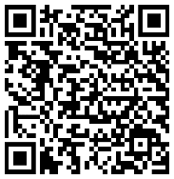
HRM Benefits
nohrmbenefits@lsuhsc.edu
403(b) Supplemental Retirement
Take action to achieve a more comfortable retirement
Learn more by attending a free educational workshop conducted by a knowledgeable professional on financial topics that matter to you.
WEBINAR TOPIC: Enroll. Take Control of Your Future Today.
DATE: Thursday, June 21, 2023
TIME: 10:00 AM to 11:00 AM Central
LOCATION: Virtual presentation
Register Today!
To register, use this code: 7047PWA11AC
*You will receive a separate email with a webinar link to access the workshop upon registration.*

Slide 10
HR Information Systems
Jane Behlen, Assistant Director, HRIS and Talent/Organizational Development

Slide 11
Human Resource Information Systems
HRIS@lsuhsc.edu
ID Badges
The Office of Human Resource Management will be unable to issue badges in Suite 603 on Monday, June 26th and Tuesday, June 27th, due to Resident Orientation.
If you have a badging concern, please email HRMidbadge@lsuhsc.edu to discuss additional options.

Slide 12
HRM Talent Acquisition
Shauna Caputo, Talent Acquisition Manager

Slide 13
HRM Talent Acquisition
recruittalent@lsuhsc.edu
Upcoming Process Updates Effective September 1, 2023
Unclassified start dates will be available twice monthly
  calendar will be provided shortly
  improve onboarding process and timely data entry
Please ensure you are sharing liaison meeting updates and information with your team members/direct reports after these meetings, so they are aware of current processes and information shared

Slide 14
Talent Development
Dr. Tranell E. Barton, Talent Development Consultant/Trainer

Slide 15
HRM Talent Development
TalentDevelopment@lsuhsc.edu
New Employee Orientation | Date Changes
New Employee Orientation (NEO) dates will be pushed back one week to better coincide with payroll periods and newly proposed twice monthly unclassified start dates.
Updated NEO dates are effective July 11, 2023.
Please find the new dates on our Orientation and Onboarding page.

Slide 16
HRM Talent Development
TalentDevelopment@lsuhsc.edu
Performance Evaluation System: PES
What is the Performance evaluation process?
(PES) is our Classified employees’ annual planning and evaluation processes.
Planning takes place at the start of the review period, and it is where the supervisor outlines the employee’s work and behavior expectations.
Evaluation takes place at the end of the review period. This is where the supervisor documents formal feedback and determines the performance rating. Performance is measured against the plan that was created at the beginning of the review period.
When is the Review Period?
The review period begins July 1 and ends June 30 each year.

Slide 17
HRM Talent Development
TalentDevelopment@lsuhsc.edu
Performance Evaluation System: PES
Where is the PES planning and evaluation completed?
The PES is completed in People Admin’s performance management module.
When will the cycle open to begin evaluations and planning?
The evaluations and planning will be available beginning July 1, 2023.

Slide 18
HRM Talent Development
TalentDevelopment@lsuhsc.edu
Performance Evaluation System: PES
Important reminders:
Newly appointed supervisors of classified staff are required to complete PES Training prior to conducting PES Evaluations and Plannings.
If an employee needs to complete this training, please reach out to Talent Development at TalentDevelopment@lsuhsc.edu for more information.
State Civil Service has been working towards making process updates to the PES. These updates included a revised scoring process and changes to the review period. They have announced that the transition has been delayed. This means that we will not be making any changes this year to the PES process or review period.
The Talent Development team will provide several training opportunities for supervisors in the coming weeks, and communication will be forthcoming.

Slide 19
Questions?

Slide 20
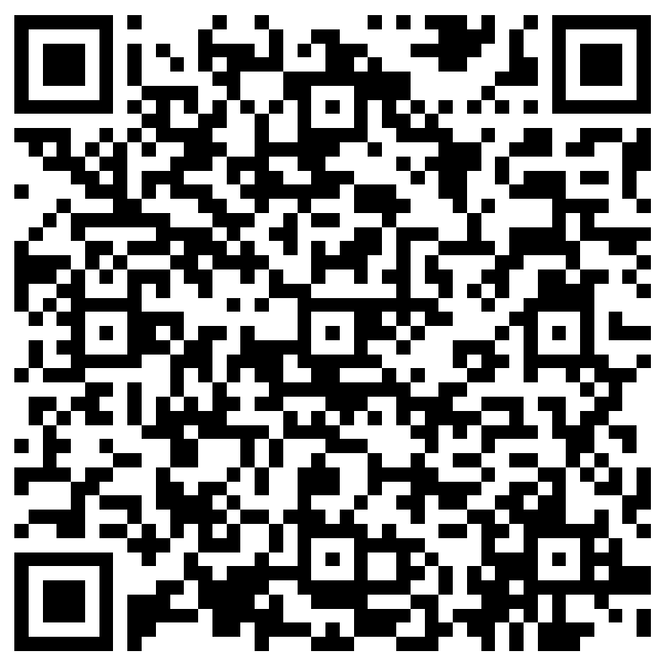
The next Zoom Liaisons Meeting will be held on
Thursday, July 20, 2023 (10:00a-11:00a)
Please let us know if there is a topic that you would like to hear about!
MS Forms: LINK HERE

Slide 21
Human Resource Management Contacts
Chief Human Resources Officer | Jill Fragoso | #3-2634
Employee Relations
Employee Relations Manager | Leila McConnell | #3-4947
Employee Relations Consultant | Carla Popularas | #3-5798
Employee Relations Consultant | Mike Jarvis | #3-1680
Compensation & Benefits
Assistant Director, Compensation and Talent Acquisition | Sara Schexnayder | #3-4226
Benefits Manager | Beth Worthen | #3-8742
Benefits Generalist (Leave Administrator) | Mark Gele | #3-7812
Benefits Consultant | Laurie Kirzner | #3-8741
Benefits Consultant | Maddie Hopkins | #3-2455
Benefits Consultant | Terry Varnado | #3-2799
Benefits Coordinator | Krystal Citty | #3-7780
Compensation Analyst | Kel Brownfield | #3-7378
Human Resource Information Systems (HRIS)
Assistant Director, HRIS and Talent/Organizational Development | Jane Behlen | #3-1616
File Room Coordinator | Janet Magee | #3-8158
Administrative Coordinator 3 | Michael Mosley | #3-4834
Human Resources Specialist | Myra Christophe | #3-1781
Talent Management
Talent Acquisition Manager | Shauna Caputo | #3-2047
Human Resources Specialist | Timethia Brown | #3-4835
HR Generalist | Cristina Guillory | #3-2044
HR Generalist | Alicia Rodriguez | #3-8740
HRM Talent Acquisition Coordinator | Tannia Jacob | #3-4832
Learning & Development Trainer | Tranell Barton | #3-8640
HRM Talent Development Coordinator | Alexander-Quang Tran | #3-2214

