Slide 1
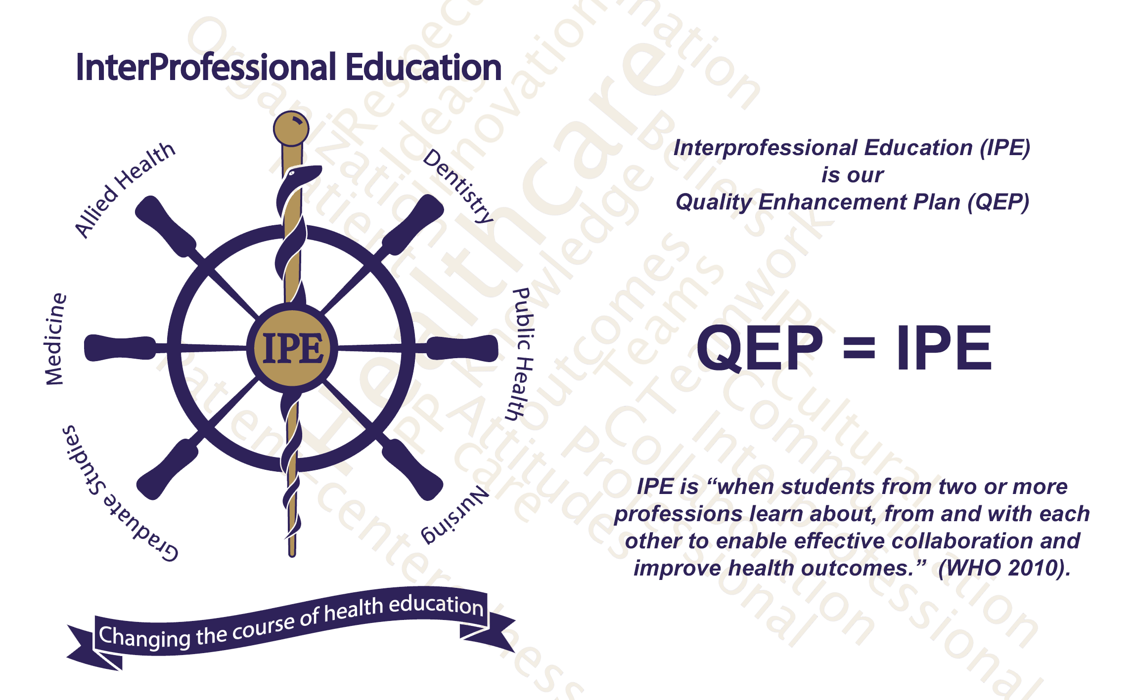

Slide 2

What is SACS-COC?
Southern Association of Colleges and Schools – Commission on Colleges
Regional body for accreditation of degree-granting, higher education institutions in the 11 Southern states.
LSUHSC New Orleans SACS-COC Accreditation Reaffirmation on-site visit is March 24-26th, 2015.

Slide 3
What is a QEP?
QEP stands for Quality Enhancement Plan.
It is a campus-wide course of action related to enhancing education and student learning.
It is a component requirement of the accreditation reaffirmation process.
It is a longitudinal plan that is tied to the institution’s mission.

Slide 4
Why IPE?
It is the logical progression of simulation-based learning, our previous QEP
Interprofessional collaborative practice is a national focus.
Faculty/student involvement already exists.
Current interprofessional education opportunities at LSUHSC New Orleans include:
  IPE elective (INTER281)
  Simulation training and case-based learning opportunities.

Slide 5
3 Major Goals for the QEP
An empowered centralized office for IPE
Facilitated faculty participation in IPE
Increased meaningful IPE opportunities
  Learner-centeredness
  Patient care teams

Slide 6
Infrastructure – 4 Initiatives
Centralized office (The Center for Interprofessional Education and Collaborative Practice – CIECP) – Director, Coordinator
Streamlined IPE registration process
Coordination between curriculum committees for new IPE development
Formal support for Interprofessional Student Alliance (IPSA)

Slide 7
Faculty Development – 3 Initiatives
Faculty liaisons from each school to facilitate coordination and new development of IPE
Toolkit of faculty development materials
Incentivization of faculty involvement

Slide 8
IPE Experiences – 5 Initiatives
Development of existing IPE activities
New foundational IPE courses
Set of case-based IPE electives
Formal relationships with clinical sites for further incorporation of IPE
Learner-centered portfolio for IPE

Slide 9
How Can You Help?
Familiarize yourself with the QEP.
Consider potential opportunities for interprofessional learner experiences.
Volunteer to help LSUHSC-NO accomplish this very important plan.

